Slide 1
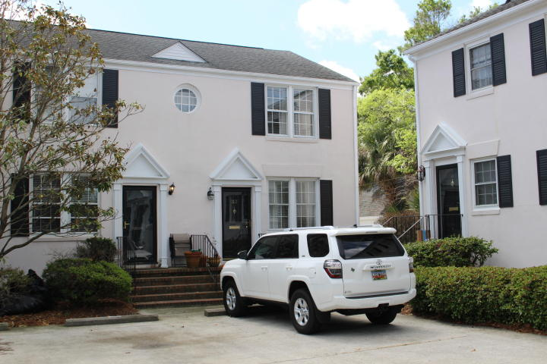
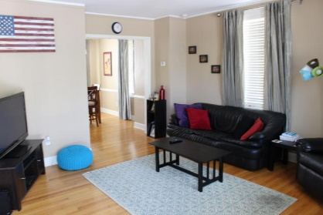
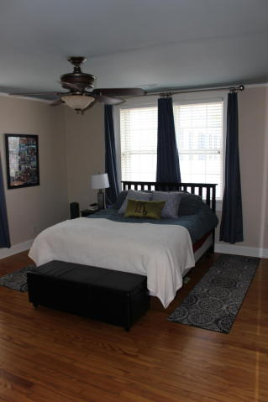
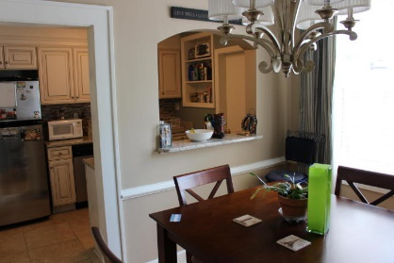
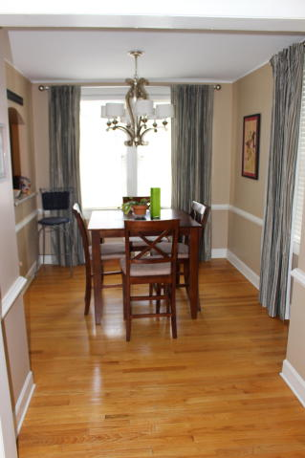
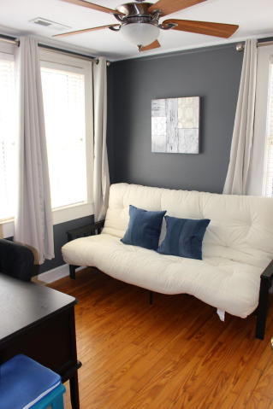
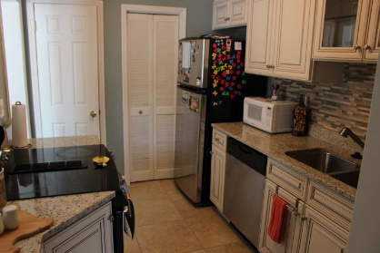
South of Broad with 2 assigned parking spaces
33 Ashley Avenue
South of Broad ~ Charleston, SC 29401
$575,000 ~ MLS# 17009044
2 Bed | 1½ Bath | 1,334 sf
Within walking distance to all the City has to offer, the Medical University and the College of Charleston. This lovely, updated, 2 bedroom townhouse is located across Broad Street from Colonial Lake. Hardwood floors throughout with ceramic tile in the kitchen, bathrooms and laundry room. The first floor contains a living room, dining room, powder room, kitchen and laundry room. The second floor contains two bedrooms and a full bathroom. There is a drop stair attic with ample storage space available.
Thomas Hartnett, Jr
Hartnett Realty Co., Inc.
1156 Bowman Road, Suite 200, Mt. Pleasant, SC 29464
tom@hartnettrealty.com
(843) 723-7222 Office | (843) 270-2915 Mobile

