Slide 1


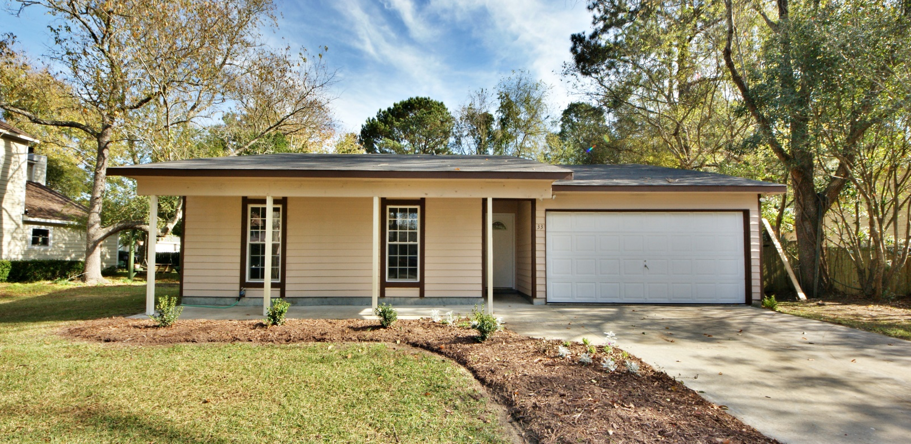
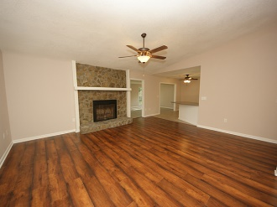
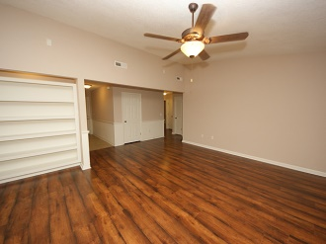
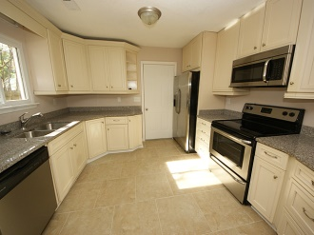
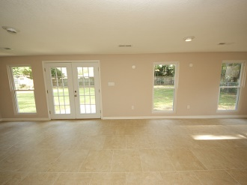
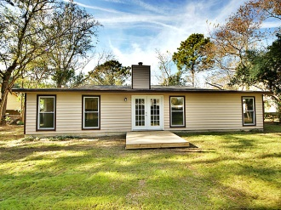
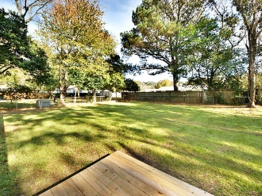
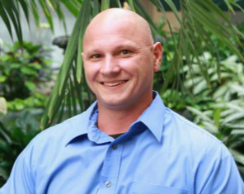


OPEN HOUSE!!
Sunday, December 7, from 1-4p
$100 gift card drawing
REDUCED TO $264,400!!
REDUCED TO $264,400!!
33 Held Circle, James Island - MLS# 1425161
RECENTLY RENOVATED!!!
3 bedroom 2 bathrooms, 1,852 SF
NEW: ROOF, FLOORS, COUNTERTOPS, BATHROOMS WINDOWS, DOORS, AND MORE!!!!
** 3.5% Commission! **
Justin Werner
Office: 843-793-1821
Cell: 859-913-4517
Justinwerner1975@gmail.com

