Slide 1
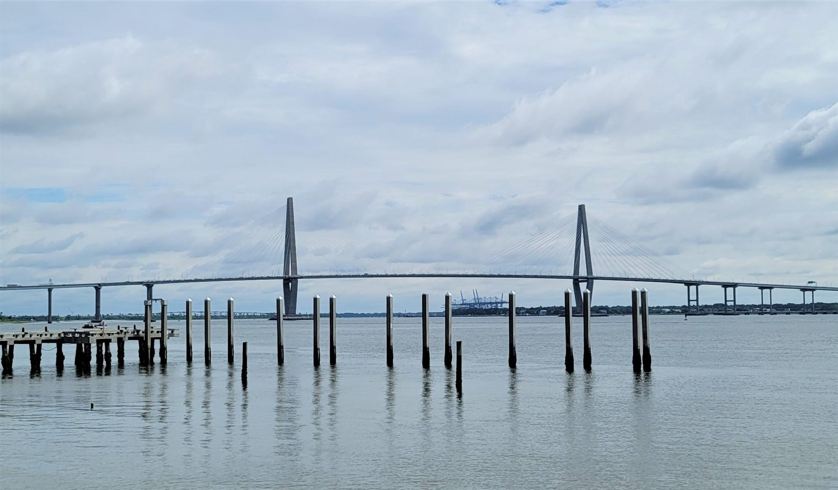
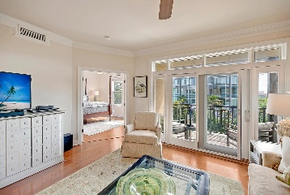
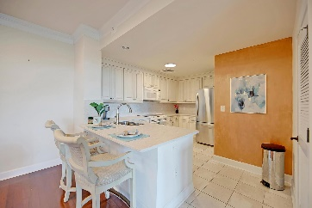
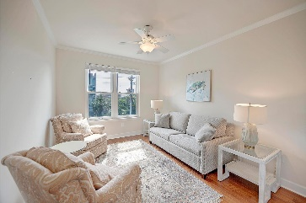
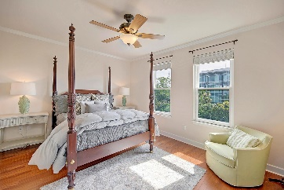
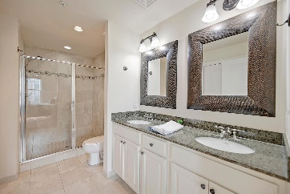
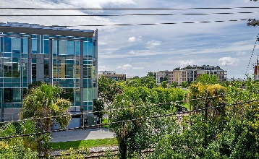
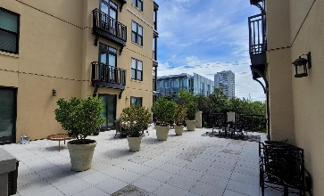
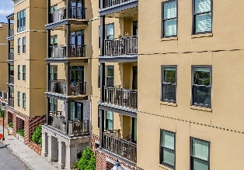
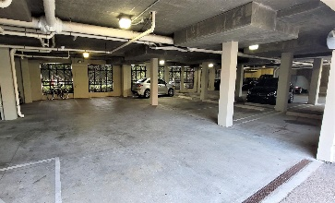
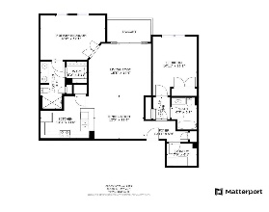



Broker's Open House Downtown Thursday 10am-11am
33 Calhoun Street 122
Gadsdenboro | Charleston, SC 29401 | MLS# 21020248 | $725,000
Executive luxury condo in the heart of downtown. This beautiful two bedroom two bathroom condominium is ideally located within one block from the Charleston harbor, the Aquarium, Liberty Square, The Gaillard Auditorium and multiple dining options. You will be a short stroll away from the Farmer's Market at Marion Square, enjoying a day of shopping on King Street or stepping back in time as you wander through the historic district, including The College of Charleston campus. This home offers a private ground floor parking garage with secure elevator access directly to your floor. A gated entryway is being added to the building soon. Unit 122 sits two levels above the parking garage and has wonderful park and rooftop views. Recently updated with new kitchen counters, a matching backsplash, sink and expanded counter seating. Hardwood floors replaced all carpeted areas. A new HVAC was installed as well. This home has been meticulously maintained and is move in ready. The open layout provides excellent space for entertaining, but also gives great privacy for guests to relax comfortably. Sip your morning coffee on your balcony or take a stroll to the water front boardwalk and watch the ships pass through the harbor. Whether this is an investment property or a primary residence, you will love being in the heart of downtown Charleston in a well-appointed, low maintenance property that is close to everything! Don't miss your opportunity to schedule a private showing.
Whitley Boyd
(843) 324-4761
WBoyd@CarolinaOne.com
www.PropertiesofCHS.com
Carolina One Real Estate | 628 Long Point Rd. | Mt Pleasant, SC 29464-3032

