Slide 1
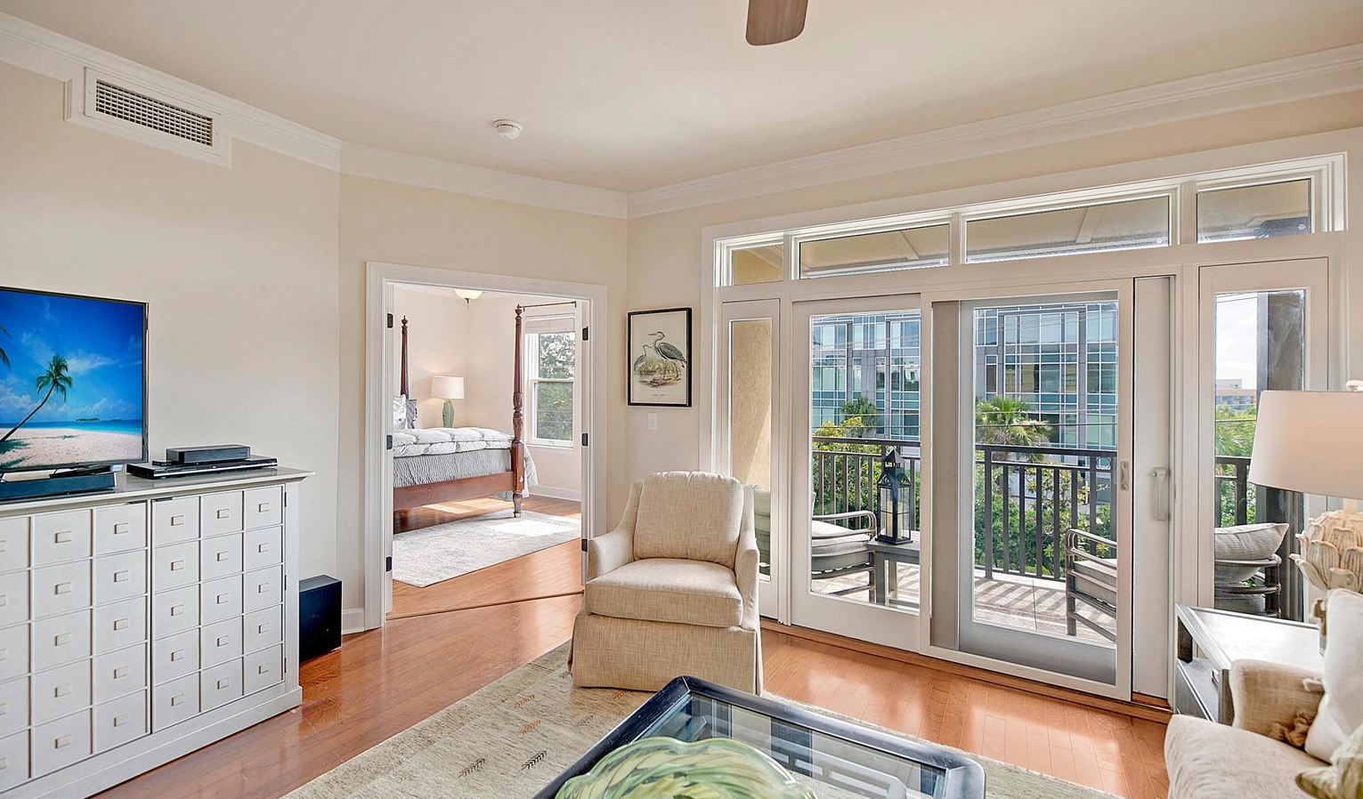
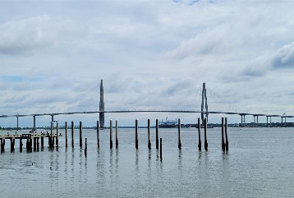
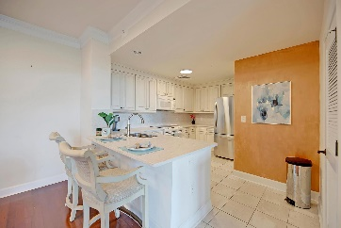
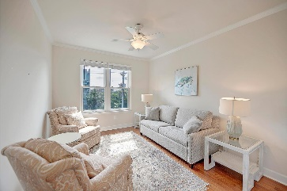
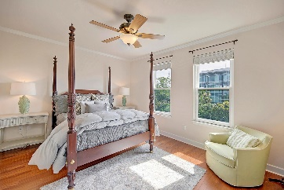
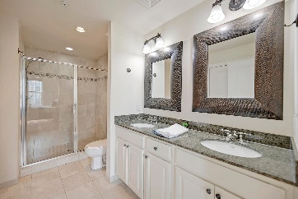

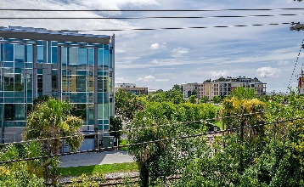
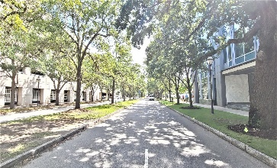
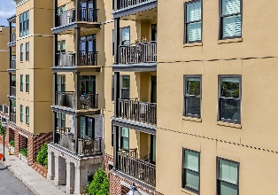
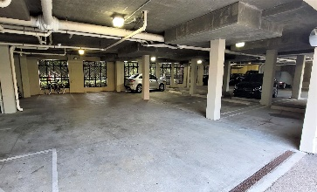
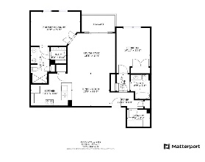


AMAZING NEW PRICE ~ EASY TO SHOW
Executive Luxury Condo In The Heart Of Downtown
33 Calhoun Street 122
Charleston, SC 29401
MLS# 21020248 | $649,900
This beautiful two bedroom two bathroom condominium is ideally located within one block from the Charleston harbor, the Aquarium, Liberty Square, The Gaillard Auditorium and multiple dining options. You will be a short stroll away from the Farmer's Market at Marion Square, enjoying a day of shopping on King Street or stepping back in time as you wander through the historic district, including The College of Charleston campus. This home offers both privacy and security with a newly gated entryway that leads to a ground floor parking garage. From there, you will take a secure elevator directly the 2nd level above the garage where you will find Unit 122. Recent updates include a matching backsplash, new sink, expanded counter seating & Hardwood floors in the bedrooms. A new HVAC was installed as well. This home has been meticulously maintained and is move in ready. The open layout provides excellent space for entertaining, but also gives great privacy for guests to relax comfortably. Sip your morning coffee on your balcony or take a stroll to the water front boardwalk and watch the ships pass through the harbor. Whether this is an investment property or a primary residence, you will love being in the heart of downtown Charleston in a well-appointed, low maintenance property that is close to everything! Don't miss your opportunity to schedule a private showing.
Take a 3D tour: https://my.matterport.com/show/?m=ukLMRD5TPvJ
Whitley Boyd
(843) 324-4761
wboyd@theexchangeco.com
www.theexchangeco.com
The Exchange Company, LLC | 49 Calhoun St | Charleston, SC 29401

