Slide 1

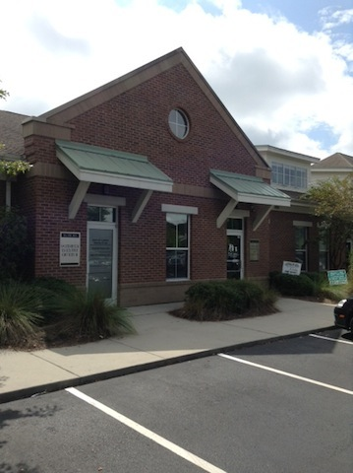
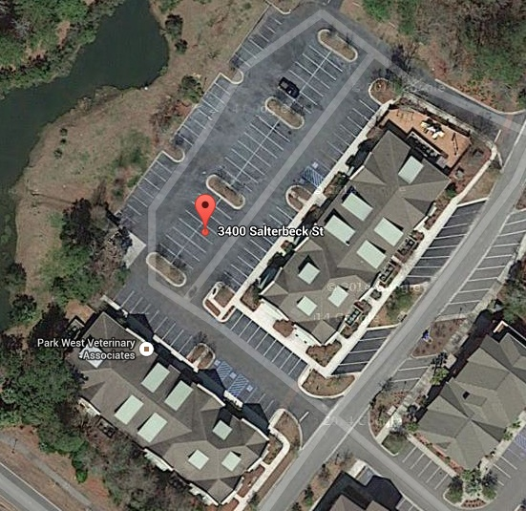
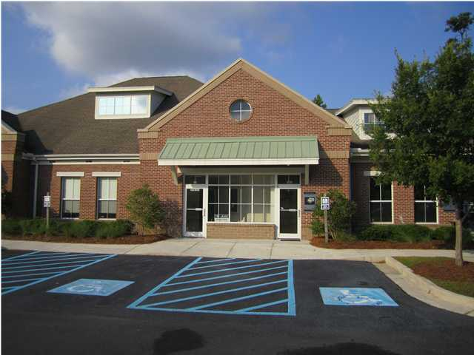
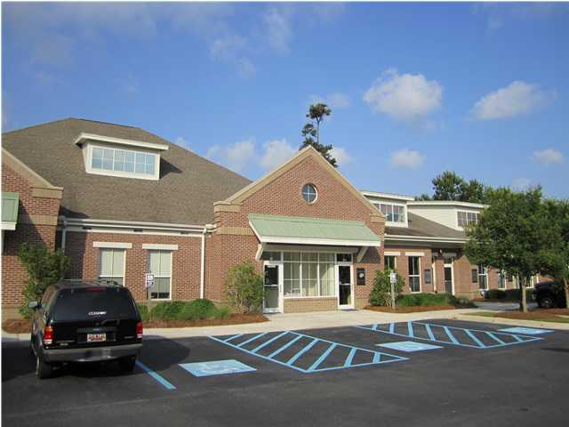


Park West Investment Property For Sale 100% OCCUPIED ~ 8.62% CAP RATE
8.62% CAP ($2,925,202)
100% Occupied Investment Portfolio for Sale. $248,642 Net Operating Income. A full package is available that shows all the tenants. This is a collection of commercial condominiums with separate tax map numbers. The majority of leases are triple net leases. Park West is a well established area. The particular Horizontal Property Regime is well run with a good owner/tenant mix.
Address: 3400 SALTERBECK ST
Area: CHS-Mt.Pleasant North of IOP Connector
Building Square Feet: 15,140
City: MOUNT PLEASANT
County: Charleston
Listing ID: 1425084
Listing Price: $193/sf
Office Class: A

