Slide 1
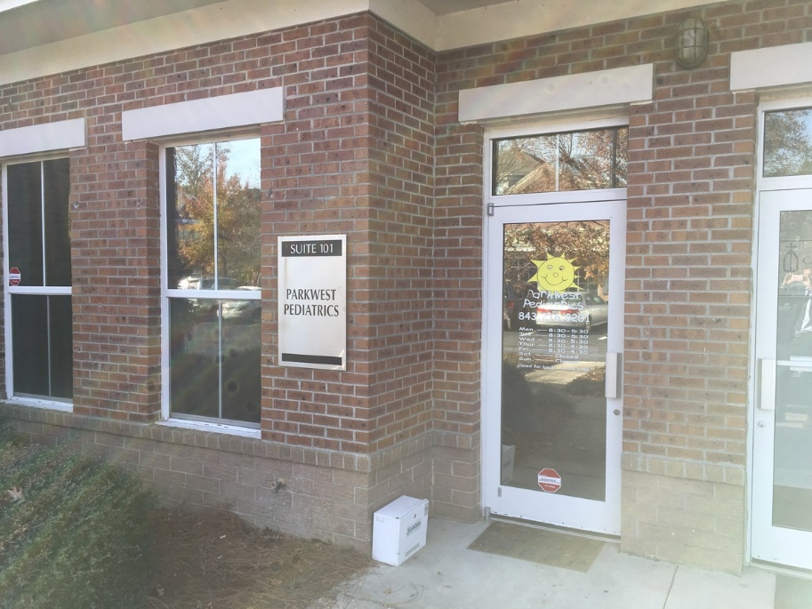
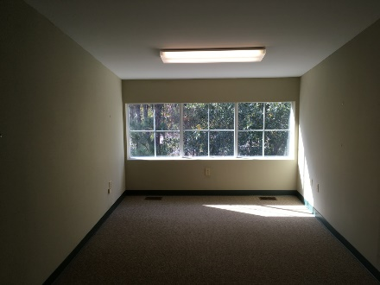
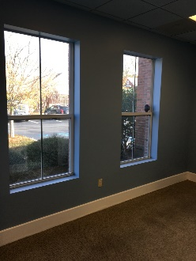
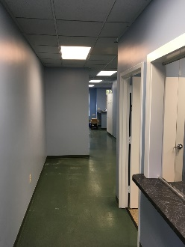
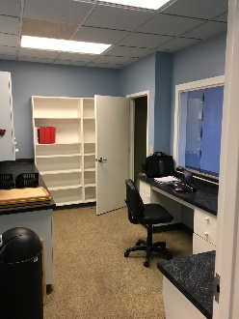
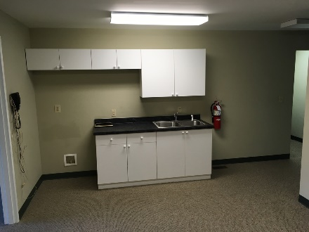


Park West Medical Office or Office for Sale
3400 Salterbeck St #101
Mt Pleasant, SC 29466
OFFICE FOR SALE
Park West Medical or General Office Space for Sale. 2,488 Square Feet consisting of 1,563 sf downstairs and 925 upstairs. The space is currently operating as Sweetgrass Pediatrics on a short term lease until August 2017. The space lays out with waiting room, reception, restrooms, labs and exam rooms all downstairs, while upstairs consists of a kitchen, private offices, server room and restroom.
Catylist ID: | #30023600
Building Size (RSF): | 2,488 SF
Sale Price: | $595,000
Unit Price: | $239.15 PSF
Property Use Type: | NNN, Investment, Vacant/Owner-User
Cap Rate: | 1.0%
Property Visibility: | Good
County: | Charleston
Tax ID/APN: | 598-00-00-061
David H Seay
CCIM, BIC, CCIM, REALTOR
(843) 364-6720
david@seaydevelopment.com
Seay Development, LLC
3404-202A Salterbeck Street
Mt. Pleasant, SC 29466
www.seaydevelopment.com

