Slide 1
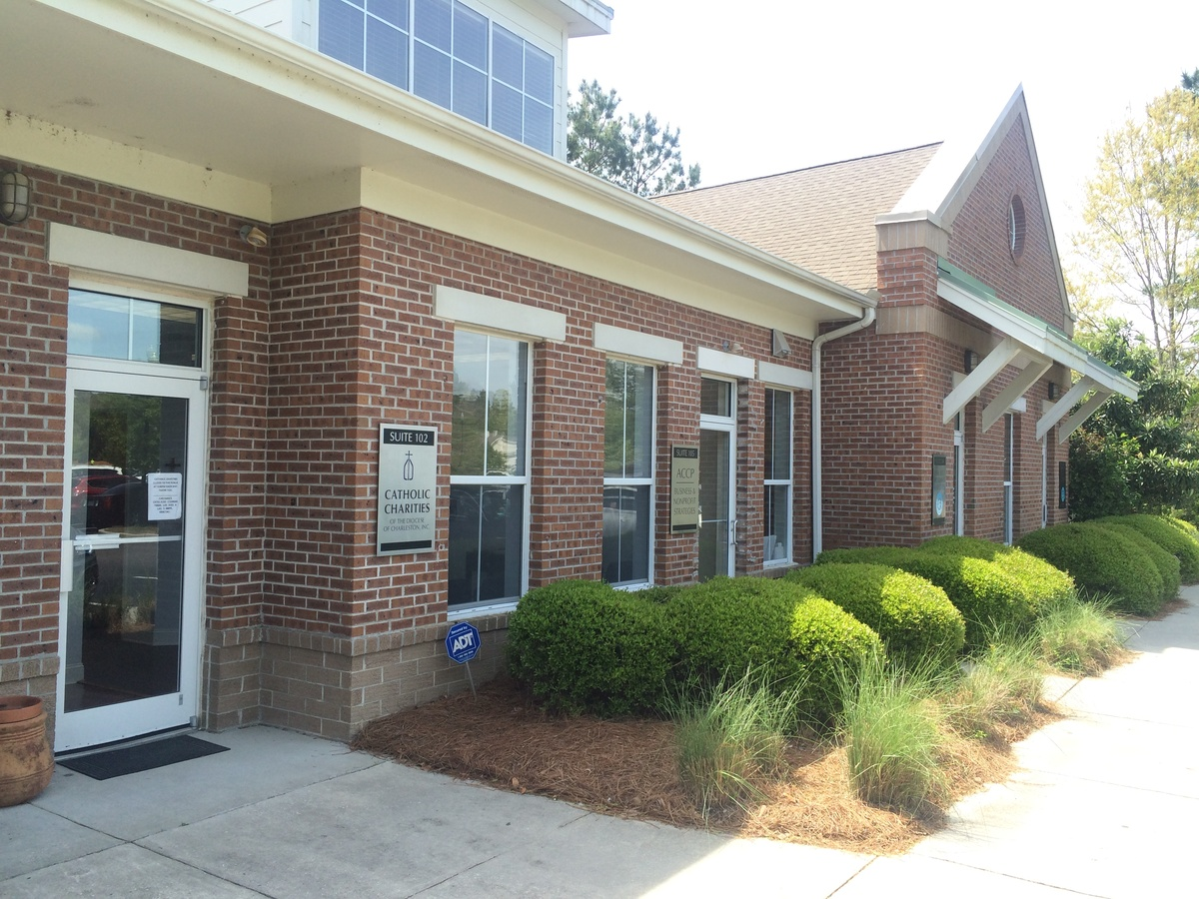

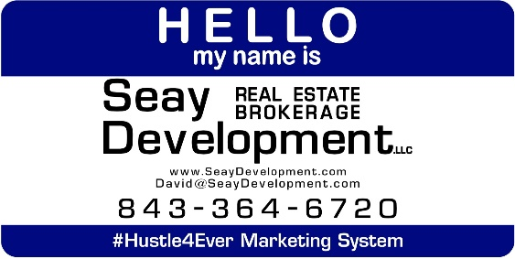
Park West 1,163 Square Feet for Sale
3400 Salterbeck St #102 Mt Pleasant, SC 29466
OFFICE FOR SALE
A three office suite in great condition. Break room, reception (could be used as fourth office). Ground level and easy to access and park, this suite has a tenant in place, but tenant may be willing to vacate should you need to owner occupy. A great opportunity to invest or move your business in. Park West is a vibrant community of mixed uses ranging from restaurants to medical professionals offering walkability.
Catylist ID: | #29952304
Building Size (RSF): | 1,163 SF
Sale Price: | $295,000
Unit Price: | $253.65 PSF
Property Use Type: | NNN, Investment, Vacant/Owner-User
Cap Rate: | 5.0%
Class of Space: | Class B
County: | Charleston
Tax ID/APN: | 598-00-00-062
David H Seay
CCIM, BIC, CCIM, REALTOR
(843) 364-6720
david@seaydevelopment.com
Seay Development, LLC
3404-202A Salterbeck Street
Mt. Pleasant, SC 29466 www.seaydevelopment.com

