Slide 1
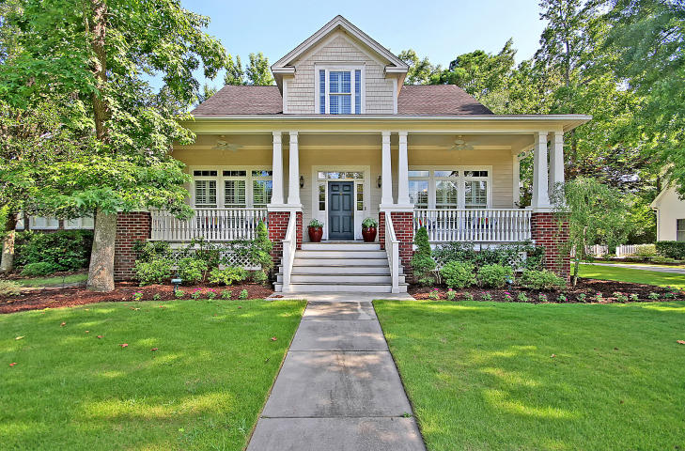
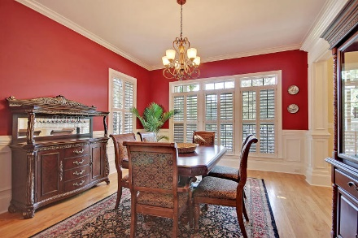
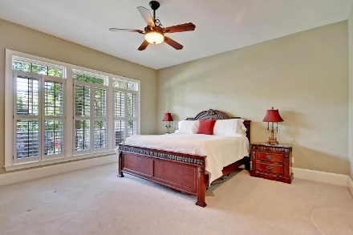
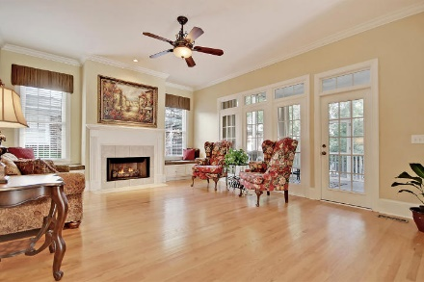
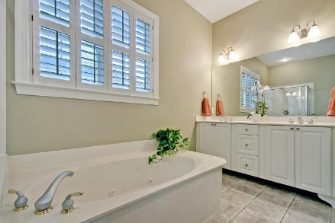
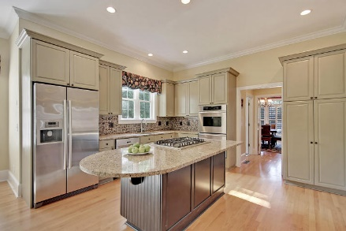
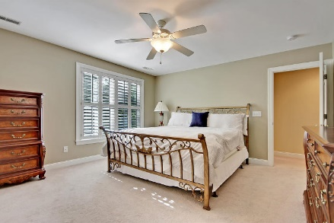
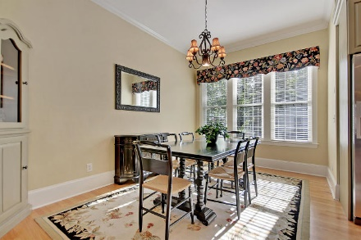
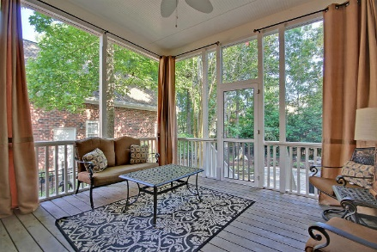
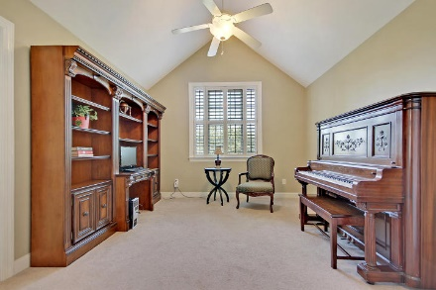
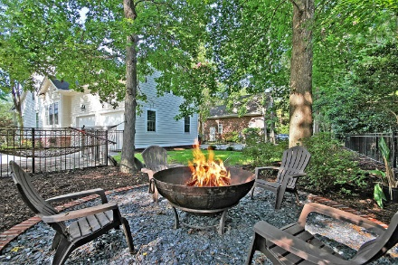
Seller Offering $5,000 Agent Bonus For Closing By 5/1/18
Price Reduced!
3404 Henrietta Hartford Road Park West ~ Mount Pleasant, SC 29466 ~ MLS# 18019029 ~ $570,000
Stunning home in Park West features beautiful outdoor living spaces & luxurious accommodations that you'll just love! A full, covered front porch, a screened-in porch, a fire pit area in the large fenced-in backyard & flagstone patio with a relaxing water feature are all great places that you can enjoy the outdoors. Inside you'll find gleaming hardwood floors, crown moulding, baseboard moulding, wainscoting in the dining room & a cozy fireplace in the living room. The granite kitchen boasts a center island with breakfast bar seating, tile backsplash, a gas range, SS appliances & an eat-in area. The first floor master has a huge walk-in closet & en-suite bath with dual vanity, walk-in shower & jetted tub. The spacious FROG offers another wonderful space that makes this house a home!
Additional features include:
Open floorplan
6 bedrooms including the FROG with 1st floor master
FROG has built-ins
Butlers pantry connects kitchen to dining room
Plantation shutters
Irrigation system
Abundant storage
Jack-n-Jill bathroom upstairs and another secondary bedroom has a cathedral ceiling and en-suite full bath
Located close to community pools, volleyball, playground and tennis center
Book your showing today!
Lisa Quick lisa@mattoneillteam.com 843-452-6688

