Slide 1

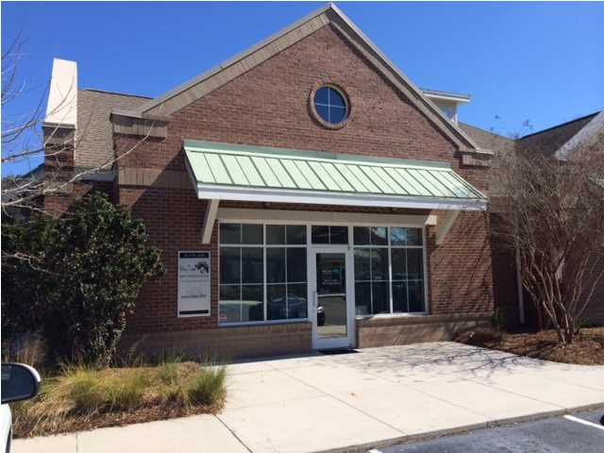
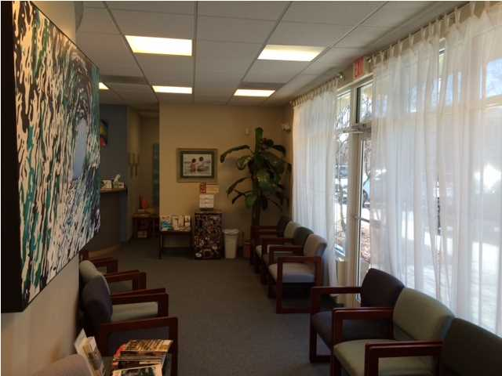
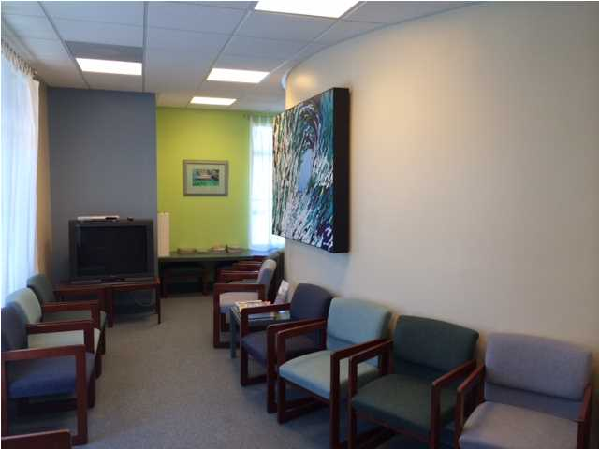
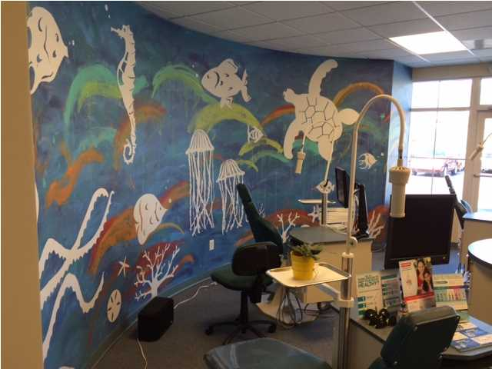
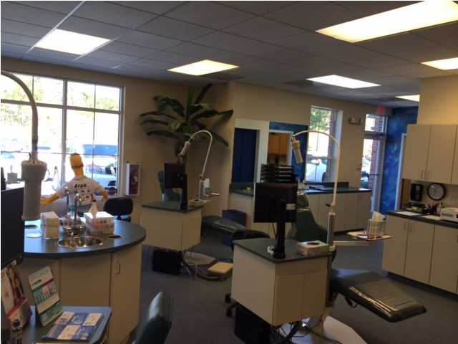
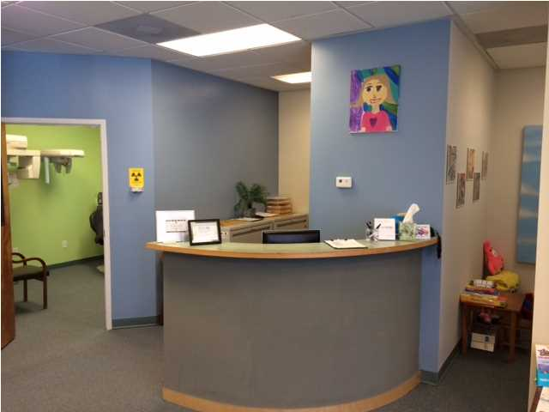
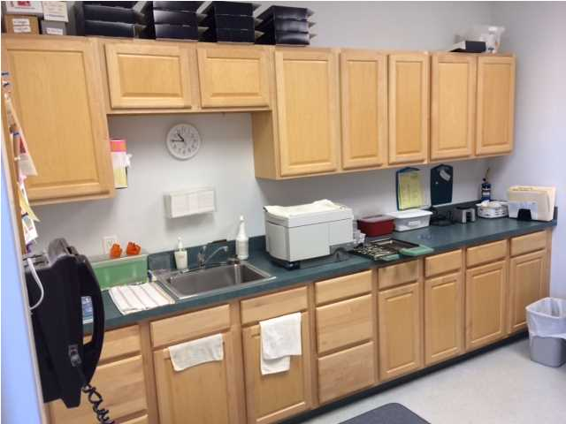
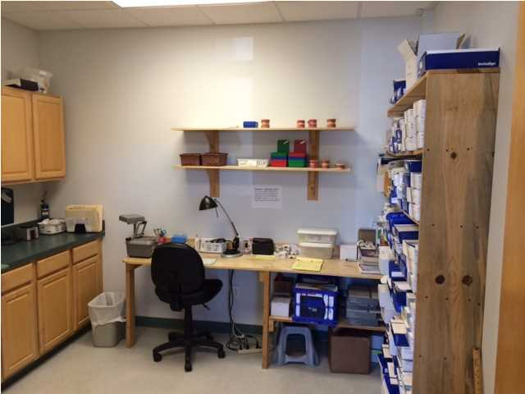
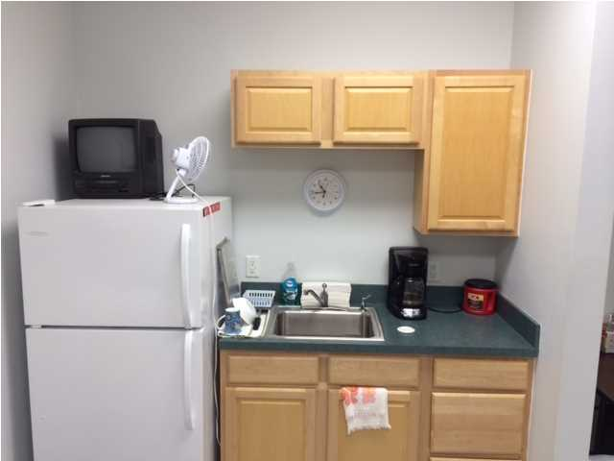


MEDICAL/PROFESSIONAL SPACE FOR SALE OR LEASE
Open floor plan on the first floor. Currently operating as a orthodontic office. See attachments for diagram. Large Executive Office on the second floor with a private staircase, however upstairs is large enough for multiple offices or large conference room. Downstairs has three entrances and can be an open office or office/retail showroom or could be modified to have many offices or even cubicles. Please note that the upstairs office is 683 square feet with 2,015 square feet downstairs. This unit is also for sale. Call for details.
Address: 3404 SALTERBECK ST
Area: CHS-Mt.Pleasant North of IOP Connector
Building Square Feet: 2698
Category: details
City: MOUNT PLEASANT
County: Charleston
Listing ID: 1406374
Listing Price: $18
Max Contiguous SqFt: 2698
Minimum Div. SqFt: 2698
Office Class: B+

