Slide 1
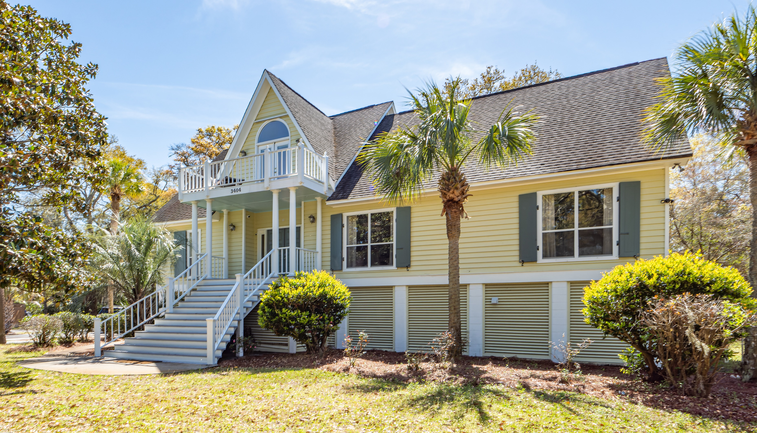
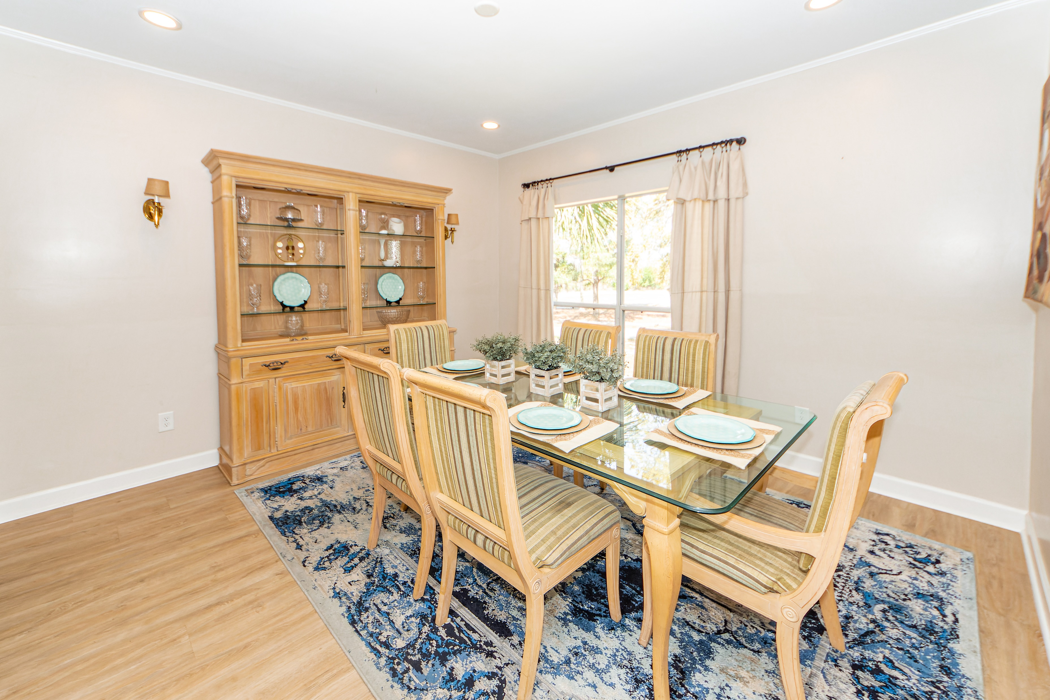
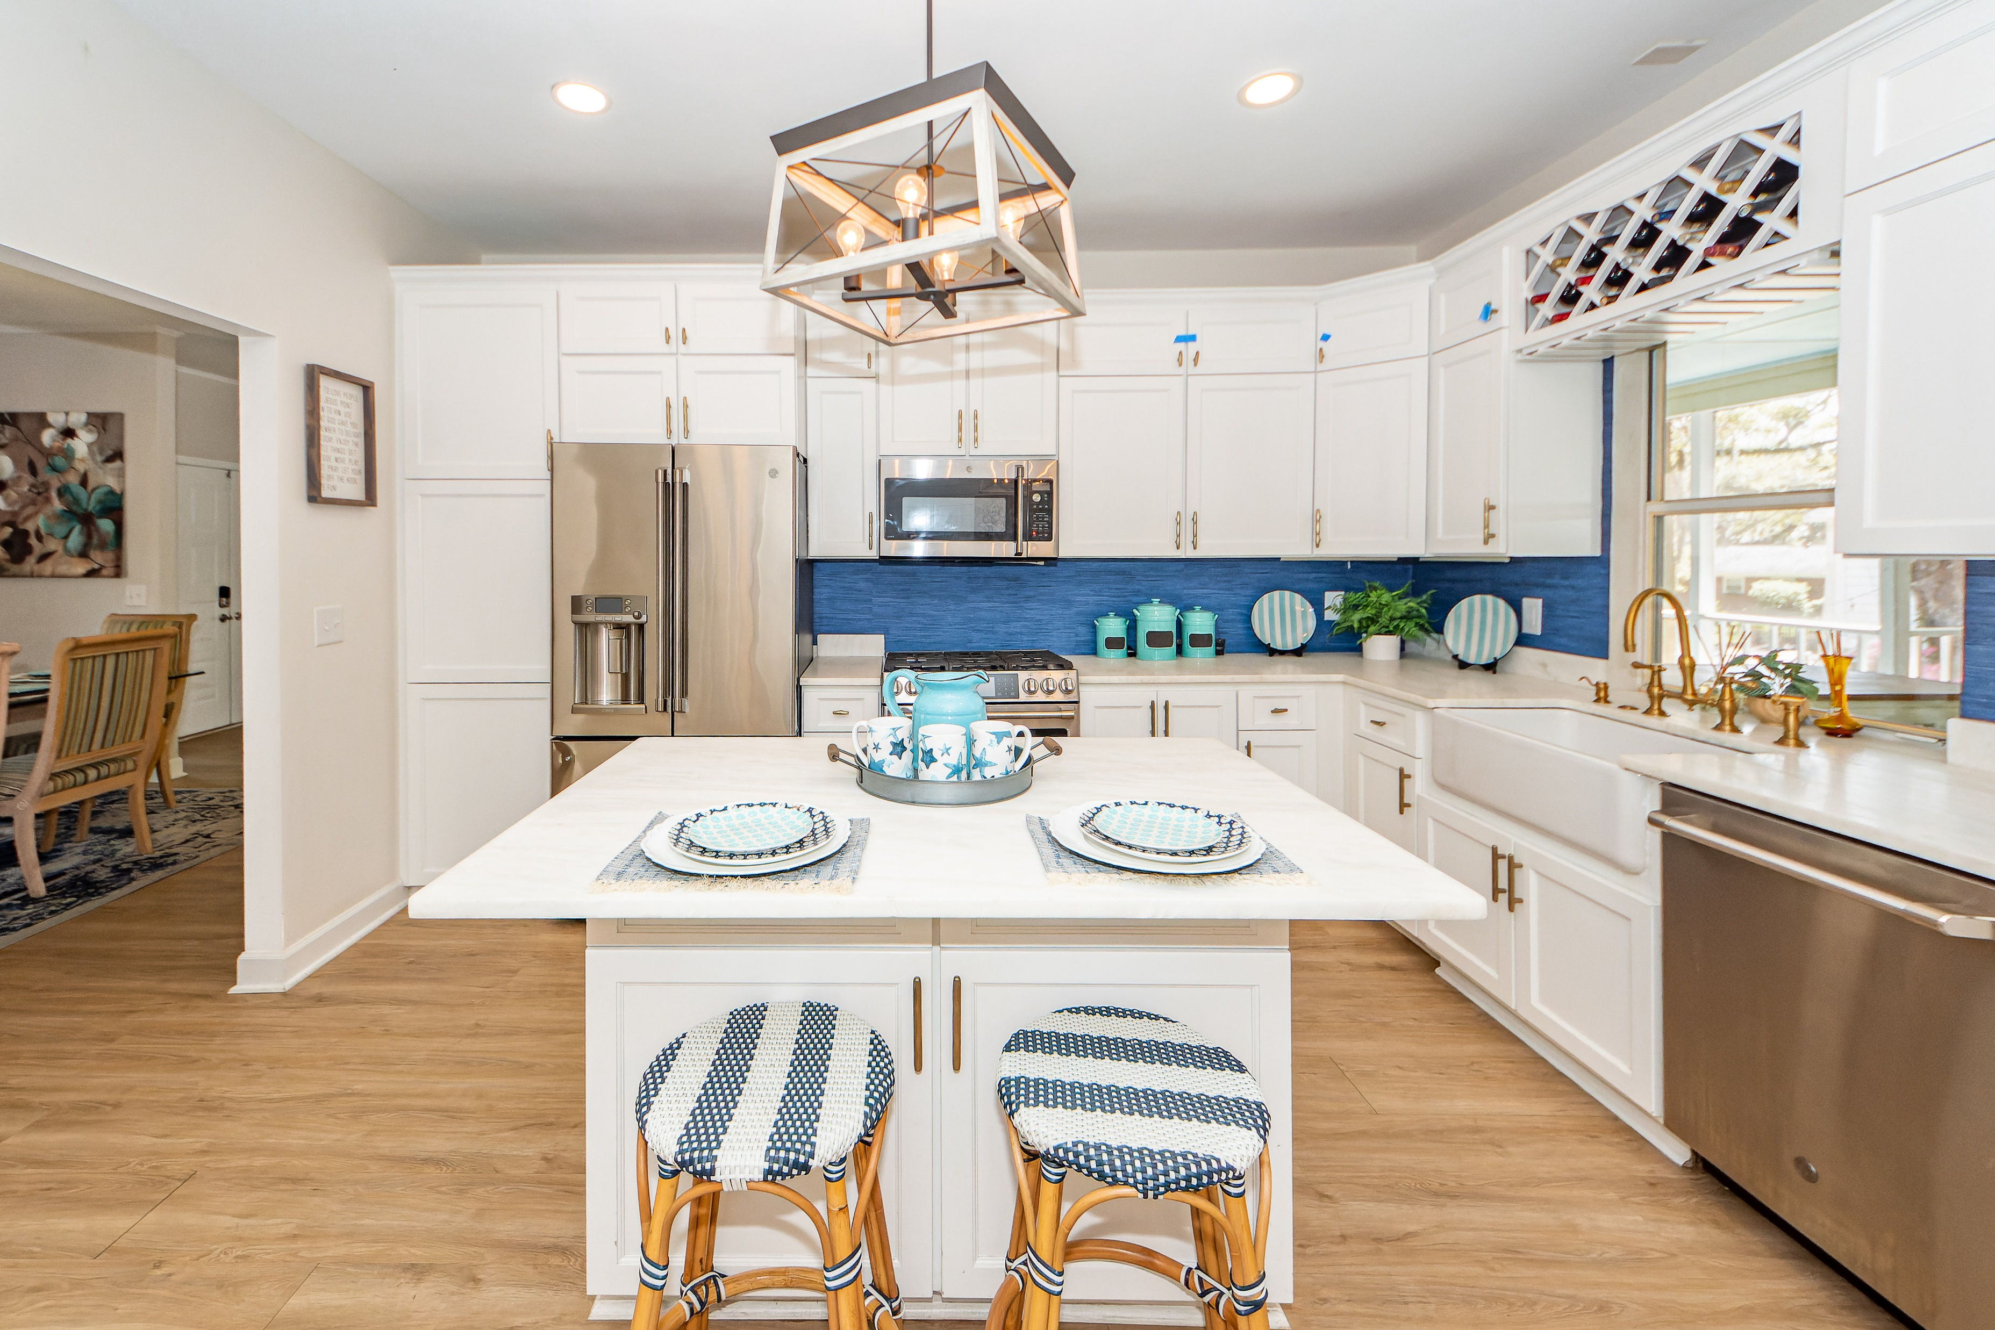
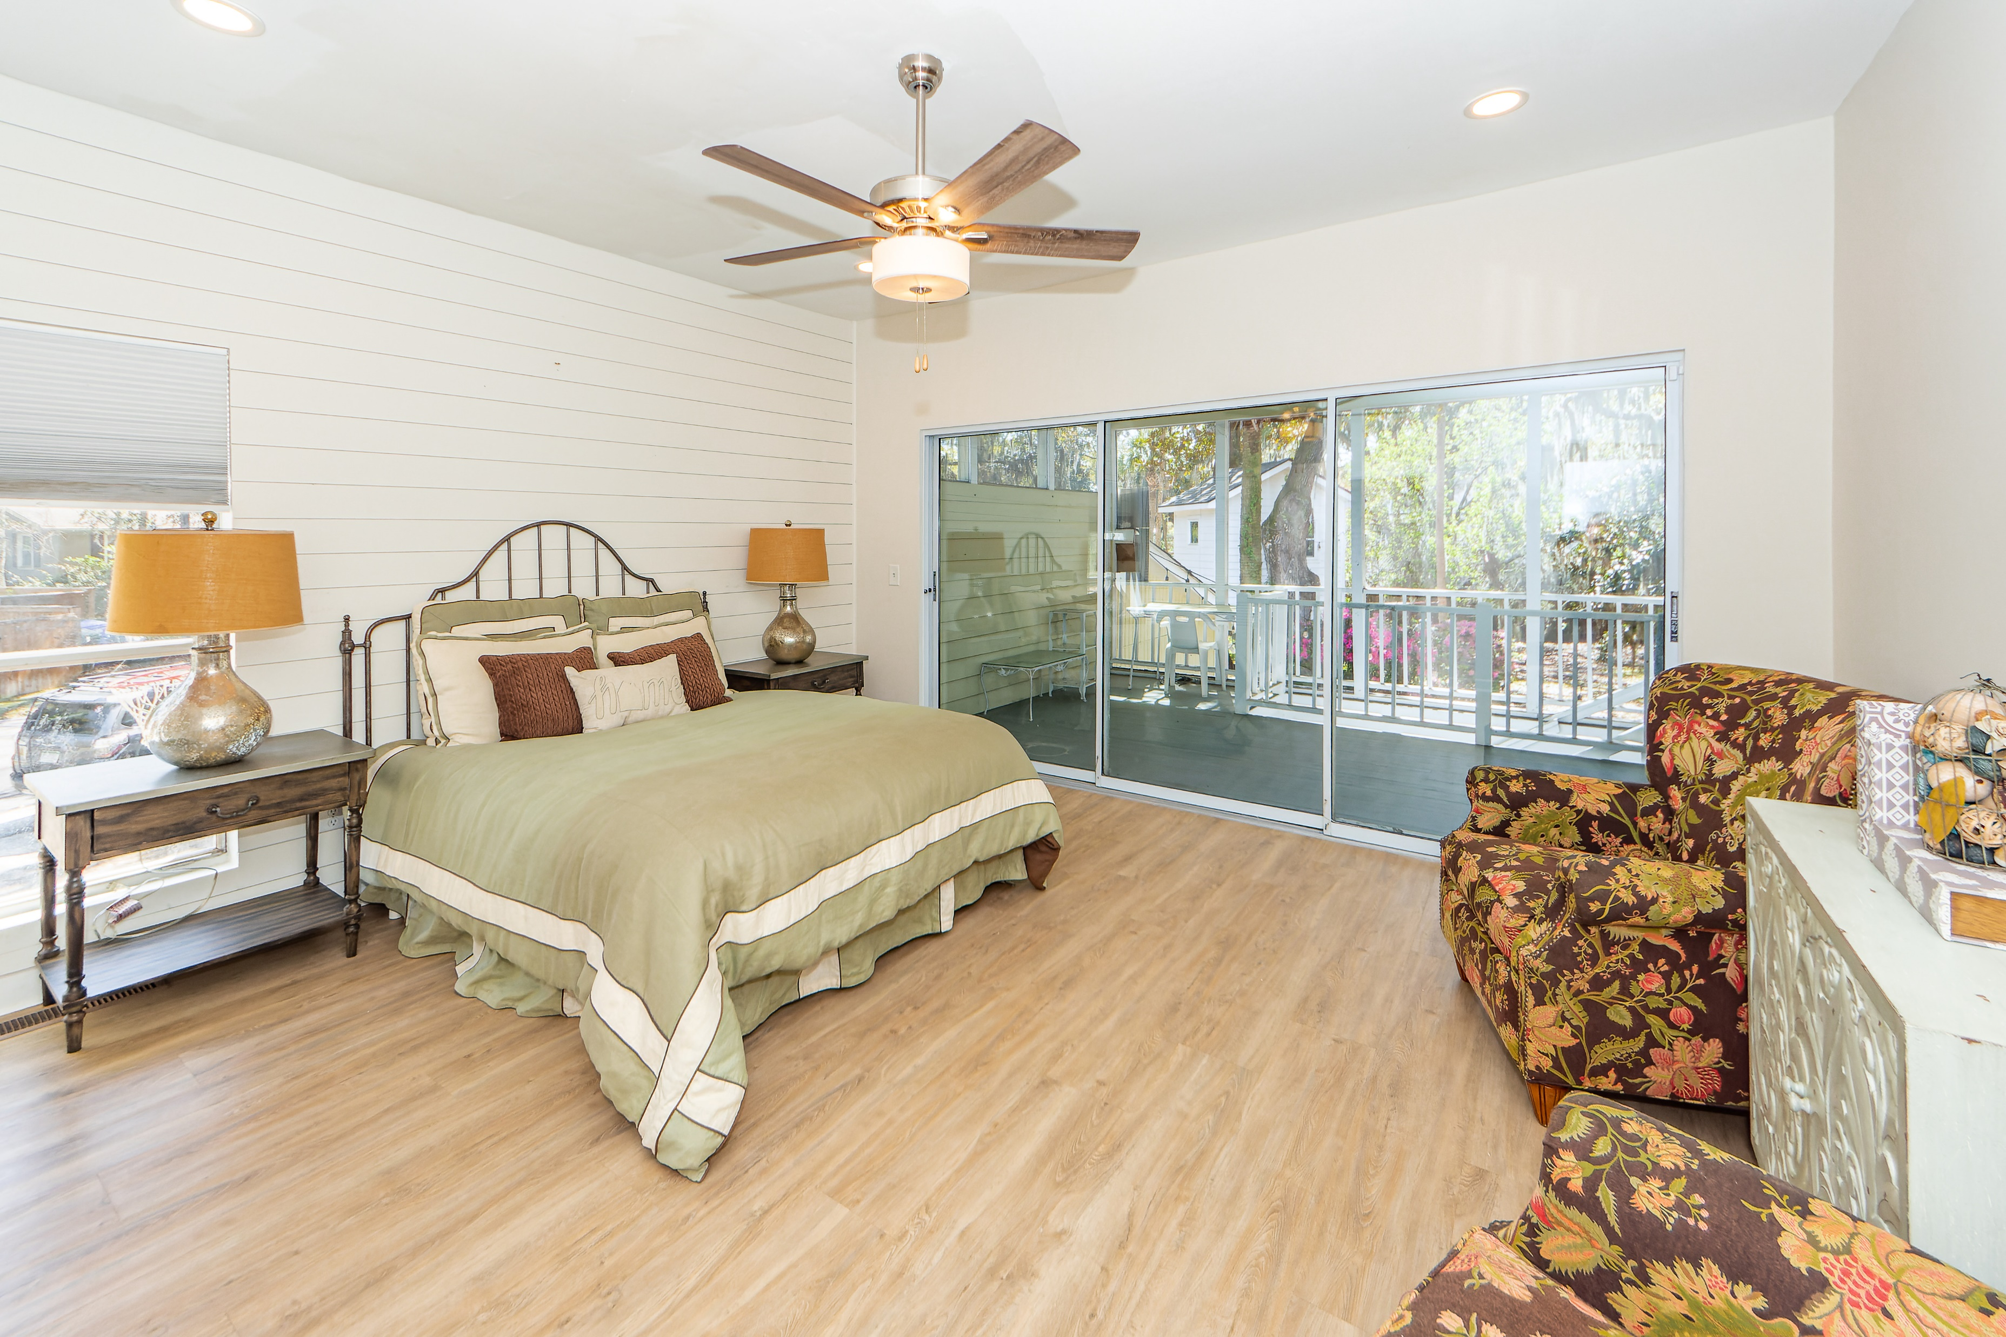
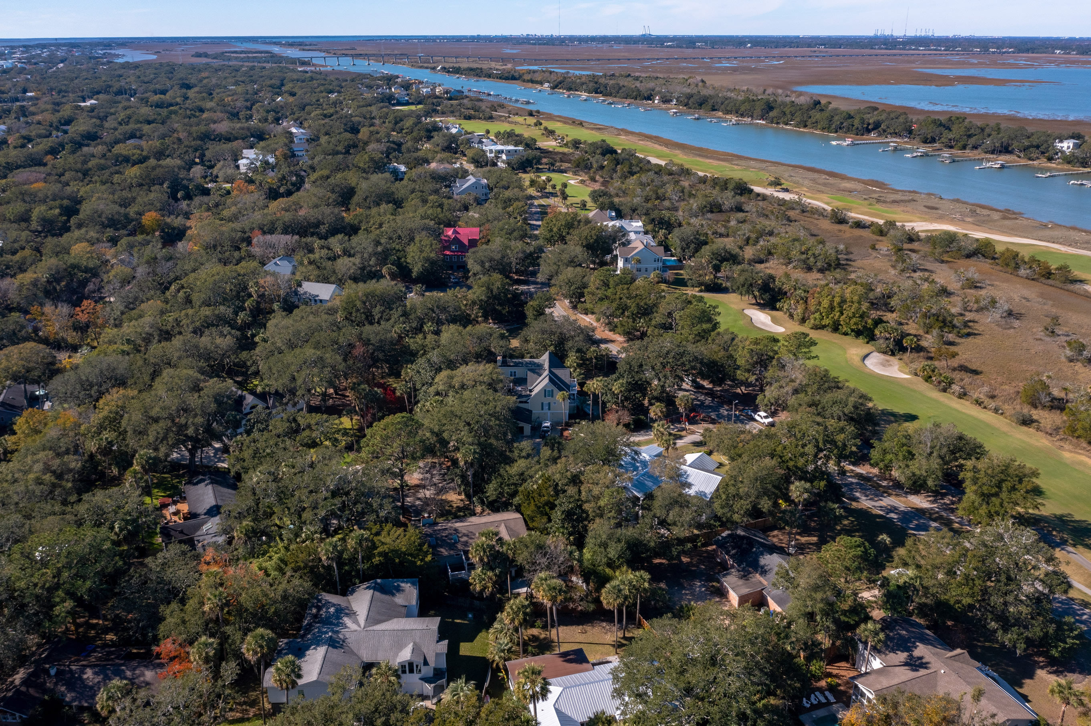
Back on the Market - Owner Anxious - Bring ALL Offers!
3404 Waterway Boulevard
Forest Trail | Isle of Palms, SC 29451 | MLS# 22029565 | $1,949,000
Well maintained home on Isle of Palms, located across the street from the Wild Dunes golf course, close to the Isle of Palms marina, a short golf cart ride to the the beach, freshly painted with an updated kitchen, updated bathrooms, new HVAC units, new ductwork, new electrical, & new mini-splits. Located on a huge corner lot, fenced in the rear with a playhouse. Ample storage in home, storage galore in the large garage area below the home, rec room/game room, & office. This house has the potential for being an excellent primary or a vacation rental. Owner currently has an active STR license with the City of Isle of Palms. Make this your home today!
Slideshow Tour | Matterport 3D Tour
Charles Salmonsen
M (843) 224-0300 | O (843) 388-6613 | charles@salmonsen.com
Salmonsen Realty | 864 Lowcountry Blvd Ste B | Mt Pleasant, SC 29464

