Slide 1
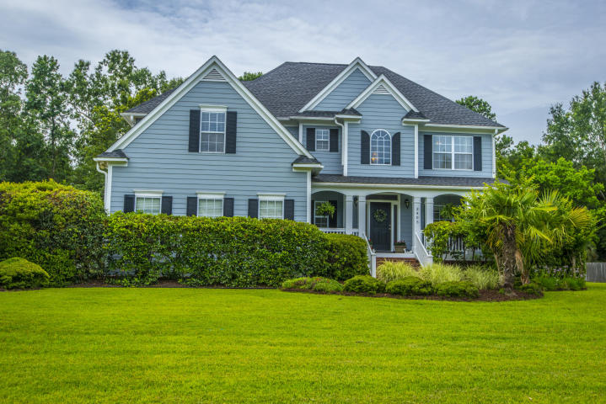
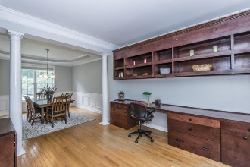
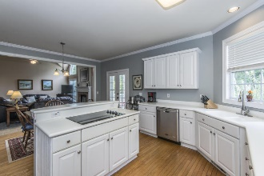
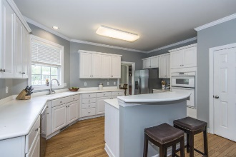
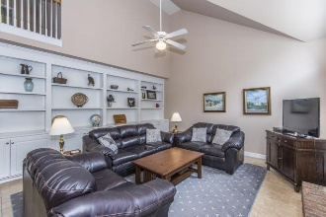
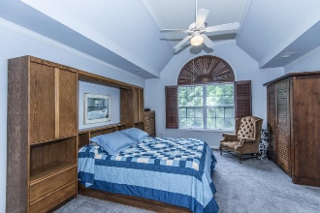
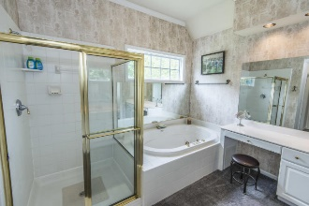
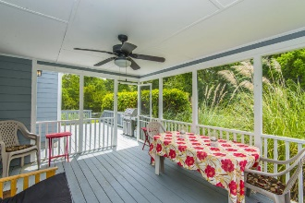
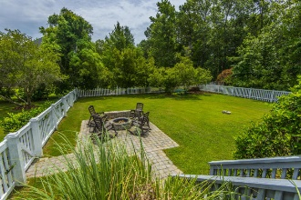
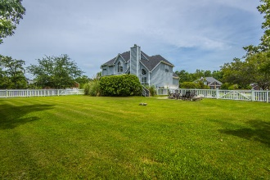


3405 Shagbark Circle
Dunes West | Mount Pleasant, SC 29466
MLS# 17015532 | $575,000
The Only Deep Water Home On Daniel Island
Open House
Sunday, Sept 3rd ~ 1–3pm
Welcome to The Woodlands of Dunes West - a beautiful executive neighborhood with large lawns, mature landscaping, wide safe streets, privacy and peace! This lovely home is set on a level one acre lot that backs up to woods for privacy. Part of the yard is fenced for pets and kids leaving a huge side yard for outdoor recreation.
NEW LOWER PRICE allows next homeowner to upgrade as desired. The home has a new roof and fresh paint inside and out. The open floor plan is great for families & entertaining and the wood burning fireplace and built in cabinets add to the charm of the space.
The screened porch and deck area are great for entertaining. Upstairs are three bedrooms with private baths and the finished room over the garage can serve as an additional bedroom or playroom. Three car garage provides lots of overflow storage.
The amenities at Dunes West include an 18 hole golf course, clubhouse, three pools which include two for families, one for adults, tennis courts, miles of walking, biking and jogging trails, and social activities at the clubhouse.
Helen Hudson
843-991-9875
helen.hudson@carolinaone.com
Carolina One Real Estate
2713 Highway 17 North
Mt. Pleasant, SC 29466

