Slide 1
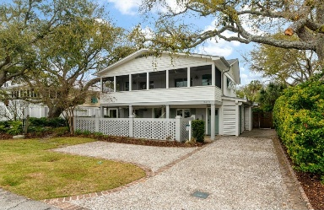
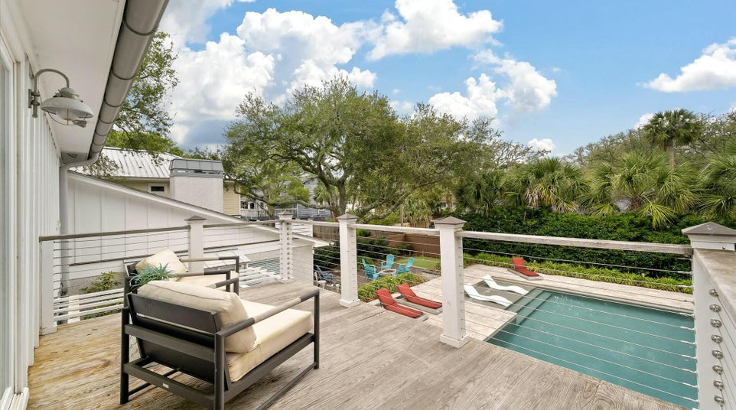
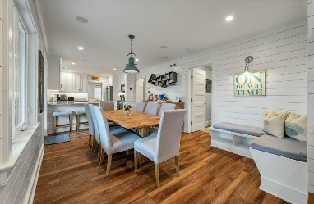
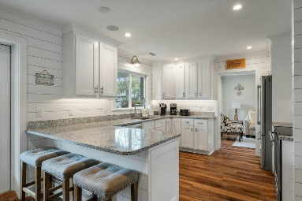
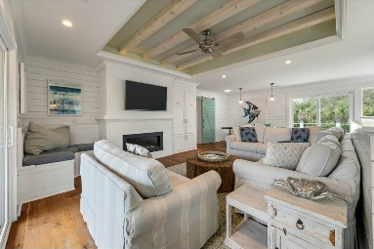
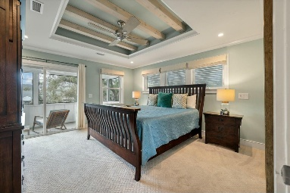
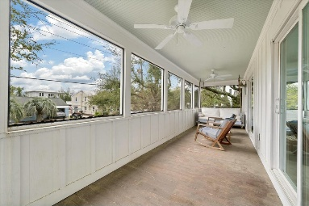
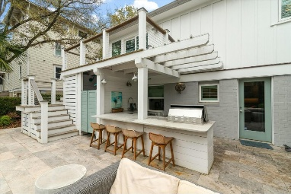


3405 CAMERON BOULEVARD
Isle of Palms, SC 29451 · MLS# 25008711 · $2,500,000
Seas The Day And Sell This Beach House
Welcome to this phenomenal Isle of Palms beach home. Experience coastal living at its finest in this quintessential beach house, ideally located in the heart of Isle of Palms this home is just a short stroll from the beach. It offers convenient access to local restaurants, the Isle of Palms Marina, and nearby shopping—all easily reachable on foot or by golf cart or bike. Upon entering you're welcomed into a cozy dining area with built-in bench seating beside the staircase. The spacious kitchen features granite countertops, crisp white cabinetry accented with nautical boat cleat pulls, and high-end appliances. A convenient bar area with countertop seating opens into a den/library, complete with custom built-in bookshelves.
A short hallway leads to the first-floor primary suite, which boasts a vaulted ceiling with skylights, a gas fireplace, and additional built-in shelving. The en suite bathroom showcases luxurious tile work and premium finishes. Two additional first-floor bedrooms share a full bathroom, making this layout ideal for guests or family members who prefer single-level living. The well-appointed laundry area, hidden behind custom barn doors, adds to the home's thoughtful design. Upstairs, a spacious loft serves as a second living space and features built-in cabinetry and a second gas fireplace surrounded by gorgeous shiplap. This versatile area comfortably accommodates a sectional sofa, ping pong table, and oversized chair. From here, step onto a screened-in porch - an inviting extension of the indoor living space.
The second-floor primary bedroom includes a beautifully crafted beamed ceiling, an en suite bathroom, and a spacious walk-in closet currently used as a charming bunk room.
This home is equipped with a full-home Sonos sound system featuring built-in speakers both inside and out. Storage abounds, with ample closet space throughout and designated owners' closets inside and outside the property. Additional upgrades include a whole-home dehumidifier, tankless gas water heater, and open-cell foam insulation throughout. Renovated down to the studs just eight years ago, the home features new systems, roofing, and city sewer connection.
The true highlight is the stunning backyard oasis. Enjoy the well-equipped outdoor kitchen and bar, complete with a gas grill, built-in mini fridge, and sink. The heated, in-ground saltwater gunite pool is surrounded by travertine tile and features a baja shelf with lounge chairs. Adjacent to the pool is a putting green and a cozy gas fire pit - perfect for entertaining. Additional amenities include an outdoor shower, storage area, and a dedicated golf cart garage.
Beautiful landscaping, irrigation, and elegant outdoor lighting complete this exceptional property. Currently a highly successful vacation rental, this home offers an unmatched combination of style, comfort, and functionality.
VIDEO TOUR
Carey Nikonchuk
843-276-1701
cnikonchuk@gmail.com
www.brennamangroup.com

