Slide 1
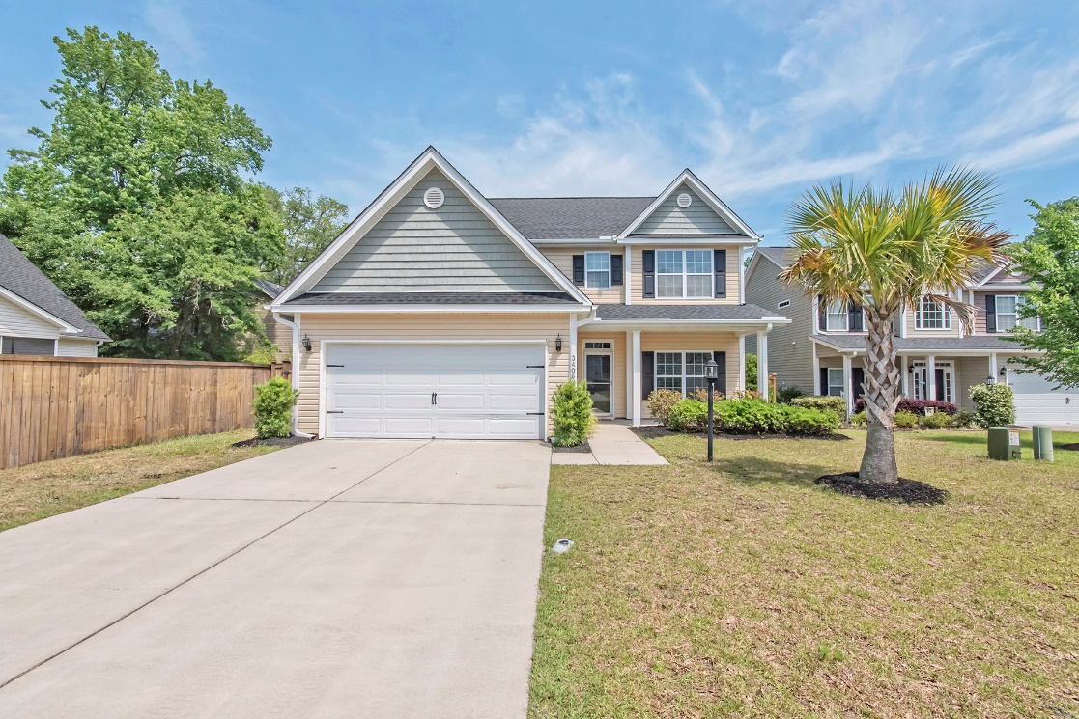
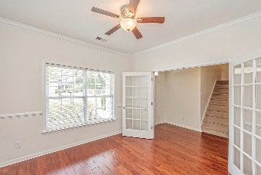
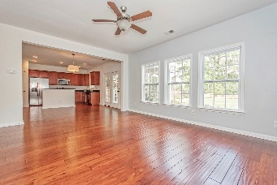
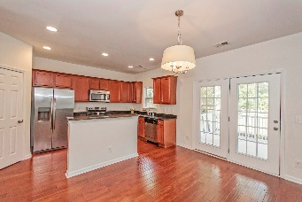
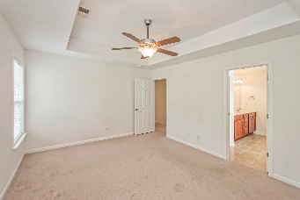
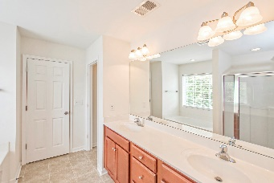
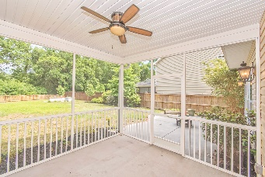
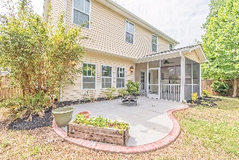
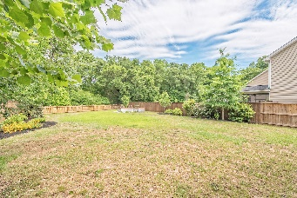
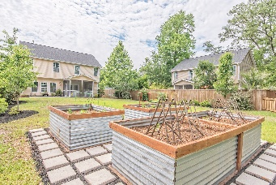
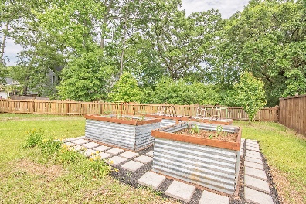


Pre-Listing Notification!
Coming Thursday, so get your buyers scheduled and ready!
Updated Throughout!
3406 Hamlett Circle
The Retreat at Johns Island
Shows like a model.
Open concept downstairs with all three bedrooms upstairs along with laundry.
Chef's kitchen with stainless steel appliances opening up to the screened in porch and patio with firepit.
Large & private back yard with privacy fence, wooded back drop, and three custom made raised planter beds full of rich soil for your tomatoes, herbs, cucumbers, etc with long lasting corrugated steel wrapping.
Haynes Johnson
Mobile - (843) 864-8159
haynes.charlestonproperties@gmail.com
The Boulevard Company, LLC | 35 Broad Street | Charleston, SC 29401 | haynes.charlestonrealestate.properties

