Slide 1
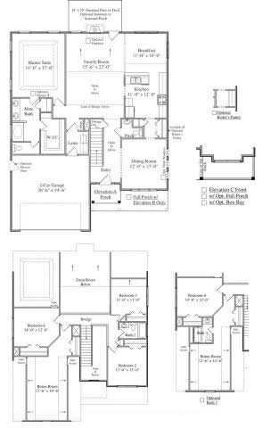
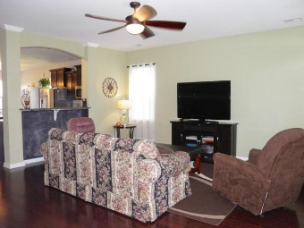
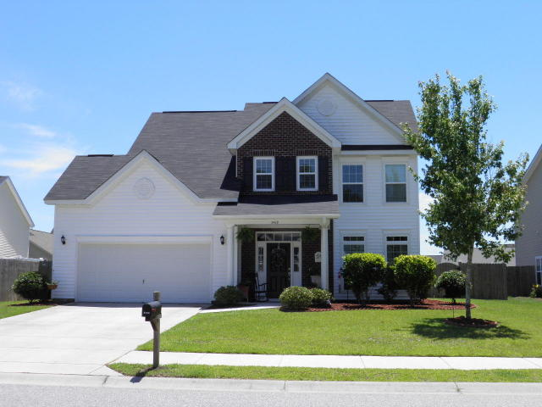
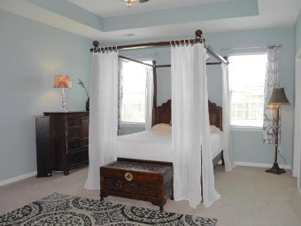
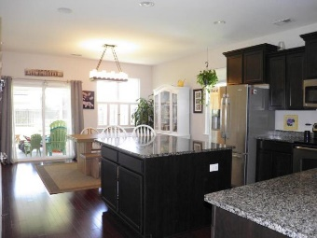
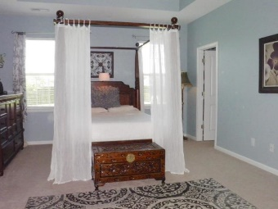
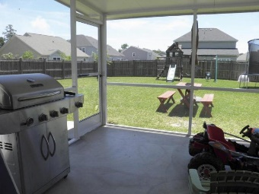
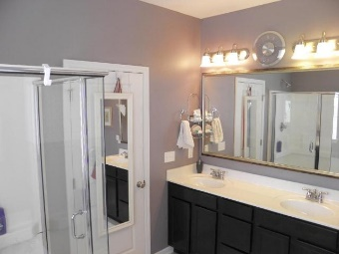

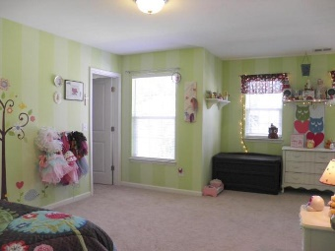
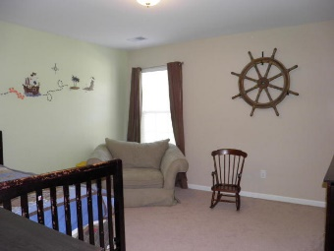
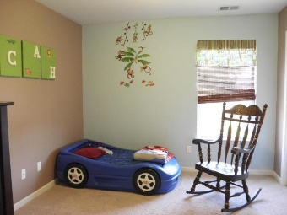

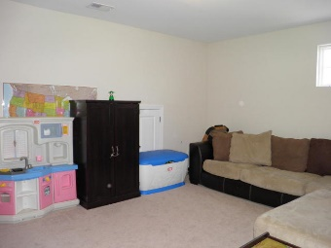
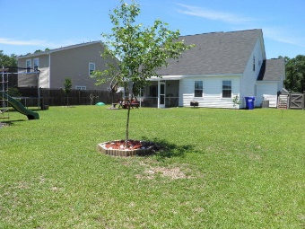

3409 Thorpe Constantine Avenue Staffordshire ~ Johns Island ~ MLS# 16015692 ~ $289,000
Wonderful home in Staffordshire with a spacious floorplan. This home boasts an upgraded kitchen with granite counters, a large center island, a pantry closet, plenty of cabinet space and built-in speakers. It also has a 'hard to find' downstairs master bedroom suite with an adjacent laundry room.
There are hardwood floors in the main downstairs living areas and a great screened in porch and two car garage. Many of the walls downstairs have just received a fresh coat of paint. Upstairs are 3 bedrooms, one of which is very large, and a flex/game room. This could be converted to a bedroom by adding a closet.
The backyard is very large and is fully fenced. Staffordshire is a beautiful neighborhood and conveniently located on Johns Island. No flood insurance is required as the home is located in an 'X' zone!

