Slide 1
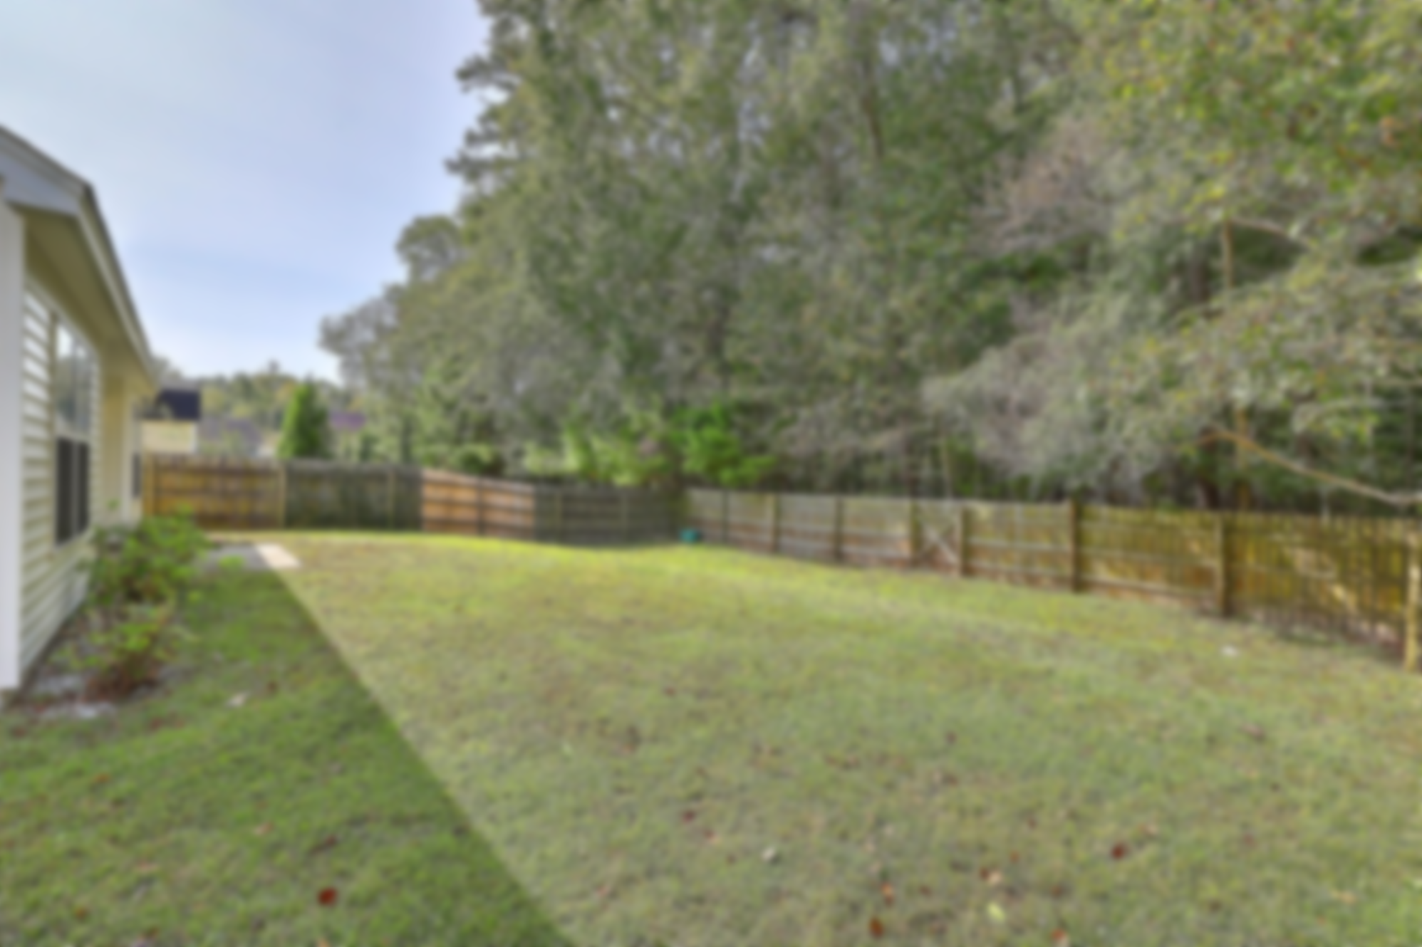
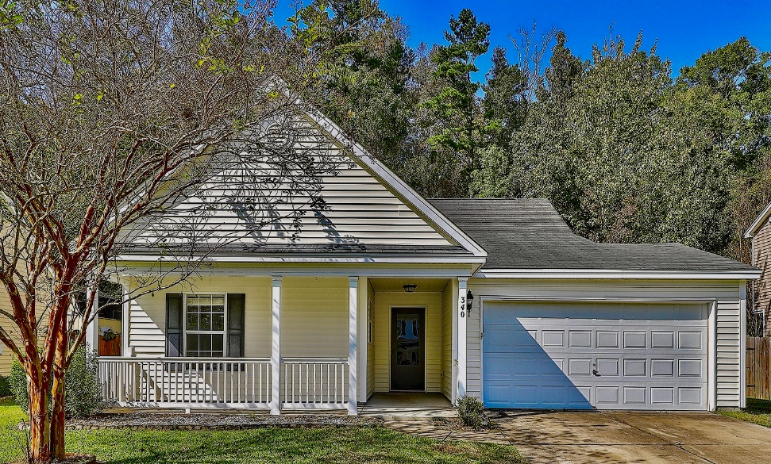
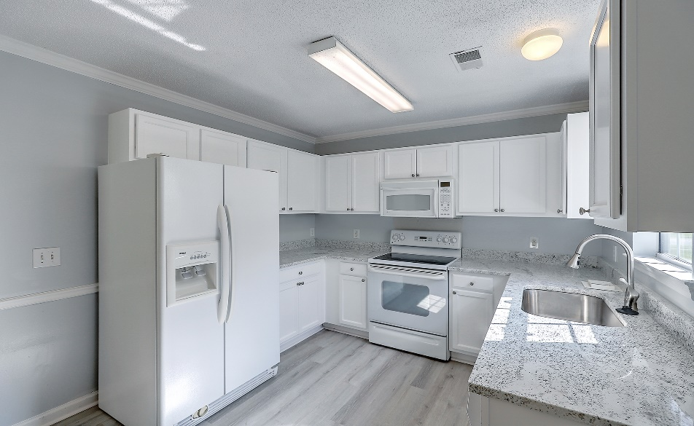
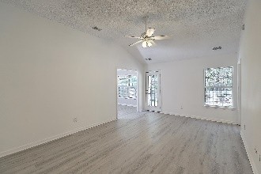
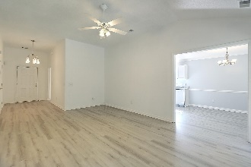
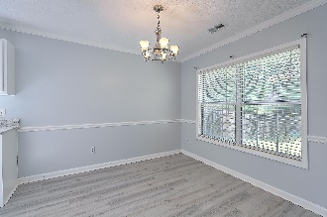
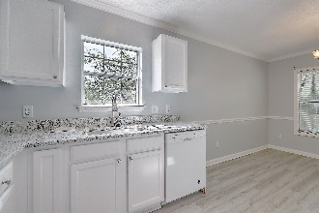
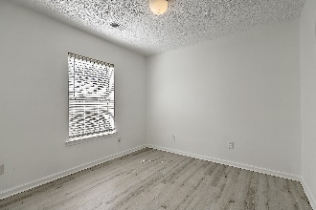
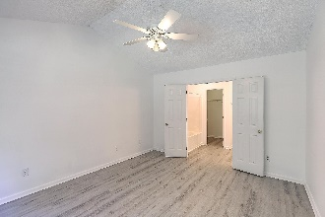
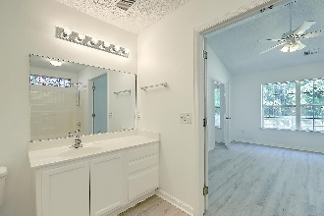
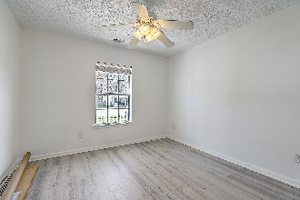
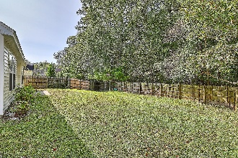
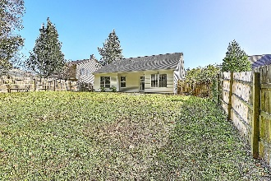


Just Listed in Dorchester District 2
340 Eagle Ridge Road
Bridges of Summerville | Summerville, SC 29485 | MLS# 20030118 | $239,900
Welcome to this gorgeous, newly updated, inviting, one-story home located in the highly desirable Bridges of Summerville! This beautiful, cozy home sits on a nice homesite with a fenced in rear back yard, and is located in the award-winning Dorchester District 2 school system. The foyer entrance welcomes you to a freshly painted home and leads to a nice size vaulted ceiling Family room. The Family Room is open to the spacious eat-in-kitchen complete with chair rail. Updated nice size kitchen includes new granite countertops, brand new sink & faucet, garbage disposal & refrigerator is included! Beautiful new Luxury Vinyl Plank Flooring throughout the entire home. The Spacious Owner's bath includes a garden tub & shower combo & a large walk-in closet as well. Also you will find two nice size additional bedrooms and a full bath. Brand new HVAC installed just installed! Hot water heater replaced in 2016. Neighborhood pool, sidewalks, and parks are close by, wonderful shopping and restaurants, easy access to the interstate puts this home in the perfect location! This clean home has been well cared for.
This house is a must-see!
Lane Gregory
843-737-1541
lanesellscharleston@gmail.com
The Boulevard Company, LLC
806 Johnnie Dodds Blvd Ste 100
Mt Pleasant, SC 29464

