Slide 1
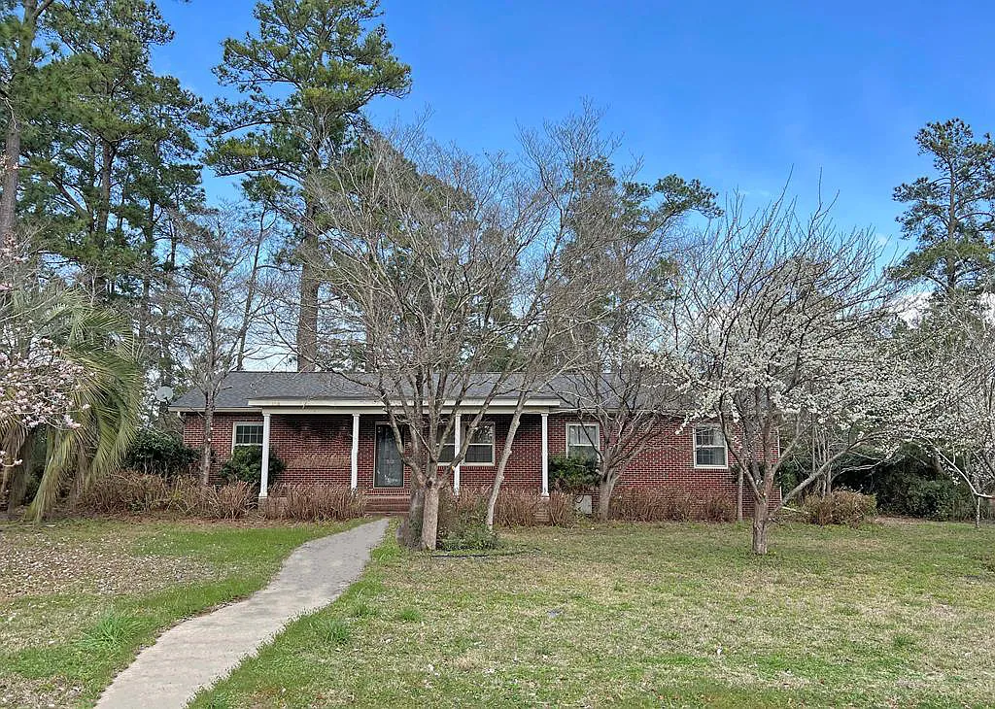
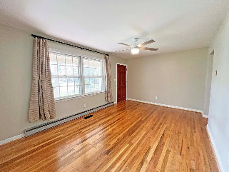
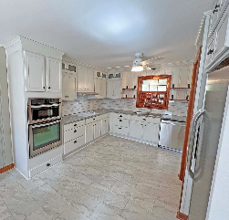
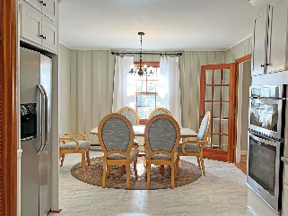
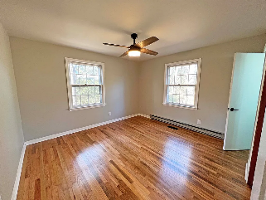
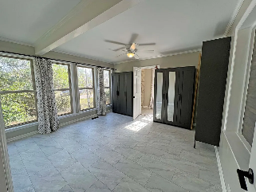
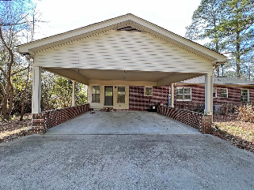

Corner Lot
340 Hampton St
Elloree, SC 29047 ~ MLS# 156173 ~ $275,000
Great In Town Elloree Corner Lot. Enjoy the small town living with this 4 bedroom updated home. New master suite with new Full bath. Fully updated Kitchen with new appliances, cabinets and counter tops. Sitting just a short drive to Columbia or Charleston leave the busy cities and enjoy small town living. 4 Lake Marion boat ramp and access with in 5 to 15 mins from this home. Jump on the boat and take a afternoon sail or head to Charleston for the weekend via the water ways. Don't miss this home! It is is MOVE IN READY!
Lake Homes Realty, LLC
Elloree, SC 29047
www.SCLakeLife.com
Kristie Anderson
(803) 387-9459
kristie@sclakelife.com

