Slide 1
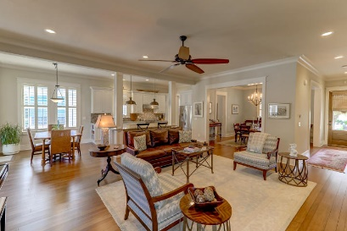
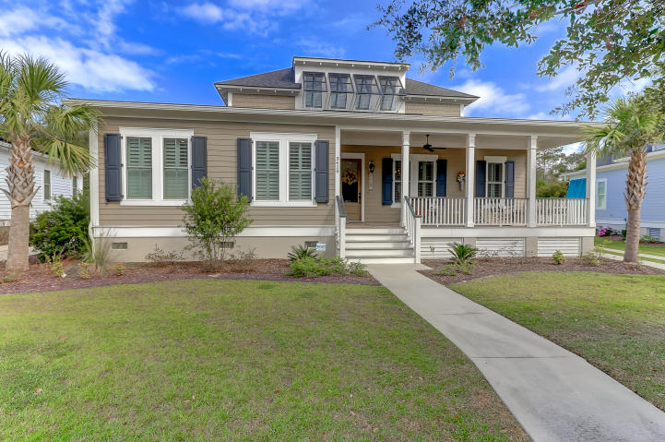
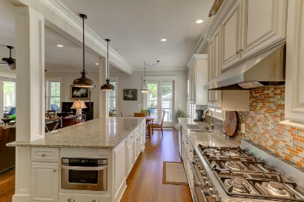
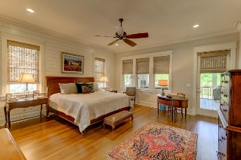
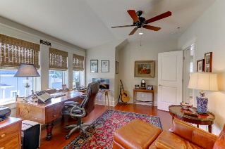
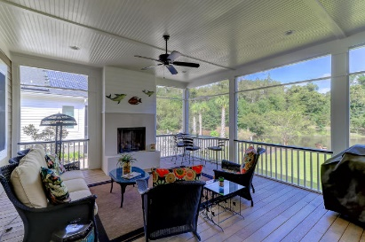
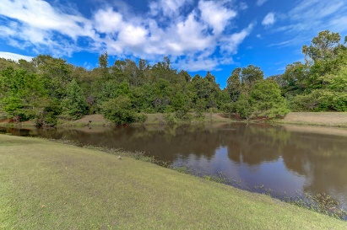


3410 Acorn Drop Lane The Villages In St Johns Woods ~ Johns Island MLS# 17027449 ~ $680,000
Custom Designed Home with Open
Floorplan & Free Energy Living!
Stunning home situated adjacent to a pond site in the desirable neighborhood of The Villages in St Johns Woods! This gracious home is a LEED Certified Platinum home and boasts Free Energy Living. Custom designed by a professional design team using the highest quality building materials and systems available. Construction was done using a structural insulated panel system (SIPS) used in the building structures for all the main structures: the foundation floor, walls and roof. The result is this home operates at a substantial cost saving on the utility bills. Solar energy systems and indoor air quality filtration are integrated in this highly efficient home.
So many more details than can be mentioned here!
Peggy Leete Office - (843) 884-1622
Cell - (843) 532-7923
pleete@carolinaone.com
www.peggyleetehomes.com
Carolina One Real Estate
628 Long Point Rd
Mt Pleasant, SC 29464

