Slide 1
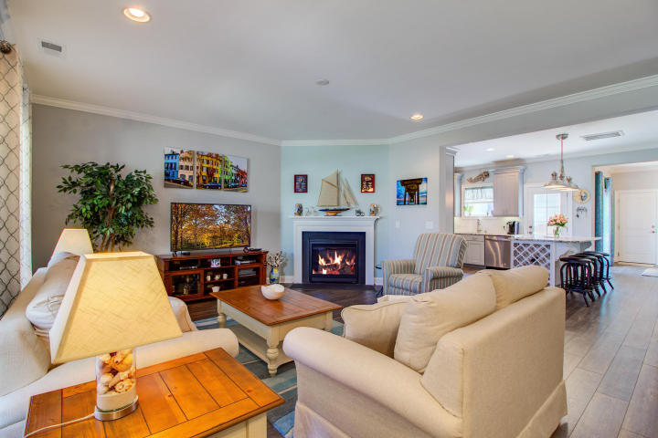
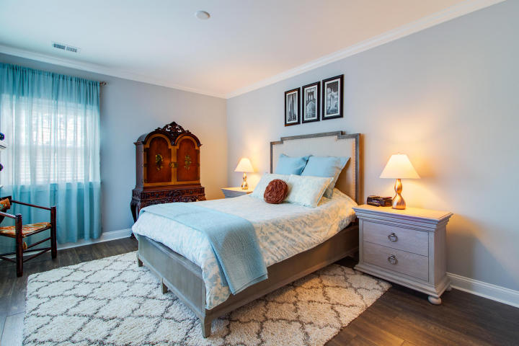
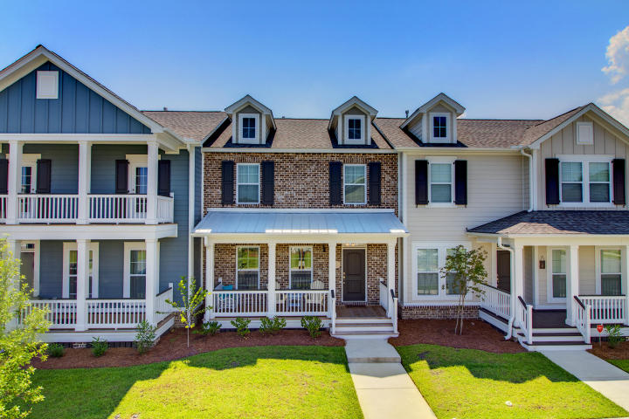
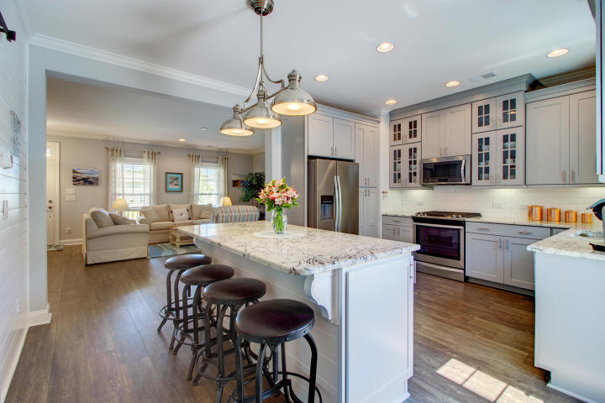
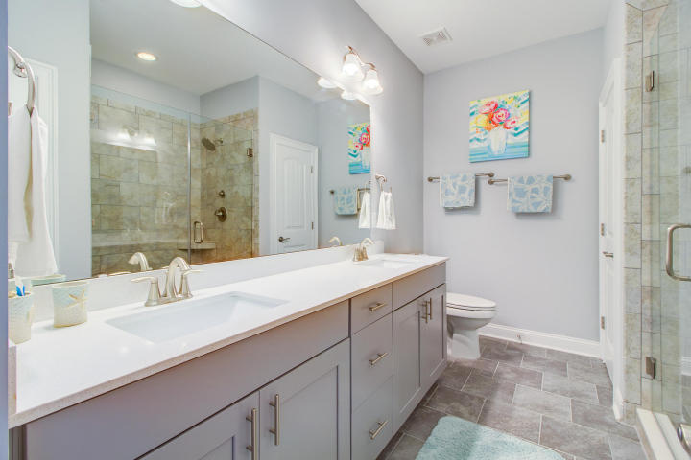
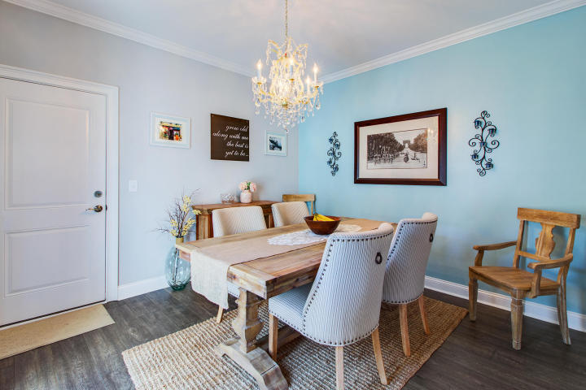
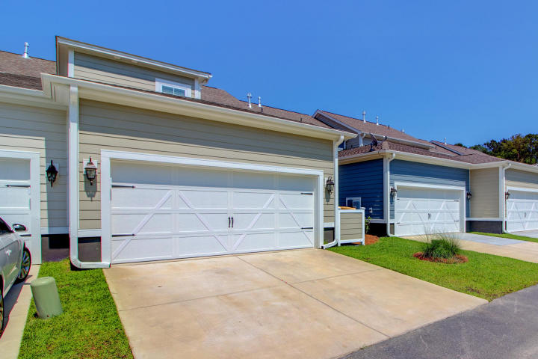
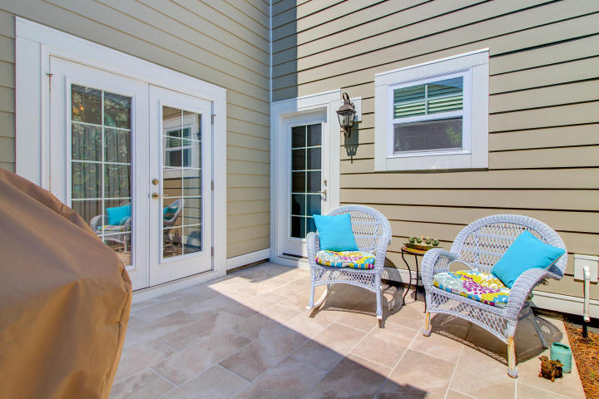
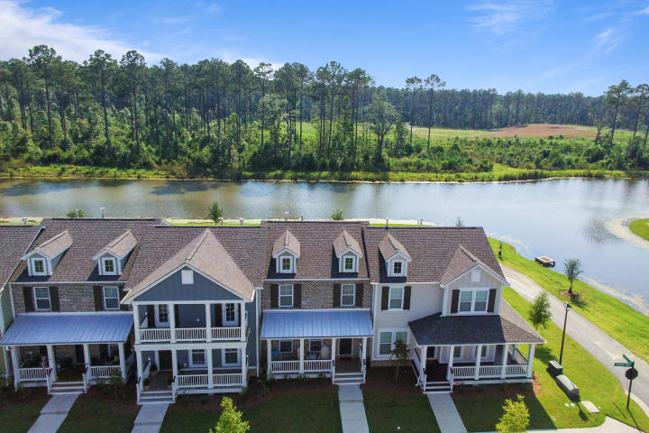


New Listing Premium Pond View Fully Upgraded & Then Some!!
3413 Fairwater Place
Carolina Park
Mount Pleasant, SC 29466
MLS# 18016698 ~ $415,000
This is a truly unique townhome, literally better than new! This one year young, three bedroom townhome is on a premium pond lot and was massively upgraded during construction. The moment you step inside you know you are in a very special home! In addition to the numerous builder upgrades, the current owners have skillfully and artistically enhanced the home further. One feature unique to this townhome is the addition of the gorgeous center island in the kitchen. It provides seating for up to four, plus additional storage and counter space. There is a shiplap wall with stylish barn door in the kitchen which closes off the laundry room from the main living space if desired. In addition, the patio has been enhanced with tile flooring. The garage has epoxy coated flooring, sturdy storage racks, and plenty of room for two cars. This floorpan is flooded with light, open and airy. It includes a gas fireplace, beautiful wood floors throughout the main level and up the stairs into the upstairs landing, currently being used as a home office. All bedrooms are on the second level, with the master on the back side of the home overlooking the pond. The master suite has a large walk in closet and a very luxurious master bath. Complete with double sinks and an elegant oversized shower with dual shower heads, you will feel like you are in a spa in your own home! The guest bedrooms share a bath that is also beautifully finished with tile floors and granite counters. The home has tasteful colors and finishes throughout and the new owner stands to benefit from the enhancements that are already made. Located on the pond in the rear of the community, there is little to no drive by traffic here. Residents in the Carolina Park Townhomes have access to the fantastic amenities including a pool and play park which are both a short walk from home. In addition, Elementary and High School Students can walk or ride bikes to school. Carolina Park is rapidly expanding to include commercial and shopping making this already popular neighborhood increasingly desirable. This is an absolutely move in ready home that is sure to sell quickly.
3D Walk thru tour on MLS or go to
https://my.matterport.com/show/?m=T2jvAiHmY22
Ellen O'Neil
Broker/Owner, ABR, e-PRO, CNE
Charleston Realtor of Distinction
(843) 300-8530
www.EllenONeilProperties.com

