Slide 1
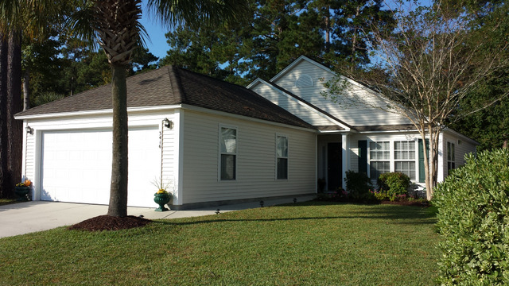
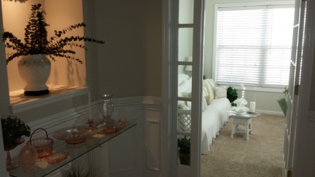
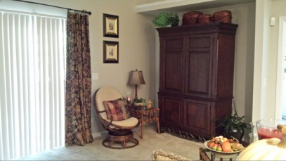
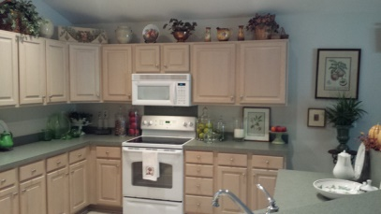
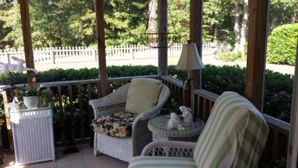
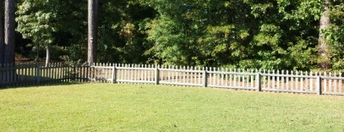

Adorable Turn-Key Home!
3416 Wellesley Court
Park West - Mount Pleasant - MLS# 14028387 - $285,000
This well maintained single level home in Park West is ideally situated on a quiet street. It sits across from a lovely park in the front and has a buffer of trees in the back. The beautiful foyer greets you as you enter into this light and bright home that features an open kitchen with cathedral ceilings in the great room and master bedroom. The kitchen, master bedroom & screened porch all boast newer tile floors which add to the overall appeal of this lovely home. Curtains & drapes do not convey. Neighborhood amenities include a pool, tennis courts, club house & walking trails. The Park West neighborhood is close to retail and professional services including a grocery store, restaurants, medical, dental, and Mt. Pleasant Hospital.
Kurt Seelig
843-906-8528
kurt@seeligrealestate.com

