Slide 1
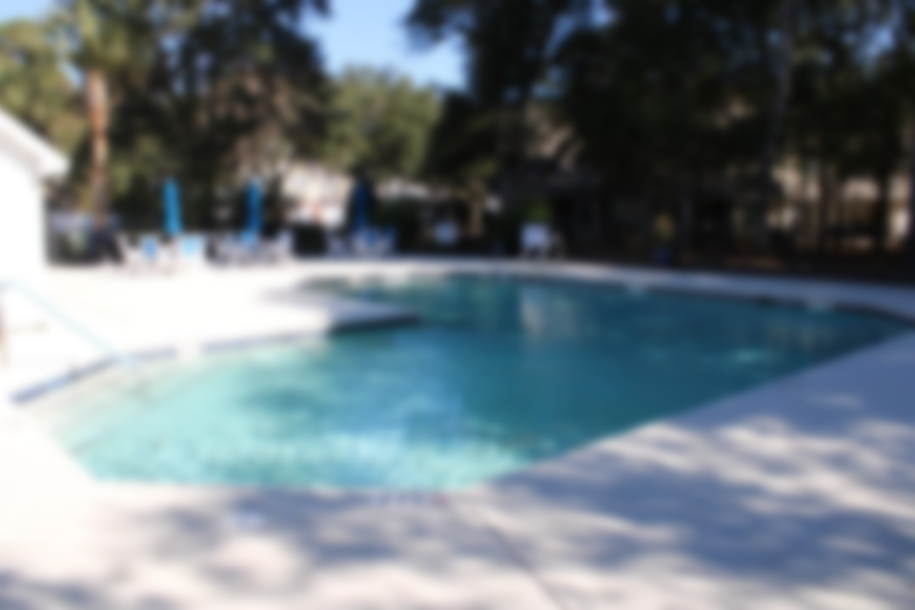
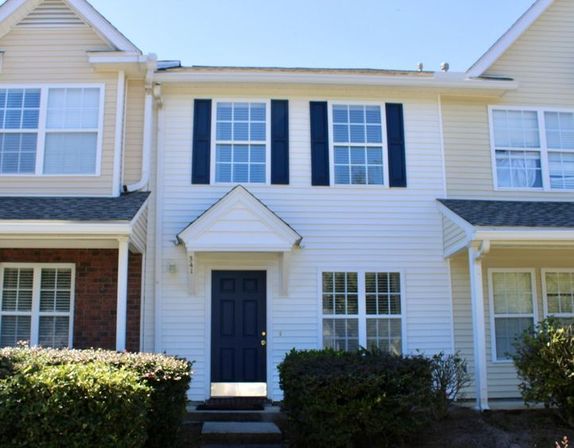
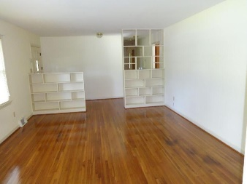
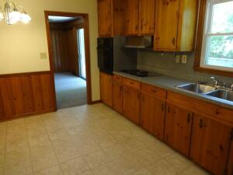
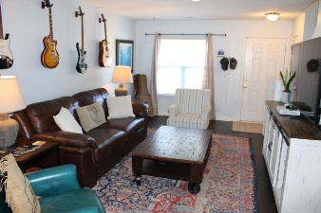
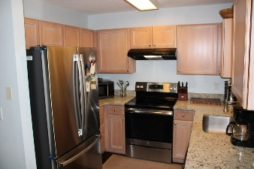
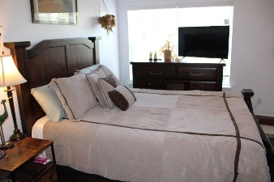
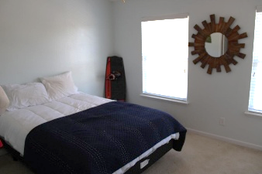
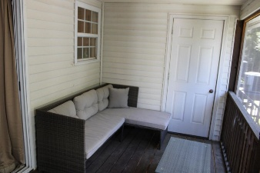

Open House Thursday 11a-2p Check Out This Beautiful New Home And Enjoy A Light Lunch
WONDERFUL TOWNHOME IN SOUGHT AFTER BERESFORD COMMONS
341 Kelsey Boulevard
Charleston, SC 29492 | MLS# 25028572 | $320,000
This quiet community is centrally located just off Clements Ferry road and close to Daniel Island, Park Circle and of course Mt Pleasant and N Charleston. The neighborhood features a community pool and plenty of room for a neighborhood walk. The home is move in ready and features a spacious living room and dining room area, modern kitchen with granite. Upstairs includes two bedrooms and a bath between. Enjoy grilling out and relaxing on the rear screen porch. Please take a look and you will see why homes don't stay on the market long in this great neighborhood.
Frank Thornhill
(843) 224-7997
frank@askfrankrealestate.com
The Boulevard Company, LLC
806 Johnnie Dodds Blvd | Suite 100 Mt Pleasant, SC 29464 www.askfrankrealestate.com

