Slide 1
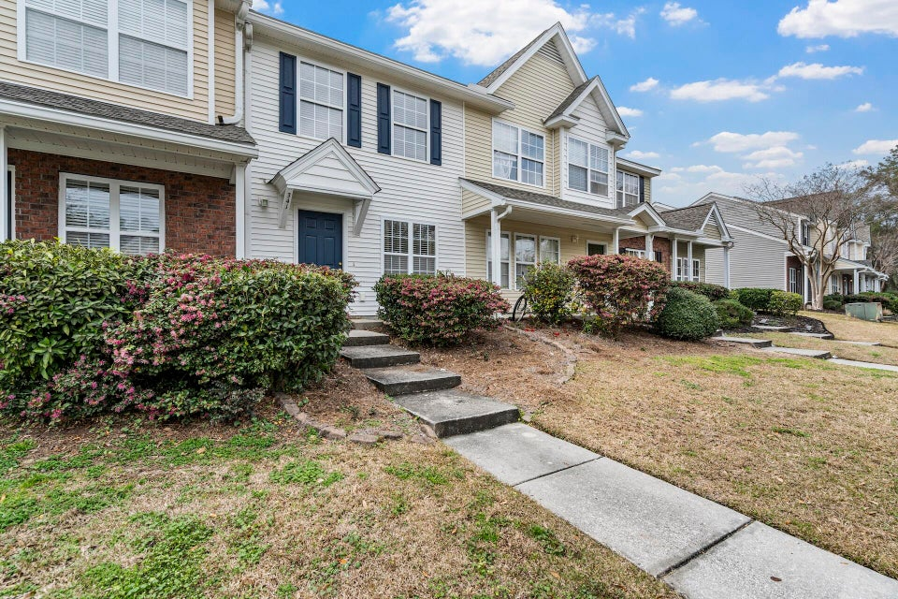
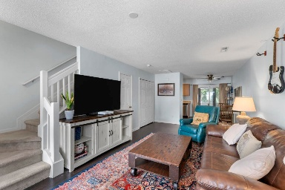
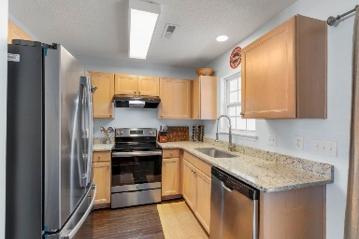
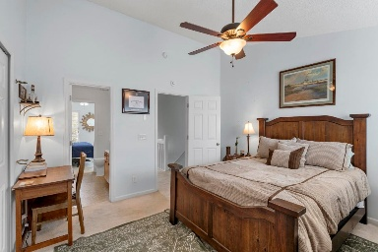
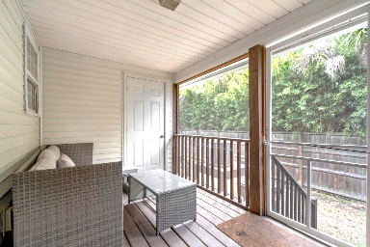
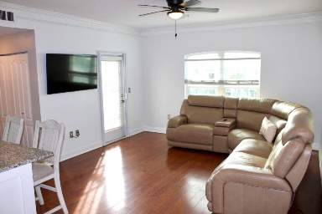
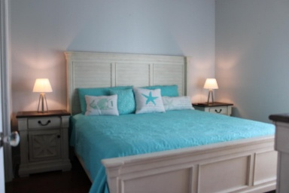
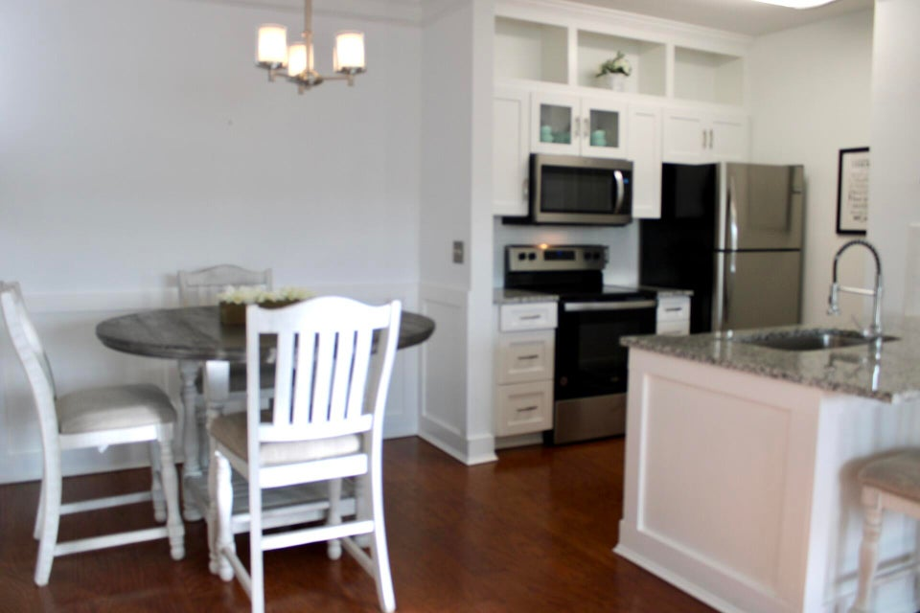
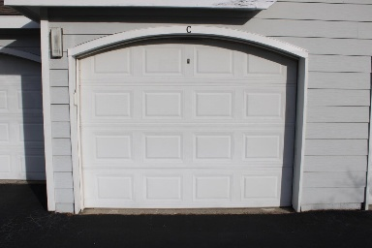
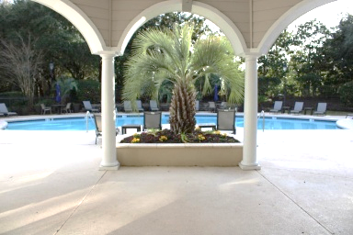

Open House Thursday 11a-2p Check Out This Beautiful New Home And Enjoy A Light Lunch
TOWNHOME OR CONDO...YOUR CHOICE
341 Kelsey Boulevard
Beresford Commons | Charleston, SC 29492 | MLS# 25028572 | $315,000
DEEDED GARAGE!
1300 Park West Boulevard 1010
Park West | Mount Pleasant, SC 29466 | MLS# 25032749 | $297,000
Frank Thornhill
(843) 224-7997
frank@askfrankrealestate.com
The Boulevard Company, LLC
806 Johnnie Dodds Blvd | Suite 100 Mt Pleasant, SC 29464 www.askfrankrealestate.com

