Slide 1
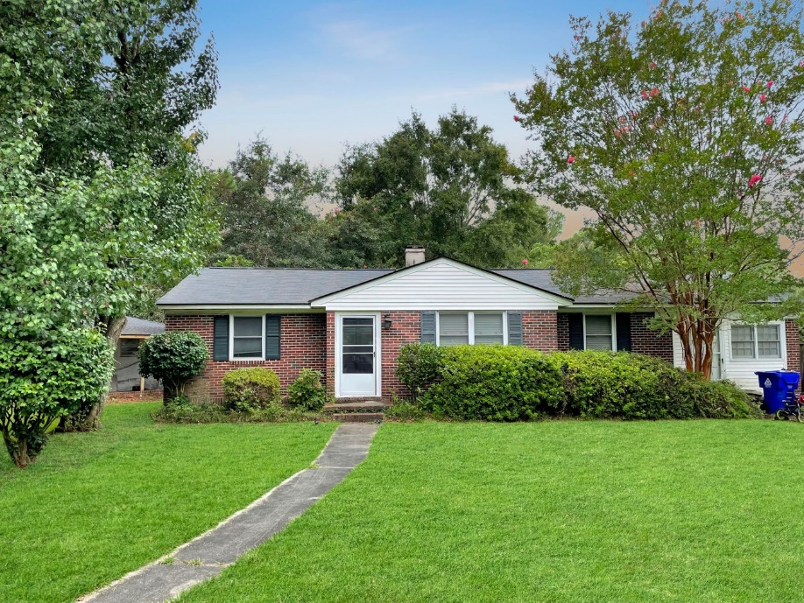
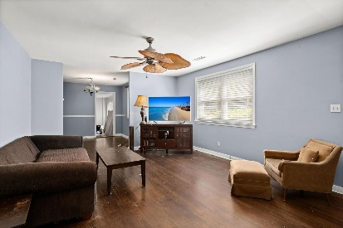
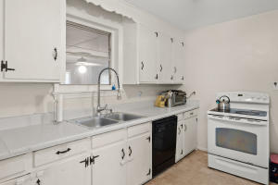
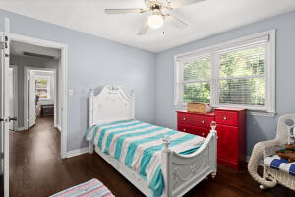
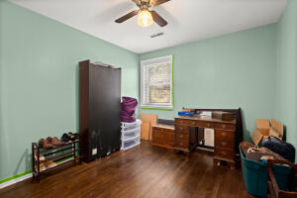
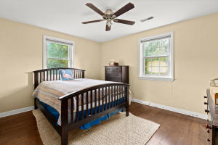
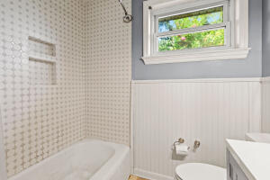
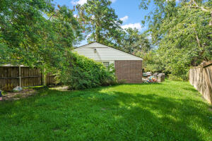
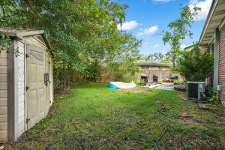



Location, Location, Location!
341 Stinson Drive Air Harbor
Charleston, SC 29407
MLS# 21020956
$359,000
3 Bed | 1 Bath | 1518sf
Wonderful brick ranch in Air Harbor, prime West Ashley with 3 spacious bedrooms and a full bathroom! This corner lot home has had the garage converted into livable space, making it the perfect office space or potential 4th bedroom. The West Ashley greenway is located just around the corner and makes getting out the house for a walk/jog, bike riding, etc extremely convenient. The home has wonderful wood floors and a double gate, which makes storing an RV, boat, or any vehicles in you backyard very easy. Come take a look at this wonderful home today!
Nick Mazzilli (843) 640-5575
nick@nickmcharleston.com www.mavenrealtysc.com
Maven Realty
2180 McMillan Ave
#71672
Charleston, SC 29405

