Slide 1
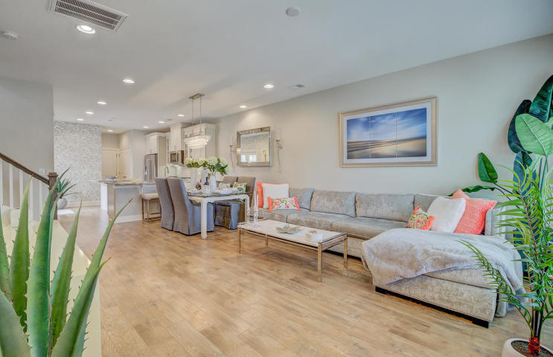
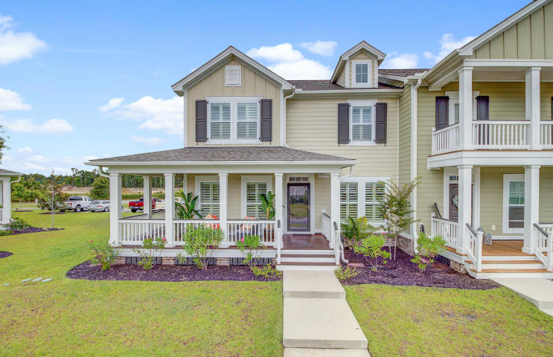
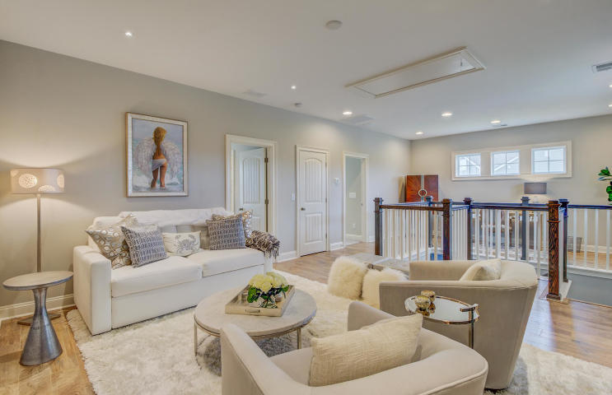
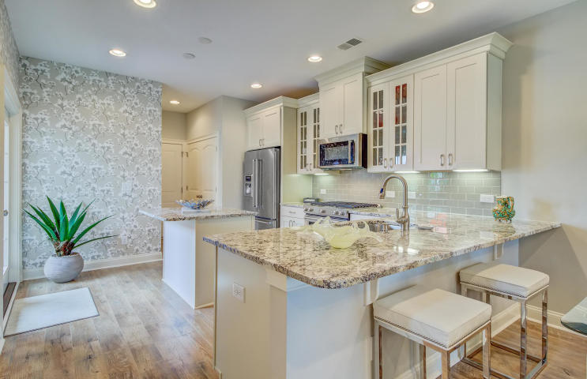
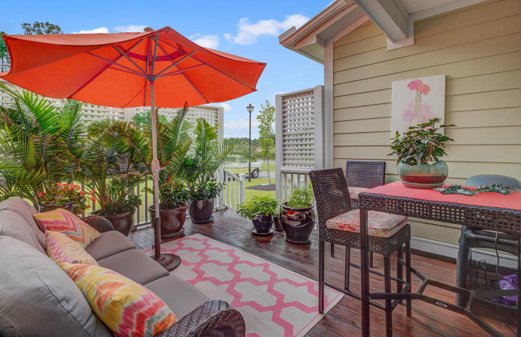
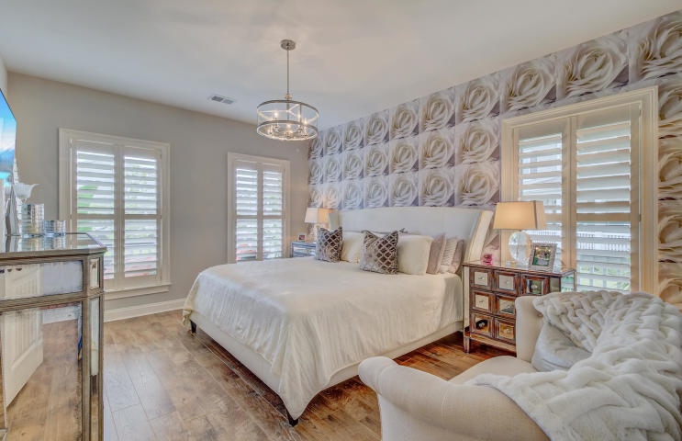
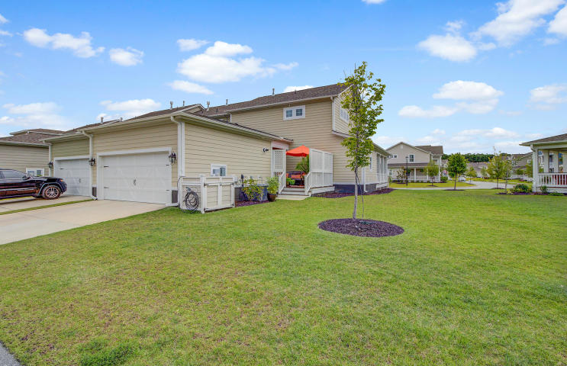


JUST LISTED! Better Than New Townhome in popular Carolina Park
3421 Fairwater Place
Carolina Park
Mount Pleasant, SC 29466
MLS# 20016780 | $485,000
You have found a very special and truly "better than new" townhome in one of Mt. Pleasant's most popular communities-Carolina Park! This is the coveted Campbell plan- a desirable end unit with the downstairs master that is rarely available. The huge wrap around porch makes the first great impression. Upon entry you will immediately appreciate the exquisite finishes and decor in this stunning, heavily upgraded home. Hardwood floors are found throughout the main level. They carry upstairs into the huge loft and bonus room, too. The kitchen is not only elegant, but the chef in your household will love preparing meals here. There is a gas range and plenty of counter space, including a center island for meal prep. The granite is stunning and the stainless steel appliances complete the beautiful look. A truly amazing pantry is a stand out feature- huge, with shelving added for efficiency and additional storage under the staircase. The master suite is located on the main level. Large enough for a sitting area, it is a special retreat for the owner. The spa shower is a beautiful upgrade and new marble counters with designer mirror add to the beauty of the master bath. As you proceed through the home you are sure to appreciate the upgrades throughout. Plantation shutters add to the classy feel of the home and the upgraded lighting selected for each room enhance its beauty. The end unit is sunny and light. Situated on a prime pond lot, storm doors with full glass were installed on the front and rear of the home to allow additional light to flow in and provide views of the pond from the kitchen. When you head upstairs you will see that the wood floors continue in this bright open second level, perfect for a home office and additional family room. Additional LED lighting was added to the bonus area and guest bedrooms. The jack and jill bath between the guest bedrooms boasts new marble counter tops and a designer mirror like the master- this owner has taken great care in creating a lovely environment for guests to enjoy. The home is impeccable! It shows like a model. The outdoor living spaces, including the wrap around porch and additional side porch off the kitchen are comfortable, attractive spaces to enjoy nearly year round with the amazing weather we are blessed with here in Charleston! The patio is a private space to enjoy morning coffee or a beverage of choice at the end of the day in peace and solitude. A large side yard will be a joy to share with children and pets. The two car garage is accessed on the rear of the home. This garage has been finished with trim and painted. Carolina Park residents enjoy first class amenities. The swimming pool complex is a crowd pleaser with lap lanes for exercise and water features for the little ones to enjoy. Adjacent to the pool is a stunning fireplace and covered eating area overlooking the tennis courts and play park. There are expansive grassy areas that make for great open spaces to play games with the kids and exercise the dogs. Students attend the highly rated schools that make Mt. Pleasant attractive to families. Carolina Park is where the new Mt. Pleasant Library is located and is home to Costco as well. Situated adjacent to Mt. Pleasant hospital and a short ride to a multitude of stores and restaurants, this location simply cannot be beat. One can be at the beach in 20 minutes and in Historic Downtown Charleston in under 30 minutes. All in all you will be hard pressed to find a more classy, elegant townhome to treasure as your own. Schedule your appointment to tour this one of a kind townhome while the opportunity lasts. Check out the virtual tour here: https://my.matterport.com/show/?m=G9sJhh5wKUe
Ellen O'Neil
Broker/Owner, ABR, e-PRO, CNE
Charleston Realtor of Distinction
(843) 300-8530
www.EllenONeilProperties.com

