Slide 1
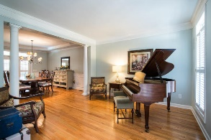
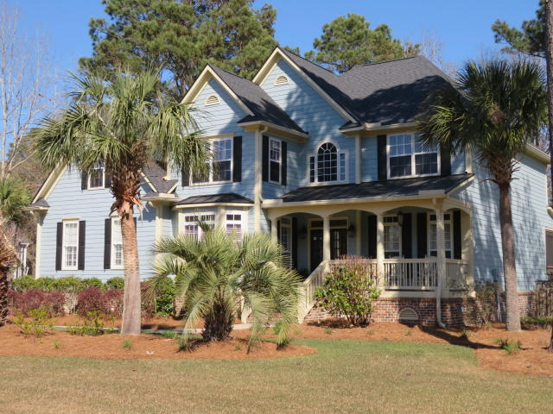
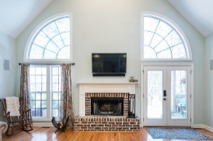
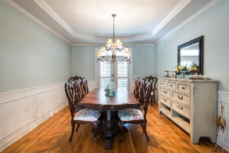
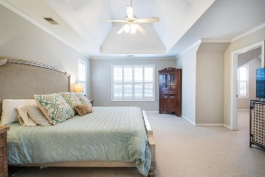
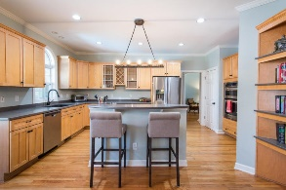
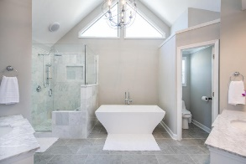
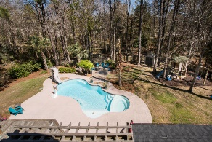
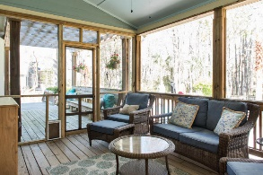
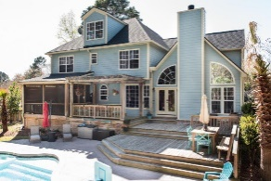
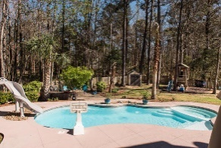
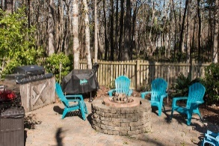

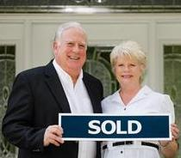
3429 Shagbark Circle Mt Pleasant ~ MLS# 18007128 ~ $717,900
OPEN HOUSE SUNDAY APRIL 8TH 2-4 PM
Amazing Home with Oasis for a Backyard. Current Owners have spared no expense maintaining yard and home by adding new roof, painting exterior, Upgrading ALL baths and refinishing hardwood floors. The unique floor plan provides wonderful flow and flexibility for formal as well as casual entertaining. The front study can be used as a downstairs guest room along with hall powder room. The living room can be used as a piano room and/or second den/ game room. Then there is the elegant formal dining room just off the kitchen. Large open kitchen with Island and Breakfast room all opening to the huge vaulted Family room with fireplace and custom bookcases. Fabulous Master bedroom suite and custom bath along with sitting room and much more. Two upstairs (Jack and Jill) bedrooms share a bathroom while 4th guest bedroom has it's own private bathroom. There is a walk up staircase leading to the third level which has 492 square feet of floored space great for storage or which could be easily finished to expanded to heated and cooled square footage for additional bedrooms and bath or hobby rooms. Now for the OUTDOOR OASIS in the Backyard: You can enter the large fenced rear yard from the side yard or from your den. Your breath will be taken away by your first visualizations of the gleaming salt water pool with slide along with the tasteful landscaping and decking surrounding the pool and the custom outdoor barbecue kitchen area and custom fire pit. This all makes a perfect setting for those outdoor parties. The large wooden deck with benches and huge screen porch with tables and chairs are wonderful focal points to see all the backyard activities including children playing in the custom playhouse. All this while adults enjoy cool beverages and hot food prepared from the indoor kitchen or from the outdoor grilling station. Someone has already gone to a lot of trouble and expense to make this home and yard a real paradise for some lucky family. Do not miss out on this one of a kind opportunity to enjoy a home and lifestyle afforded only a few.
$550,000
Tommy Lovett Tommy - (843) 442-1276
tlovett@carolinaone.com www.tommylovettrealestate.com
Carolina One Real Estate
628 Long Point Rd.
Mt Pleasant, SC 29464-3032

