Slide 1
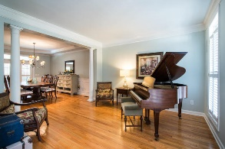
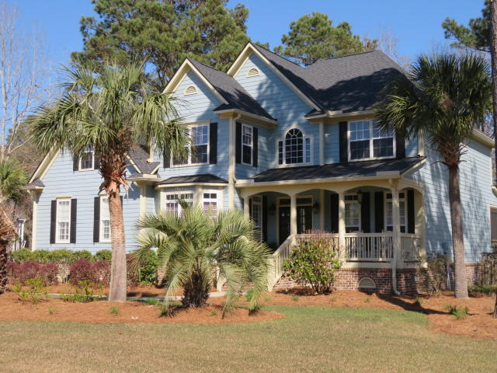
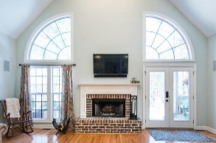
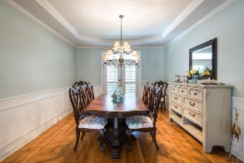
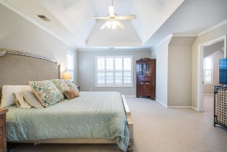
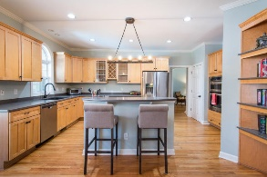
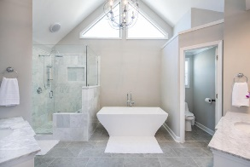
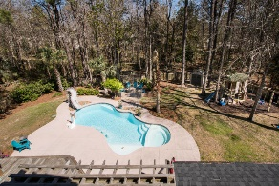
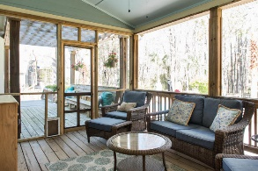
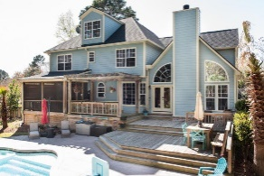
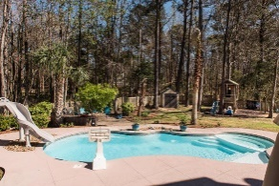
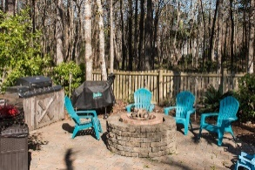

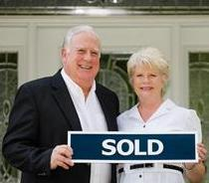
3429 Shagbark Circle
Mt Pleasant ~ MLS# 18007128 ~ $689,900
OPEN HOUSE THIS WEEKEND!
Saturday June 2nd 2-4pm
Owner has made major price adjustments along with offering considerable buyer incentives !!! award winning design provides wonderful living spaces plus unfinished walk up third floor. Hardwood flooring on first level, open kitchen with island and breakfast room, vaulted family room with fireplace and bookcases, nice full front porch, entry foyer with powder room, separate study, living room, formal dining room, huge master bedroom suite with separate dressing/ exercise room or office plus magnificent vaulted custom master bathroom, guest bedroom with bath and two bedrooms share a bath. The backyard is an oasis with large wooden deck and screen porch overlooking fenced yard with landscaping surrounding in ground salt water pool with slide, firepit, outdoor kitchen, custom playhouse and more!!
Two upstairs (Jack and Jill) bedrooms share a bathroom while 4th guest bedroom has it's own private bathroom. There is a walk up staircase leading to the third level which has 492 square feet of floored space great for storage or which could be easily finished to expanded to heated and cooled square footage for additional bedrooms and bath or hobby rooms. Now for the OUTDOOR OASIS in the Backyard: You can enter the large fenced rear yard from the side yard or from your den. Your breath will be taken away by your first visualizations of the gleaming salt water pool with slide along with the tasteful landscaping and decking surrounding the pool and the custom outdoor barbecue kitchen area and custom fire pit. This all makes a perfect setting for those outdoor parties. The large wooden deck with benches and huge screen porch with tables and chairs are wonderful focal points to see all the backyard activities including children playing in the custom playhouse. All this while adults enjoy cool beverages and hot food prepared from the indoor kitchen or from the outdoor grilling station. Someone has already gone to a lot of trouble and expense to make this home and yard a real paradise for some lucky family. Do not miss out on this one of a kind opportunity to enjoy a home and lifestyle afforded only a few.
$550,000
Tommy Lovett
Tommy - (843) 442-1276
tlovett@carolinaone.com
www.tommylovettrealestate.com
Carolina One Real Estate
628 Long Point Rd.
Mt Pleasant, SC 29464-3032

