Slide 1
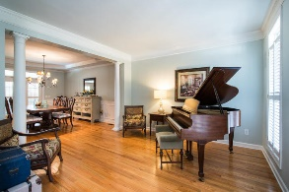
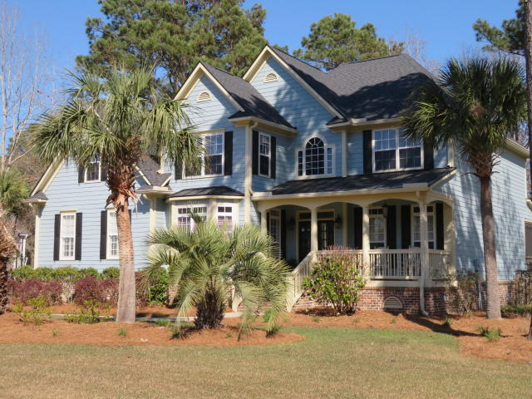
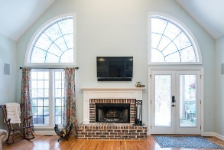
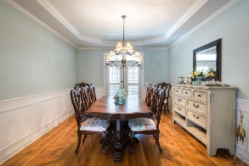
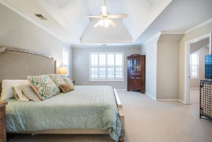
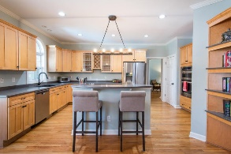
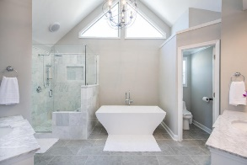
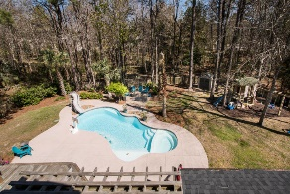
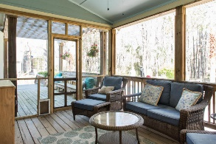
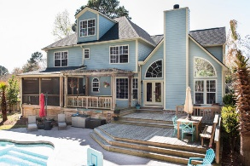
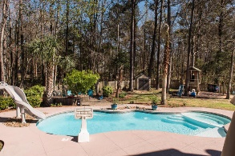
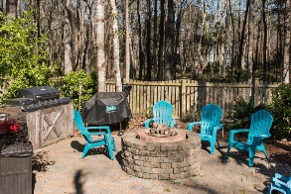

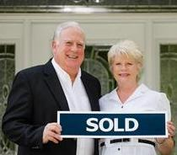
3429 Shagbark Circle
Mt Pleasant ~ MLS# 18007128 ~ $719,900
Great Home In Dunes West Just Listed
This is an amazing home with an Oasis for a backyard. The home has been meticulously taken care of with new architectural roof and freshly painted exterior. The master bathroom along with the other bathrooms have all been upgraded and hardwoods floors refinished. The unique floor plan provides wonderful flow and flexibility for formal as well as casual entertaining. The front study can be used as a downstairs guest room with hall powder room. The living room can be used as a piano room and/or second den/ game room. Then there is the elegant formal dining room just off the kitchen. Large open kitchen with island and breakfast room all opening to the huge vaulted family room with fireplace and custom bookcases. Fabulous Master bedroom suite and custom bath and sitting room and much more. Two upstairs (Jack and Jill) bedrooms share a bathroom while 4th guest bedroom has it's own private bathroom. There is a walk up staircase leading to the third level which is 492 square feet of floored space great for storage or which could be easily finished to expanded to heated and cooled square footage for additional bedrooms and bath or hobby rooms. Now for the OUTDOOR OASIS in the Backyard: You can enter the large fenced rear yard from the side yard or from your den. Your breath will be taken away buy your first impressions of the beautiful salt water pool with slide along with the tasteful landscaping surrounding the pool , the custom outdoor barbecue kitchen area and custom fire pit. This all makes a perfect setting for those outdoor parties. The large wooden deck with benches and huge screen porch with tables and chairs are wonderful focal points to see all the backyard activities including children playing in the custom playhouse. All this while adults enjoy cool beverages and hot food prepared from the indoor kitchen or from the outdoor grill. Someone has already gone to a lot of trouble and expense to make this home and yard a real paradise for some lucky family.
$550,000
Tommy Lovett
Tommy - (843) 442-1276
tlovett@carolinaone.com
www.tommylovettrealestate.com
Carolina One Real Estate
628 Long Point Rd.
Mt Pleasant, SC 29464-3032

