Slide 1
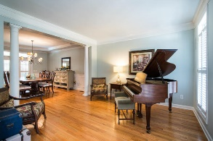
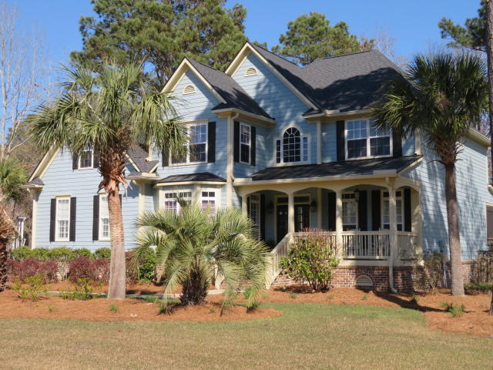
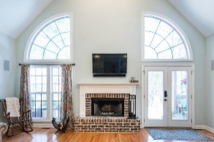
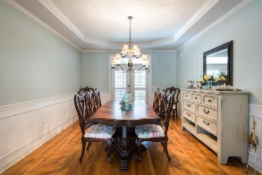
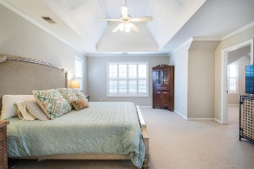
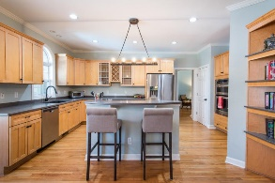
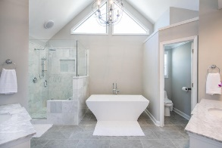
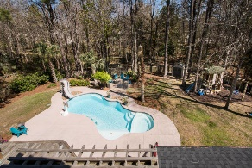
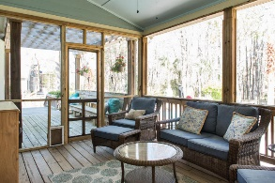
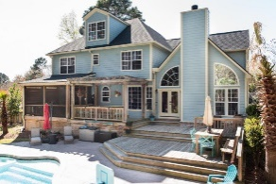
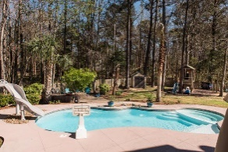
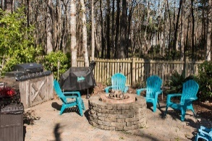

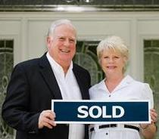
3429 Shagbark Circle Mt Pleasant ~ MLS# 18007128 ~ $699,900
CUSTOM HOME WITH SALT WATER POOL IN DUNES WEST
$10,000 Price Reduction
MAJOR PRICE ADJUSTMENT FOR CARPET AND KITCHEN COUNTER TOP UPGRADES AND/OR CLOSING COST: Current Owners have spared no expense to make this home the best that it can be by insuring all repairs have been completed on home and pool, property being maintained and fully warranted, a new roof was installed, exterior painted,floors refinished, all baths upgraded, yard landscaped along with installing playground, outdoor kitchen and fire pit and storage shed. Pool was changed over to Salt Water System with Sand Filter in 2015. Award winning floor plan for design and flexibility. Entry Foyer, Study, LR, Formal DR, Kitchen with Island, Breakfast Room, Vaulted Family Room, Powder Room, Open Deck,Screened Porch,Master Bedroom Suite w/separate office/exercise room and Master Bathroom to die for. Two upstairs (Jack and Jill) bedrooms share a bathroom while 4th guest bedroom has it's own private bathroom. There is a walk up staircase leading to the third level which has 492 square feet of floored space great for storage or which could be easily finished to expanded to heated and cooled square footage for additional bedrooms and bath or hobby rooms.Now for the OUTDOOR OASIS in the Backyard: You can enter the large fenced rear yard from the side yard or from your den. Your breath will be taken away by your first visualizations of the gleaming salt water pool with slide along with the tasteful landscaping and decking surrounding the pool and the custom outdoor barbecue kitchen area and custom fire pit. This all makes a perfect setting for those outdoor parties. The large wooden deck with benches and huge screen porch with tables and chairs are wonderful focal points to see all the backyard activities including children playing in the custom playhouse. All this while adults enjoy cool beverages and hot food prepared from the indoor kitchen or from the outdoor grilling station. Someone has already gone to a lot of trouble and expense to make this home and yard a real paradise for some lucky family. Do not miss out on this one of a kind opportunity to enjoy a home and lifestyle afforded only a few.
$550,000
Tommy Lovett Tommy - (843) 442-1276
tlovett@carolinaone.com www.tommylovettrealestate.com
Carolina One Real Estate
628 Long Point Rd.
Mt Pleasant, SC 29464-3032

