Slide 1
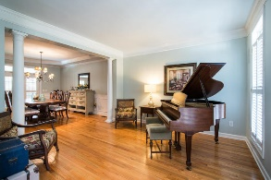
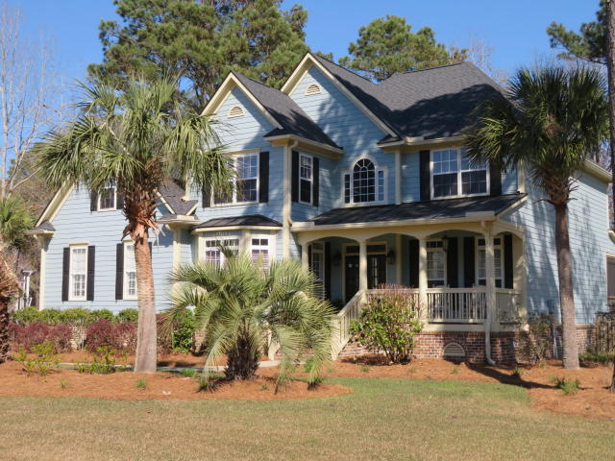
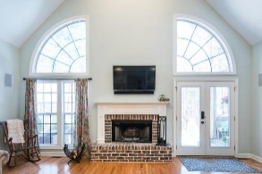
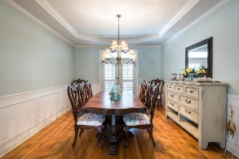
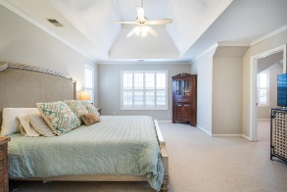
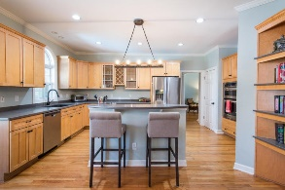
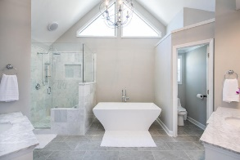
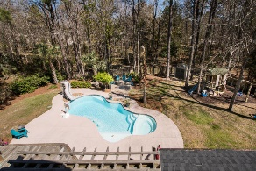
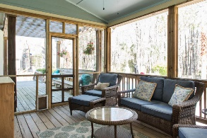
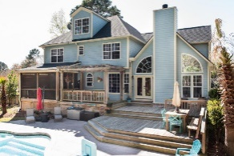
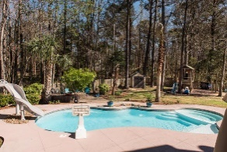
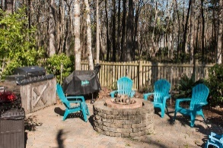

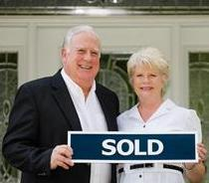
3429 Shagbark Circle Mt Pleasant ~ MLS# 18007128 Was $739,900 … NOW OFFERING AT $689,900
WOW !!! ANOTHER PRICE ADJUSTMENT
$689,000 With Incentives Towards Upgrades/Closing Costs
$550,000
MAJOR PRICE ADJUSTMENT FOR THIS EXCEPTIONAL HOME WITH BACKYARD OASIS!!
This property has been properly maintained and fully warranted, a new architectural 50 year roof was installed 2 years ago with gutter system, exterior painted, hardwood floors refinished, all baths upgraded, yard landscaped along with installing playground, outdoor kitchen, fire pit and storage shed. Pool was changed over to Salt Water System with Sand Filter in 2015. Award winning floor plan for design and flexibility. Entry Foyer, Study, LR, Formal DR, Kitchen with Island, Breakfast Room, Vaulted Family Room with fireplace and built in bookcases, Powder Room, Open Deck, Screened Porch, Master Bedroom Suite w/separate office/exercise room, magnificent vaulted Master Bathroom, walk up third story and more.
Tommy Lovett Tommy - (843) 442-1276
tlovett@carolinaone.com www.tommylovettrealestate.com
Carolina One Real Estate
628 Long Point Rd.
Mt Pleasant, SC 29464-3032

