Slide 1
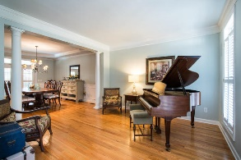
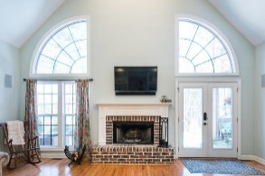
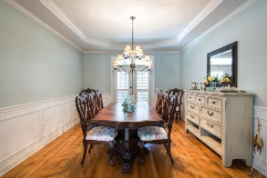
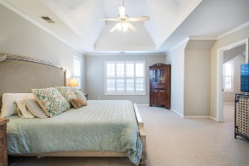
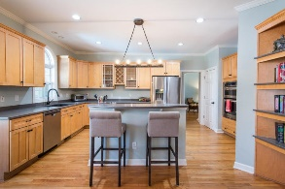
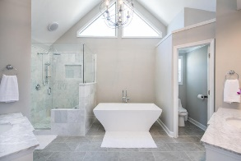
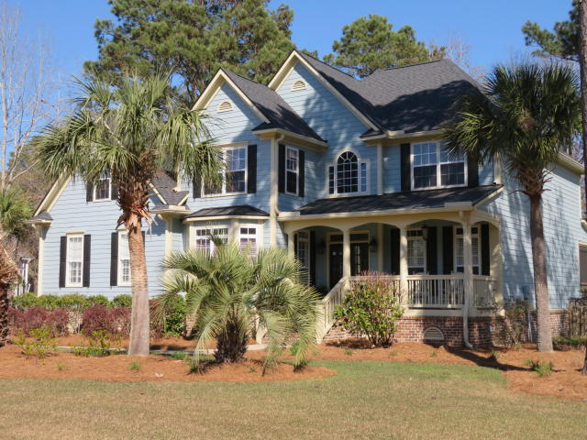
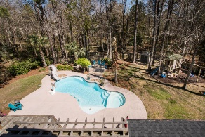
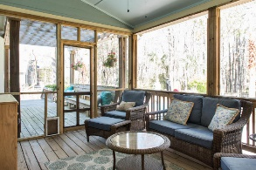
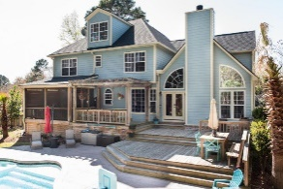
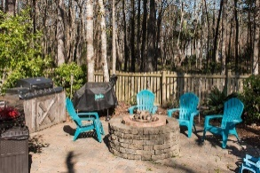

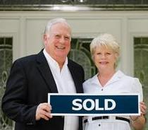
3429 Shagbark Circle
Mount Pleasant ~ MLS# 18007128
WAS $729,900...NOW OFFERING AT $679,000
Open House Saturday June 16th from 11a-2p
OWNER SAYS SELL!!!! $50,000 PRICE REDUCTION!!!!
Relaxing Outdoor Oasis & Amazing Entertainment Opportunities
$550,000
OWNER HAS MADE MAJOR IMPROVEMENTS AND PRICE ADJUSTMENTS MAKING THIS HOME A GREAT BUY FOR SOMEONE. THIS AWARD WINNING HOUSE DESIGN HAS STUDY, LR, FORMAL DR , SPACIOUS OPEN KITCHEN WITH ISLAND AND BREAKFAST ROOM W/BAY OPEN TO HUGE VAULTED FAMILY ROOM WITH FIREPLACE. WONDERFUL MASTER BEDROOM SUITE WITH SEPARATE DRESSING/ EXERCISE ROOM OR OFFICE PLUS MAGNIFICENT VAULTED CUSTOM MASTER BATHROOM WITH TILE SHOWER AND SEPARATE CUSTOM TUB,DOUBLE VANITIES AND DOUBLE WALK IN CLOSETS, PLUS A GUEST BEDROOM WITH BATH AND TWO BEDROOMS SHARE A BATH.THEN THERE IS THIRD FLOOR WALK UP WHICH IS UNFINISHED. BACKYARD IS AN OASIS WITH LARGE WOODEN DECK AND SCREEN PORCH OVERLOOKING FENCED YARD WITH LANDSCAPING SURROUNDING IN GROUND SALT WATER POOL WITH SLIDE, FIRE PIT, OUTDOOR KITCHEN, CUSTOM PLAYHOUSE AND MORE.
Tommy Lovett
Tommy - (843) 442-1276
tlovett@carolinaone.com
www.tommylovettrealestate.com
Carolina One Real Estate
628 Long Point Rd.
Mt Pleasant, SC 29464-3032

