Slide 1
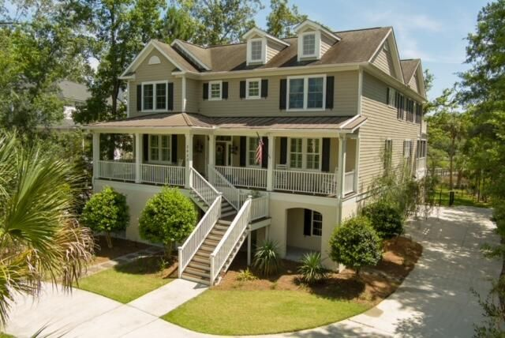
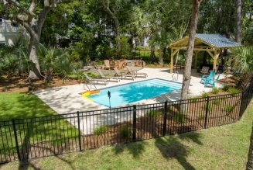
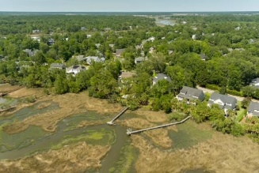
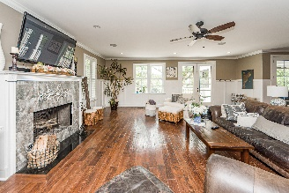
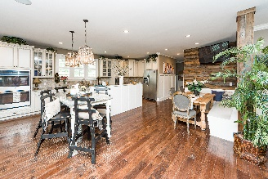
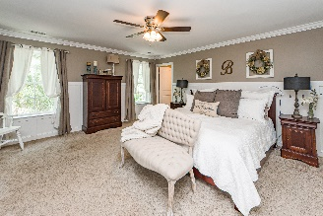
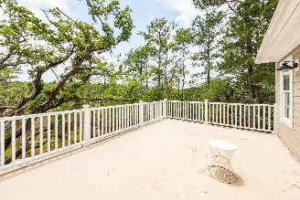
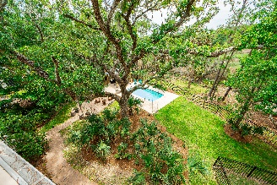
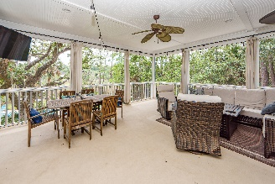
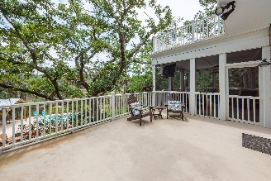
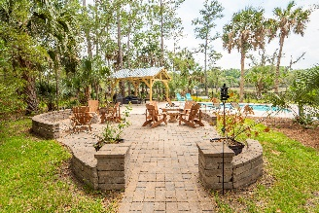



CUSTOM BUILDERS HOME!! TAKE YOUR CLIENTS TO SEE THIS MT. PLEASANT FIREWORK!
3432 Henrietta Hartford Road
Park West
Mount Pleasant, SC 29466
MLS# 22016968
$2,280,000
CUSTOM Builders HOME!! Here's your to opportunity to purchase a beautifully designed Builders personal home that not only has an incredibly functional floor plan, but a perfect space for everything! This three level elevated Lowcountry Estate is situated on a large private wooded lot with magnificent Oaks covering over half of an acre! Sit on your back porch or lounge by the newly constructed saltwater pool and enjoy Charleston sunsets and breathtaking Marsh views! Or grab your paddle board or Kayak for an excursion down Toomer Creek from the shared dock! This stunning property truly has it all!! Some of the most notable features include: Large plank durable wood floors throughout. Shiplap and pallet feature walls, incredibly spacious open concept kitchen/den area with a huge island. 2 Built in seating areas in the eat in kitchen, Gas cooktop, double ovens, and an oversized pantry, 3 car garage and fully finished insurable lower level! The main level of this pristine property features a private downstairs office, large mudroom, Living room (currently a man cave/tv room), 3 stop elevator, and even Art room! Upon following the flowing hardwood staircase and spacious hallways upstairs you will find 6 total bedrooms with their own private baths, including the gorgeous master suite. The private master suite with its neutral palate is the perfect retreat to relax and unwind. With tile floors, granite countertops, and a large vanity, this retreat is complete with a fully glassed in frameless shower. Enjoy the giant two-sided master closet, an ideal set up for two designated areas and an expansive wardrobe. If you're searching for storage this home has closets galore, plenty of storage space throughout the home with oversize closets, and in the elevated three car garage! The garage level of this home is fully finished with its own private entrance and half bath, it is fully insurable, heated and cooled and boasts a den, and game room/playroom with the perfect area for a kids play, or an ideal set up for the ultimate man cave! The possibilities with this space are endless! It could be used for an In-law Suite or 7th bedroom! It is conveniently connected to the massive three car garage which leads out to the gorgeous backyard and pool oasis. The large tree canopy allows privacy while swimming in your pool and taking in the gorgeous views from the marsh! Enjoy the outdoors sitting on the rocking chair front porch, oversized large rear screen porch, or out by the patio and crystal clear blue pool. The saltwater pool was just installed in 2022, as well as the covered patio/outdoor gazebo which could be easily converted to an outdoor kitchen. This area is a perfect place to host gatherings and relax in your private yard enjoying a Lowcountry sunset. For added convenience there is a private outdoor shower just outside the garage. The large U-shaped driveway provides extensive parking and flexibility. Park West Neighborhood features a community clubhouse, large tennis facility, 1 large kids pool, 1 Large lap pool with open air pavilion and picnic tables, walking/biking trails, playgrounds, allows golf carts, and there is even a neighborhood swim team! The home is zoned for, and just a few miles from the award winning Mount pleasant schools and recreation department. And if you are an avid golfer there are 3 desirable community golf courses in close proximity! Don't let this amazing property get away!! Make an offer today to call this home yours!
3D Matterport Tour: https://charlestonvirtualhomes.com/2220268
Chrissy Strickland 843-906-5553
chrissyresiderealestate@gmail.com www.residerealestatellc.com
Reside Real Estate LLC
155 Wingo Way Unit 421 Mt. Pleasant, SC 29464

