Slide 1
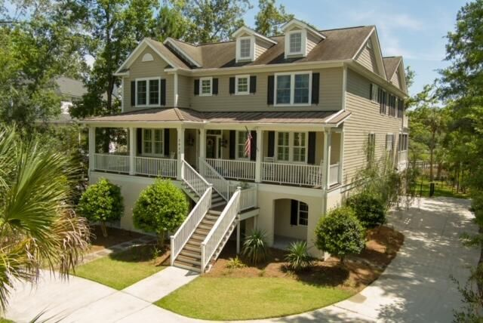
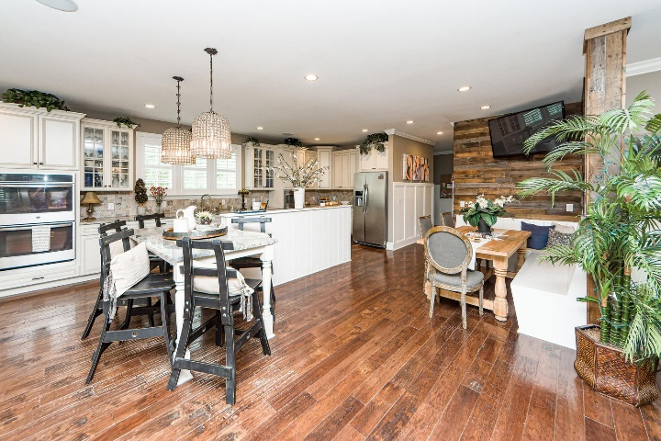
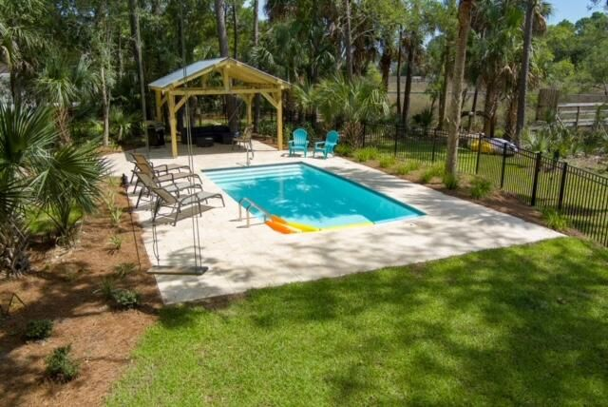
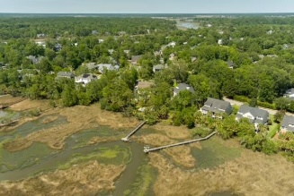


OPEN HOUSE THIS WEEKEND AGENTS ONLY FRIDAY :: PUBLIC SUNDAY :: 12-2 BOTH DAYS
3432 Henrietta Hartford Road
Park West
Mount Pleasant, SC 29466
MLS# 22016968
$1,980,000
DON'T MISS THIS ONE!!
Builders personal home
New saltwater pool and outdoor Kitchen/Patio area just installed in 2022
Outdoor shower
Fully fenced in yard
Huge private lot
Shared dock with Lift
3 stop elevator
Fully finished insurable lower level
Marshviews and gorgeous sunsets
Personal Furniture / home items negotiable
6 Bedrooms
Huge Master closet
Huge U shaped driveway with TONS of parking space
Award winning school zone
Awesome neighborhood amenities!
Make an offer today to call this home yours!
3D Matterport Tour: https://charlestonvirtualhomes.com/2220268
Chrissy Strickland 843-906-5553
chrissyresiderealestate@gmail.com www.residerealestatellc.com
Reside Real Estate LLC
155 Wingo Way Unit 421 Mt. Pleasant, SC 29464

