Slide 1
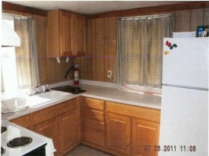
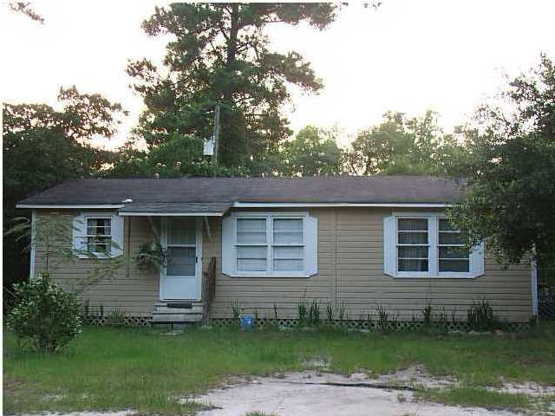
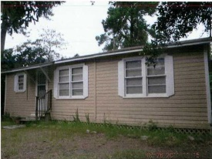
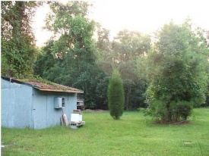
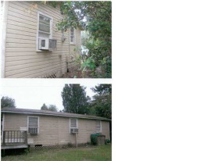


Future Investment Property
3433 S Live Oak Dr
Moncks Corner, SC 29461
MLS# 1500624
$114,000
1014 sq ft home, Commercial/Rental investment or great for office park for new proposed hospital going in less than a 1/4 down the road. One of the Closest available properties to Carnes Crossroads. Great potential to buy now. Home sold as is condition. The kitchen was remodeled with new appliances and cabinets and the bathroom was also remodeled. 2 bedroom, kitchen, bathroom, large living room and dining room. Huge back yard.
Connie White, Broker
C: 843-532-3356
conniesyouragent@gmail.com
Charleston Homes
111 Spring Hall Dr
Goose Creek, SC 29445

