Slide 1
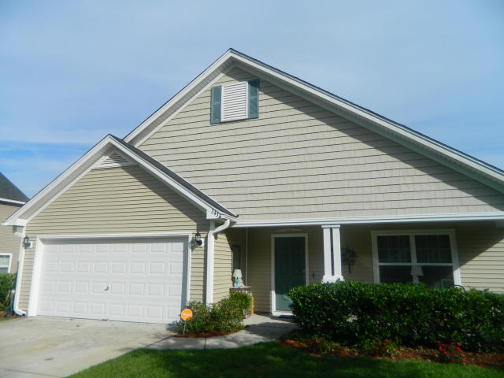
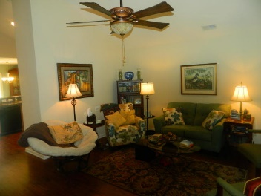
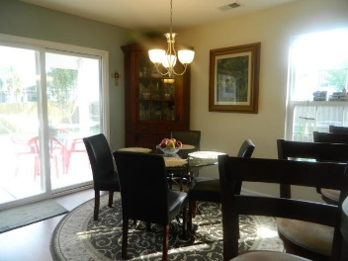
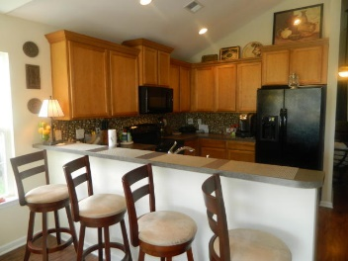
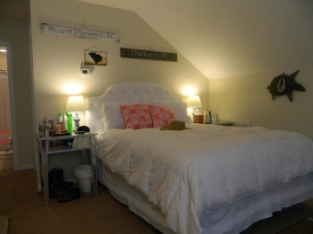
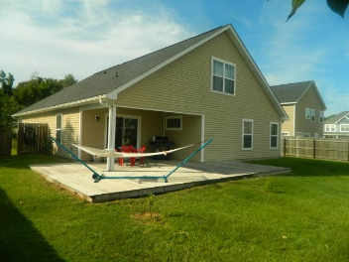
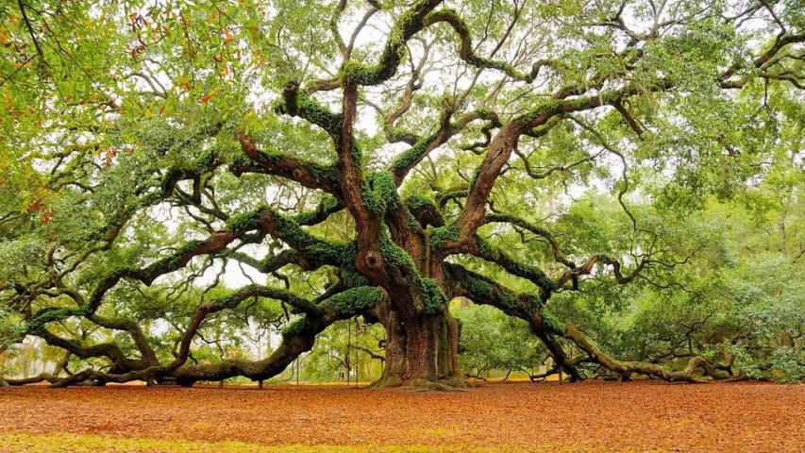

3435 Thorpe Constatine Avenue
Staffordshire ~ Johns Island ~ MLS# 17021777 ~ $269,000
Open House Saturday 1-5 & Sunday 10-2
This well maintained home offers an expansive floor plan consisting of 4 bedrooms 3 baths , dual masters up and down! over 2,000 sq ft in the heart of growing Johns Island! With the expansion of the Stonoferry and widening of the roads this gem will provide the best investment for the right family! Very near Main Rd and the infamous Angel OAK tree you won't find a deal like this ! Priced to move and well under the average price per sq ft this home won't last long! With a very Meticulously cared for lawn and lots of green space this yard is amazing for entertaining guests! Fully integrated sound system in the kitchen as well security system with electronic door locks, camera at the front and even a double car garage this home is the ideal family plan and provided piece of mind.
Chip Streeter
(843) 300-8797
chip.streeter@cbcarolinas.com
Coldwell Banker Residential Brokerage
1127 Queensborough Blvd
Mount Pleasant, SC 29464

