Slide 1
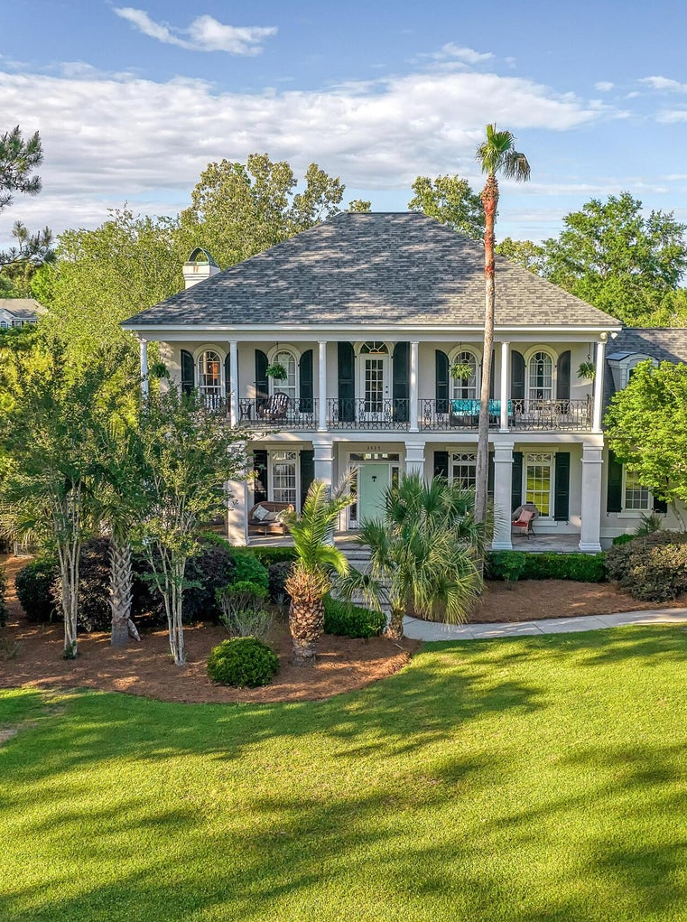
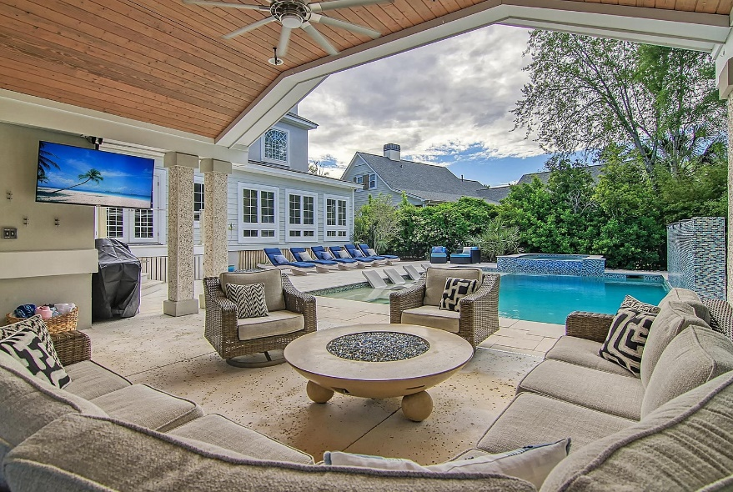
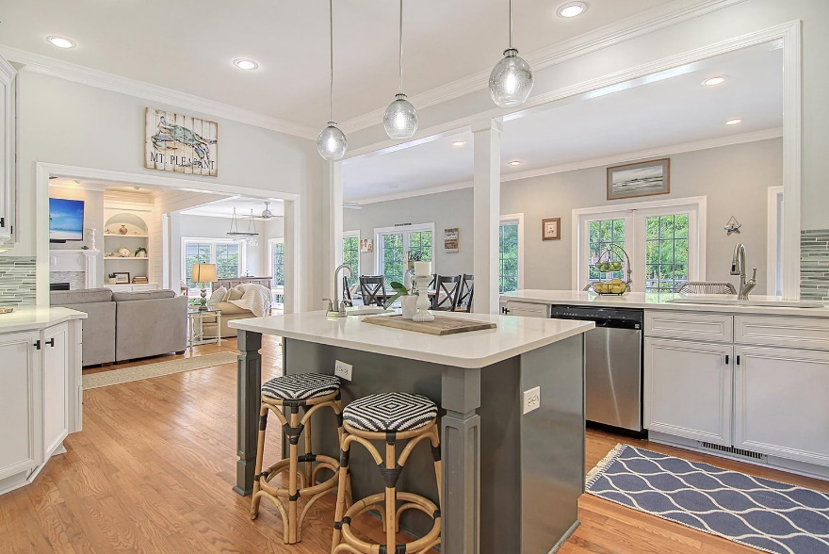


Motivated Seller
Improved Price
3435 Henrietta Hartford Road
Park West | Mount Pleasant, SC 29466
MLS# 23008360 | $1,749,900
Chrissy Strickland
843-906-5553
chrissyresiderealestate@gmail.com
www.residerealestatellc.com
Exquisite custom home in the beautiful established subdivision of Tennyson at Park West, with sweeping gorgeous live oaks, and spacious lots, your perfect oasis awaits!! Are you looking for a low maintenance, open concept home, with the perfect entertainment space, or maybe even an In-law suite? Well NOW you've have found it all in one property!! Situated on a large heavily landscaped corner lot! And what is even better is this beautiful home has had a new roof installed in 2019, a fully encapsulated crawl space, new HVAC units, new heat pump, and pool pump, What a huge piece of mind for any buyer! Come lounge by the pool as you gaze at the beautiful waterfall wall, lay on your tanning ledge, or take a dip in the hot tub. Have a barbecue at your spacious and covered outdoor pool pavilion kitchen that includes: a stainless Bosch dishwasher, an icemaker, refrigerator and sink. Enjoy the convenience of the coastal designed outdoor bath and shower! This is the perfect space to entertain or unwind after a long week. Inside this tastefully designed home the spacious family room is open to the bright and airy kitchen which overlooks the creatively designed backyard pool retreat.
Reside Real Estate LLC
155 Wingo Way Unit 421
Mt. Pleasant, SC 29464

