Slide 1
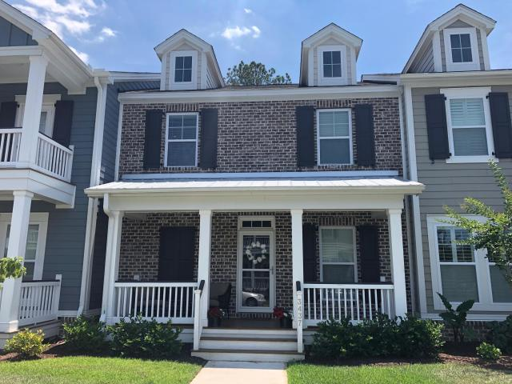
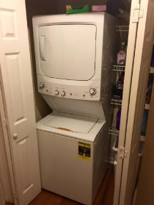
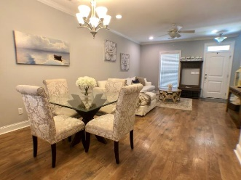
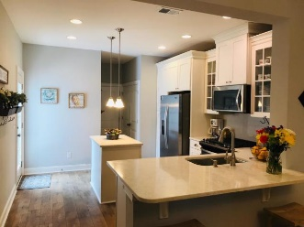
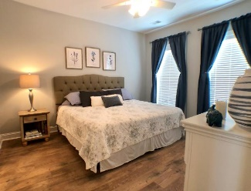
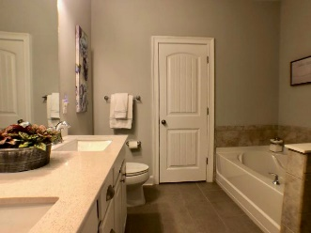
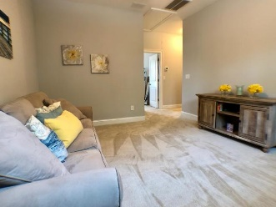
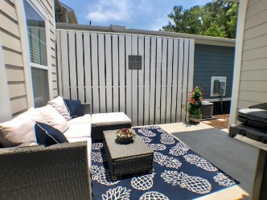
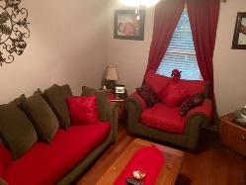
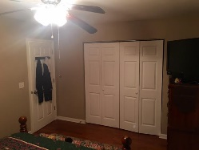
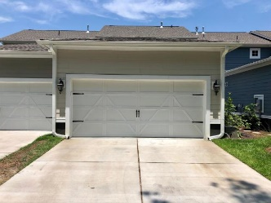
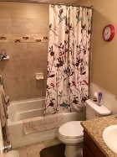
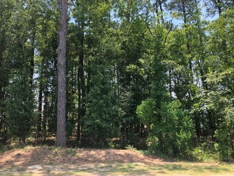


3437 Fairwater Place Carolina Park Mount Pleasant, SC 29466 MLS# 19015960 $395,000 3 Bedrooms | 2½ Baths | 1,622 sf
Open House Thursday from 10a-12p
Motivated Seller!
This beautiful townhome, in the desirable Carolina Park subdivision, is move-in ready and well maintained. Located on a very quiet street, the 2-car garage is located in the back lane, with a buffer of trees for extra privacy. Side by side parking in your new driveway means no shuffling of cars! The location is ideal since it's close to the beach, the new library, schools are within walking distance, downtown Charleston, shopping and restaurants. Carolina Park is a wonderful place to live for young families, empty nesters or seniors! Great find in Mount Pleasant! Upon entering the Wagner open-concept floor-plan, the living room, kitchen and dining area are all open to one another and lead out to the private patio. The first-floor master bedroom is very convenient with a private, luxurious bath, including a tiled shower, garden tub and a walk-in closet.
The spacious upgraded gourmet kitchen includes white 42" cabinets, with glass door inserts, a pantry, tiled backsplash, energy efficient stainless-steel appliances and a laundry area. The beautiful light-colored, upgraded quartz counter tops and cabinets create a nice fresh appearance. There is a half bath located on the first floor. The upgraded light oak, laminated floors are throughout the first floor, as well as the stair treads leading to the second floor.
The second floor is generously sized and has two large bedrooms, see pictures for sizes, and a large loft area. Excellent area for the kids to play or an office. There's a large full-sized bathroom with a shower/tub to bathe the kids!
HERS-rated, gas heat, tankless water heater, and all the fun Carolina Park has to offer. Walk to the pool, tennis or take a walk along the walking paths, this home will not last long! Plans for a town center with shops and restaurants are in the planning stages with the town council. Check out the website for Carolina Park.
Susan Day
843-900-0477 homes@charlestonbyday.com
www.charlestonbyday.com
Brand Name Real Estate | 4 Carriage Lane Suite 106 | Charleston, SC 29407

