Slide 1
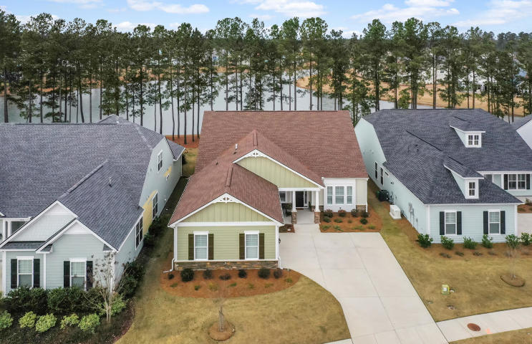
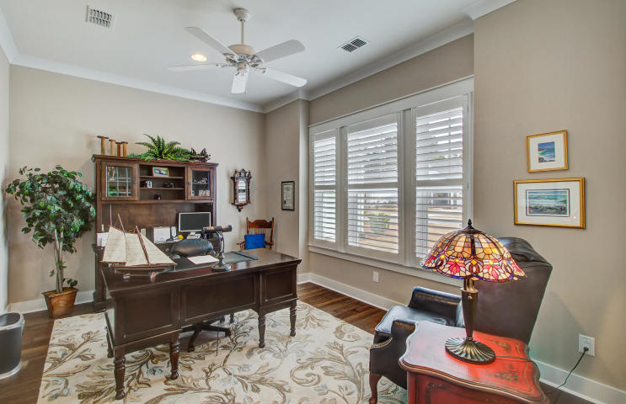
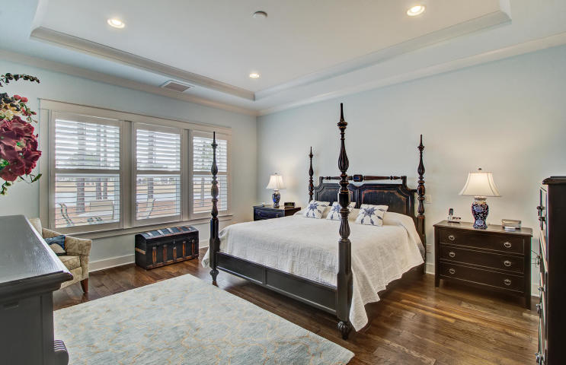
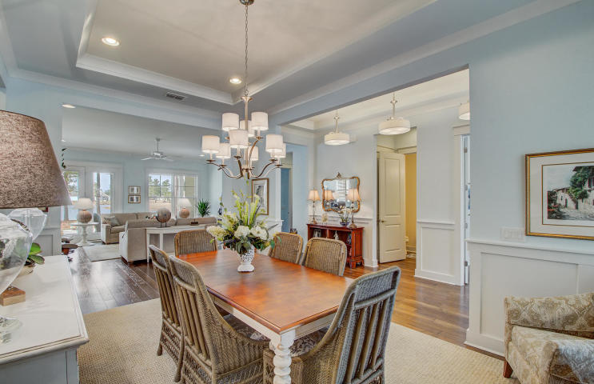
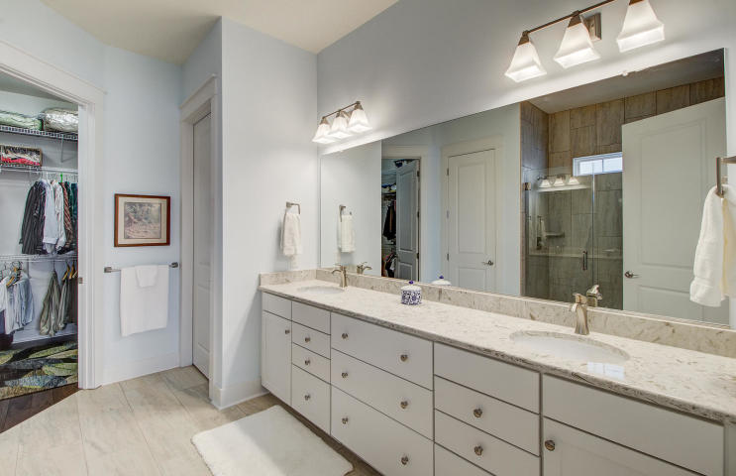
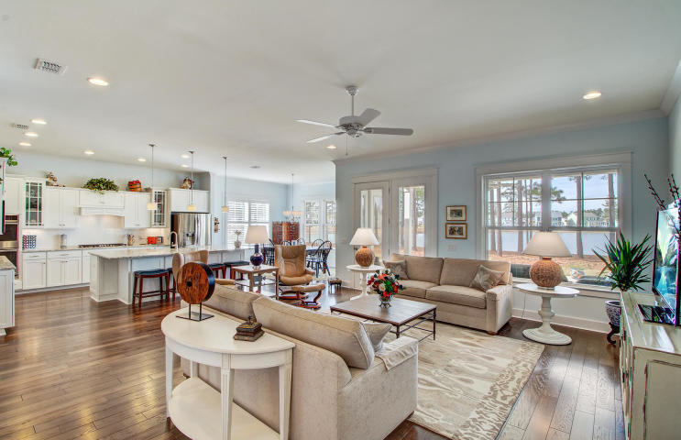
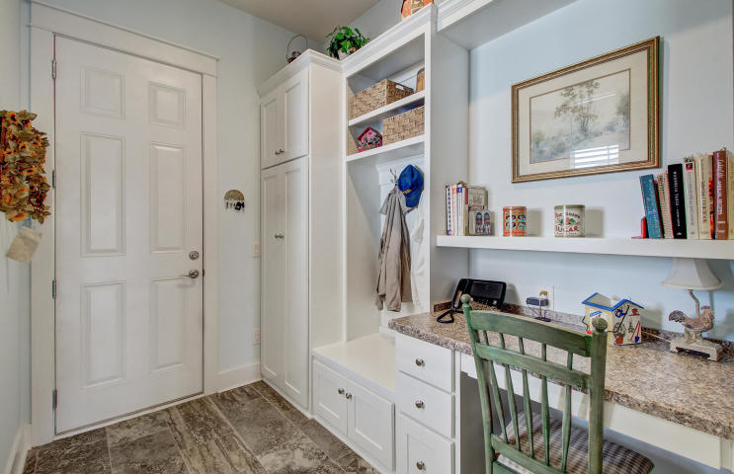
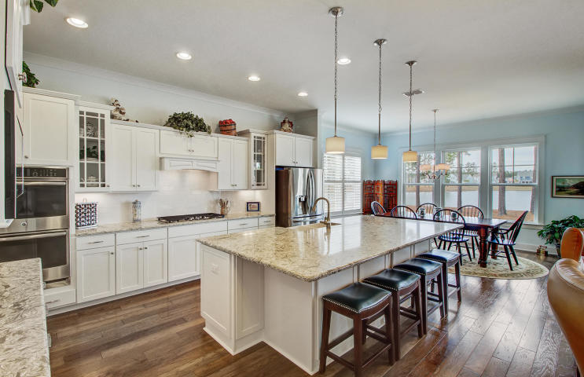
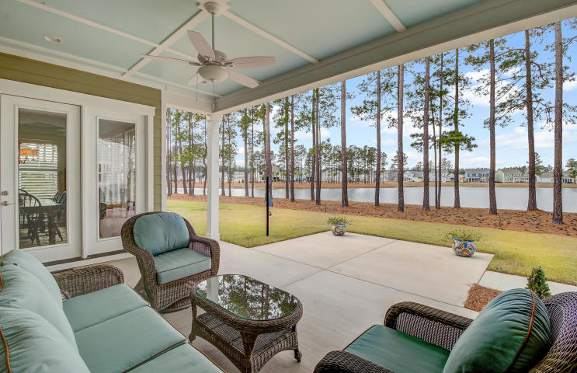
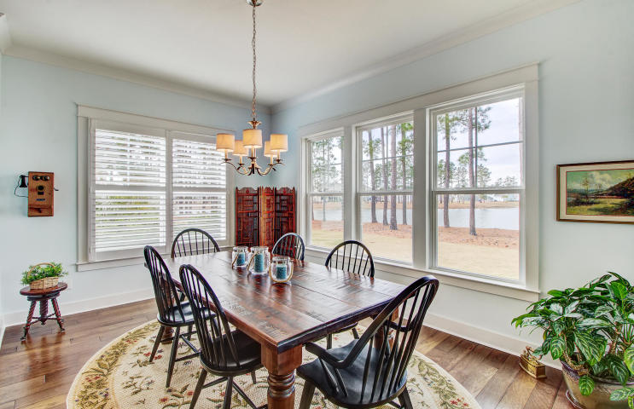
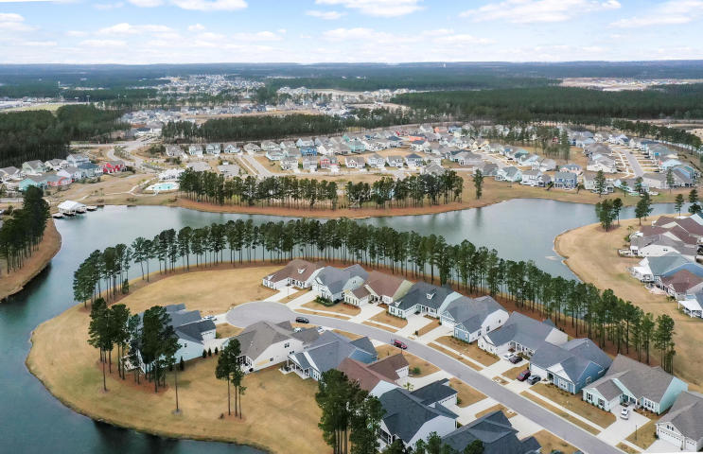



Welcome Home
You'll wish you never had to leave!
343 Fish Creek Court
Four Seasons at Lakes of Cane Bay · Summerville, SC 29486
MLS# 20003086 · $500,000
This is truly a one of a kind waterfront property. There are no lakeside homesites available and the builder is
not presently building this floorplan. As you enter this immaculate residence, you are immediately awed with
panoramic views of the lake from every angle. Seller spared no expense when selecting this unique lakefront homesite near the end of a quiet cul de sac or when selecting high end options when building this home. The open and light home is the perfect blend of subtle elegance and coastal charm. A welcoming front porch opens to 10 ft ceilings and 8 ft entries that capture light and enhance the water view. No carpet to vacuum in this home – hardwood floors and tile throughout! The gourmet kitchen features a stunning quartz island, white cabinetry, stainless steel Profile appliances, and walk-in pantry. The kitchen island opens to an inviting great room, informal kitchen nook, and formal dining room with trayed ceilings. The rear covered patio has been extended, creating the ideal outdoor oasis for grilling, entertaining, and watching the sunset over the water. The owner's suite is spacious and overlooks the water.
Four Seasons is the only 55+ community in Cane Bay that provides 8.5 miles of navigable lake access, a gated entrance that is guarded 24/7, and included basic cable and trash service. Amenities trump any of the other 55+ communities of Summerville. There is a dedicated pool for grandchildren, as well as a tot lot and two 'adult' pools, a billiards room, demonstration kitchen and so much more.
Chari Karinshak
(843) 810-8287
chari@charlestonfinehomes.com
Charleston Fine Homes Team
Yvette Grist · 843.312.0696
Yvette@CharlestonFineHomes.com
Coldwell Banker Residential Brokerage · 1127 Queensborough Blvd. 103 · Mt Pleasant, SC 29464

