Slide 1
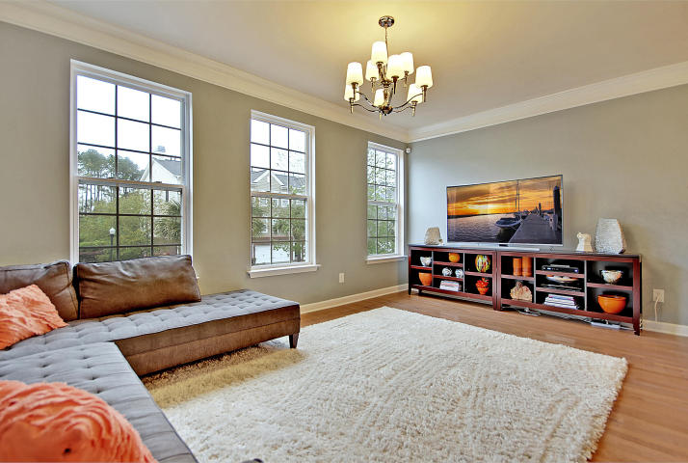
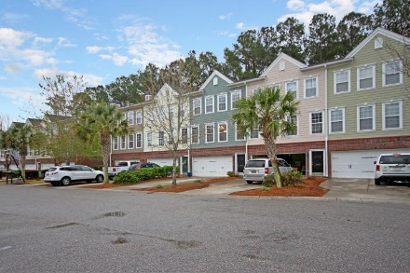
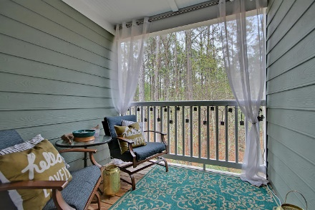
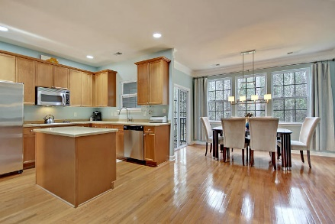
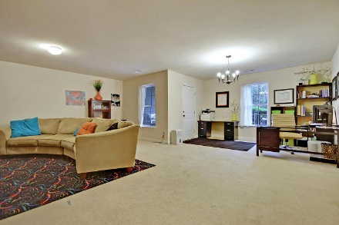
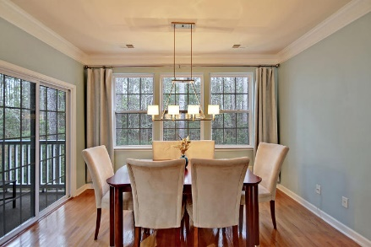
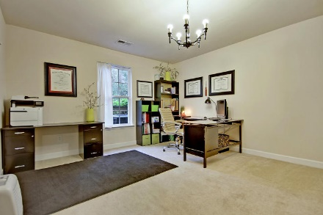
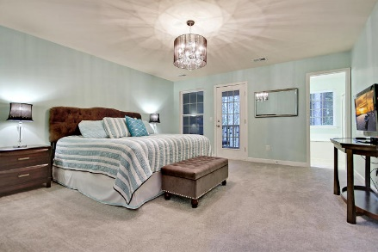
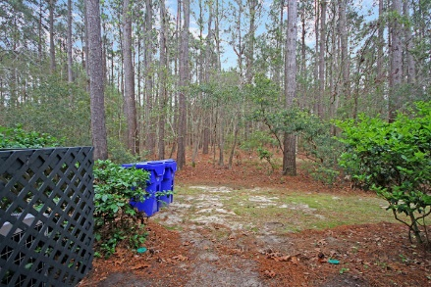
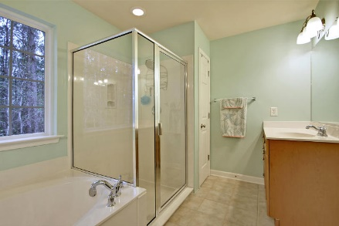
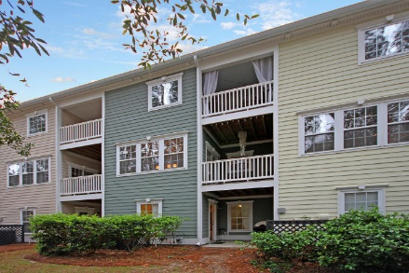

Welcome To Paradise
3443 Claremont Street
Park West ~ Mount Pleasant ~ MLS# 18009531 ~ $334,900
Welcome to paradise in Mount Pleasant's beautiful Park West where this move-in ready, 3-level level townhome will take your breath away.
This open floor plan has gorgeous hardwood floors, a spacious living room and dining room area and a stunning eat-in kitchen with a center Island and access to the deck from the eat-in area.
The master suite is a beautiful oasis with a balcony overlooking the peaceful woods and massive walk-in closet and includes an ensuite bath with dual vanity, walk-in shower and garden tub.
One of the best surprises in this home is the amazing bonus room on the ground level that is ideal for a workout area playroom media room and it also leads to a covered patio.
Park West includes swimming pools, tennis courts, a playground, beach volleyball, and walking trails.
Leslie Toller Leslie@Mattoneillteam.com 843-972-3244

