Slide 1
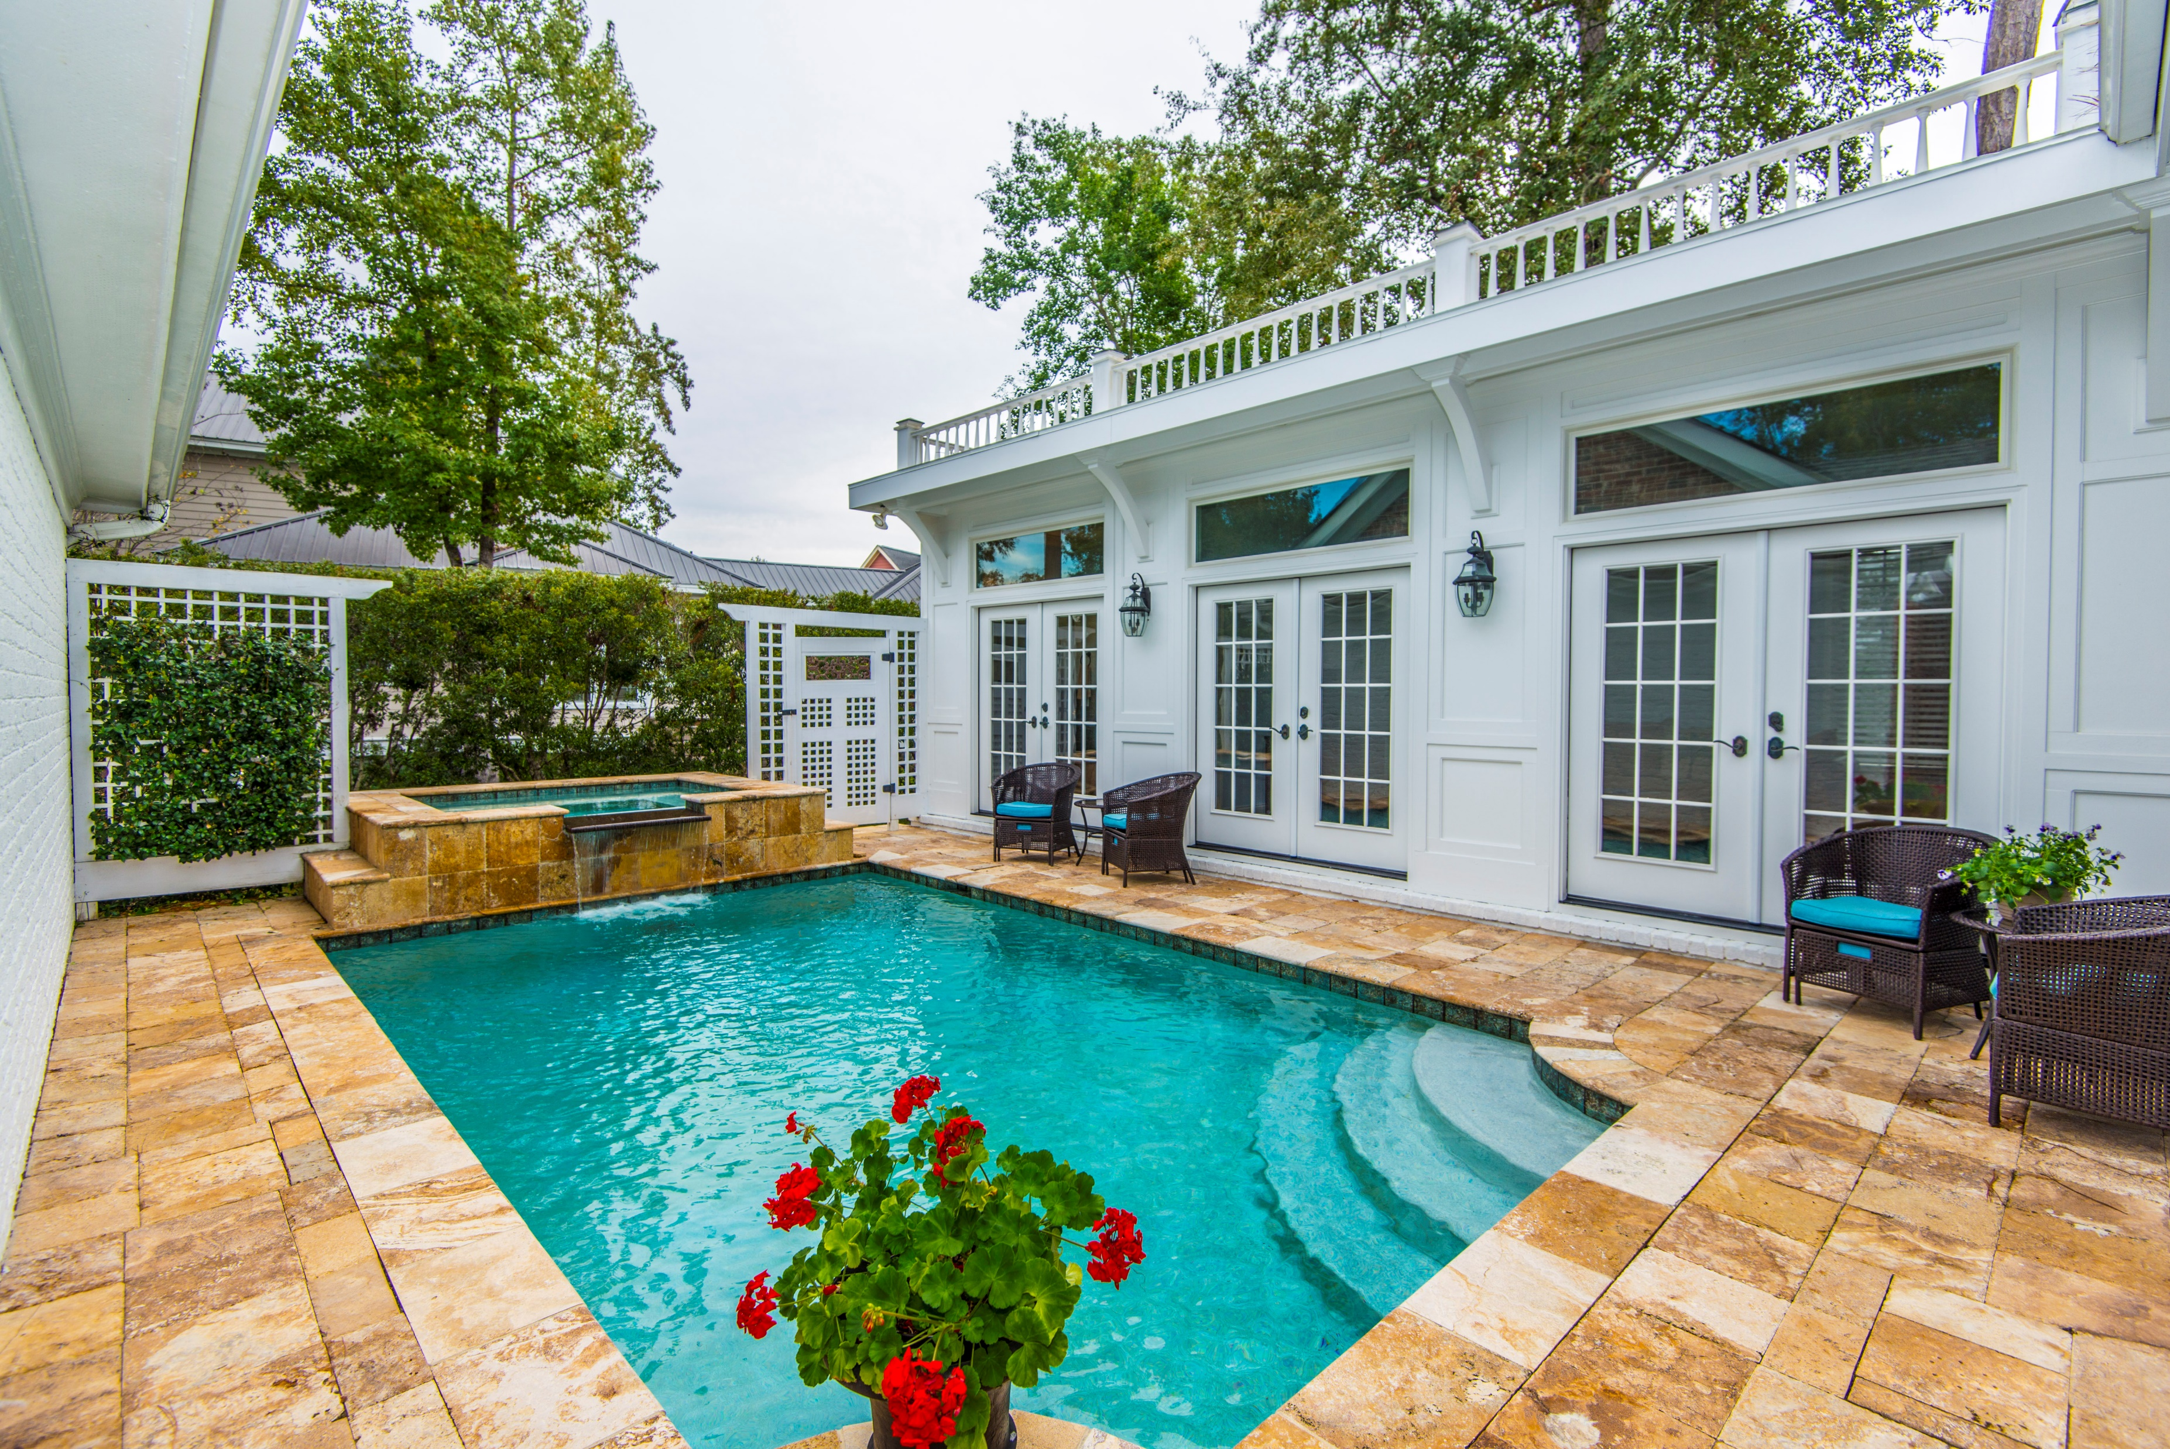
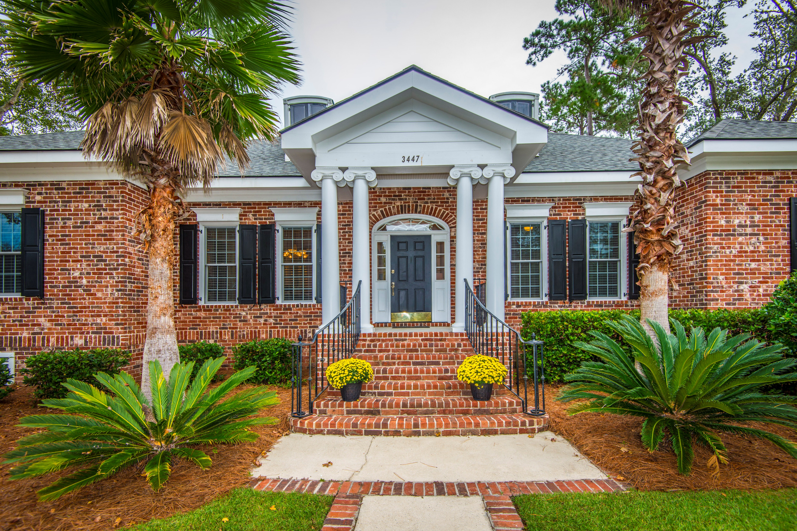
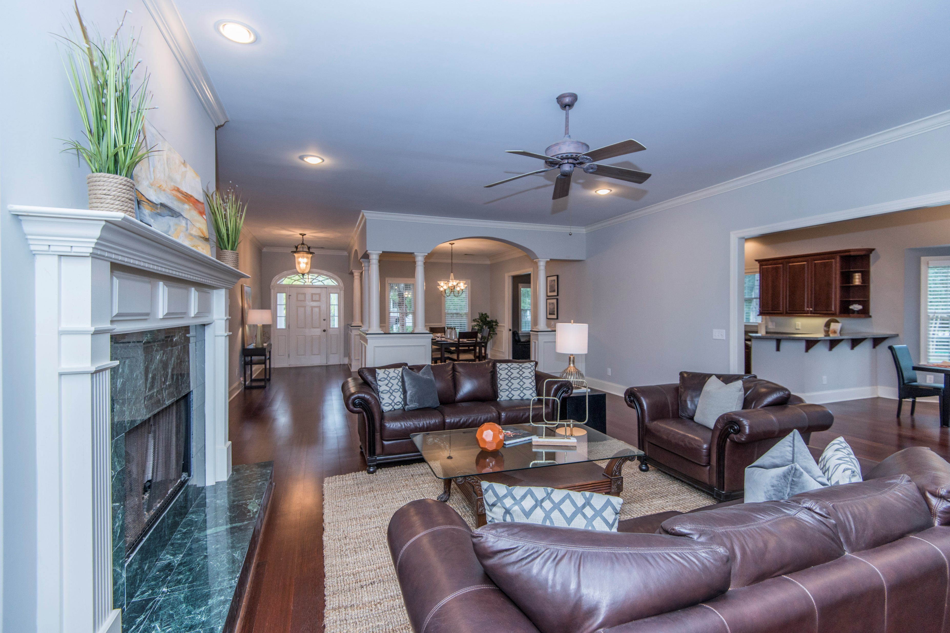
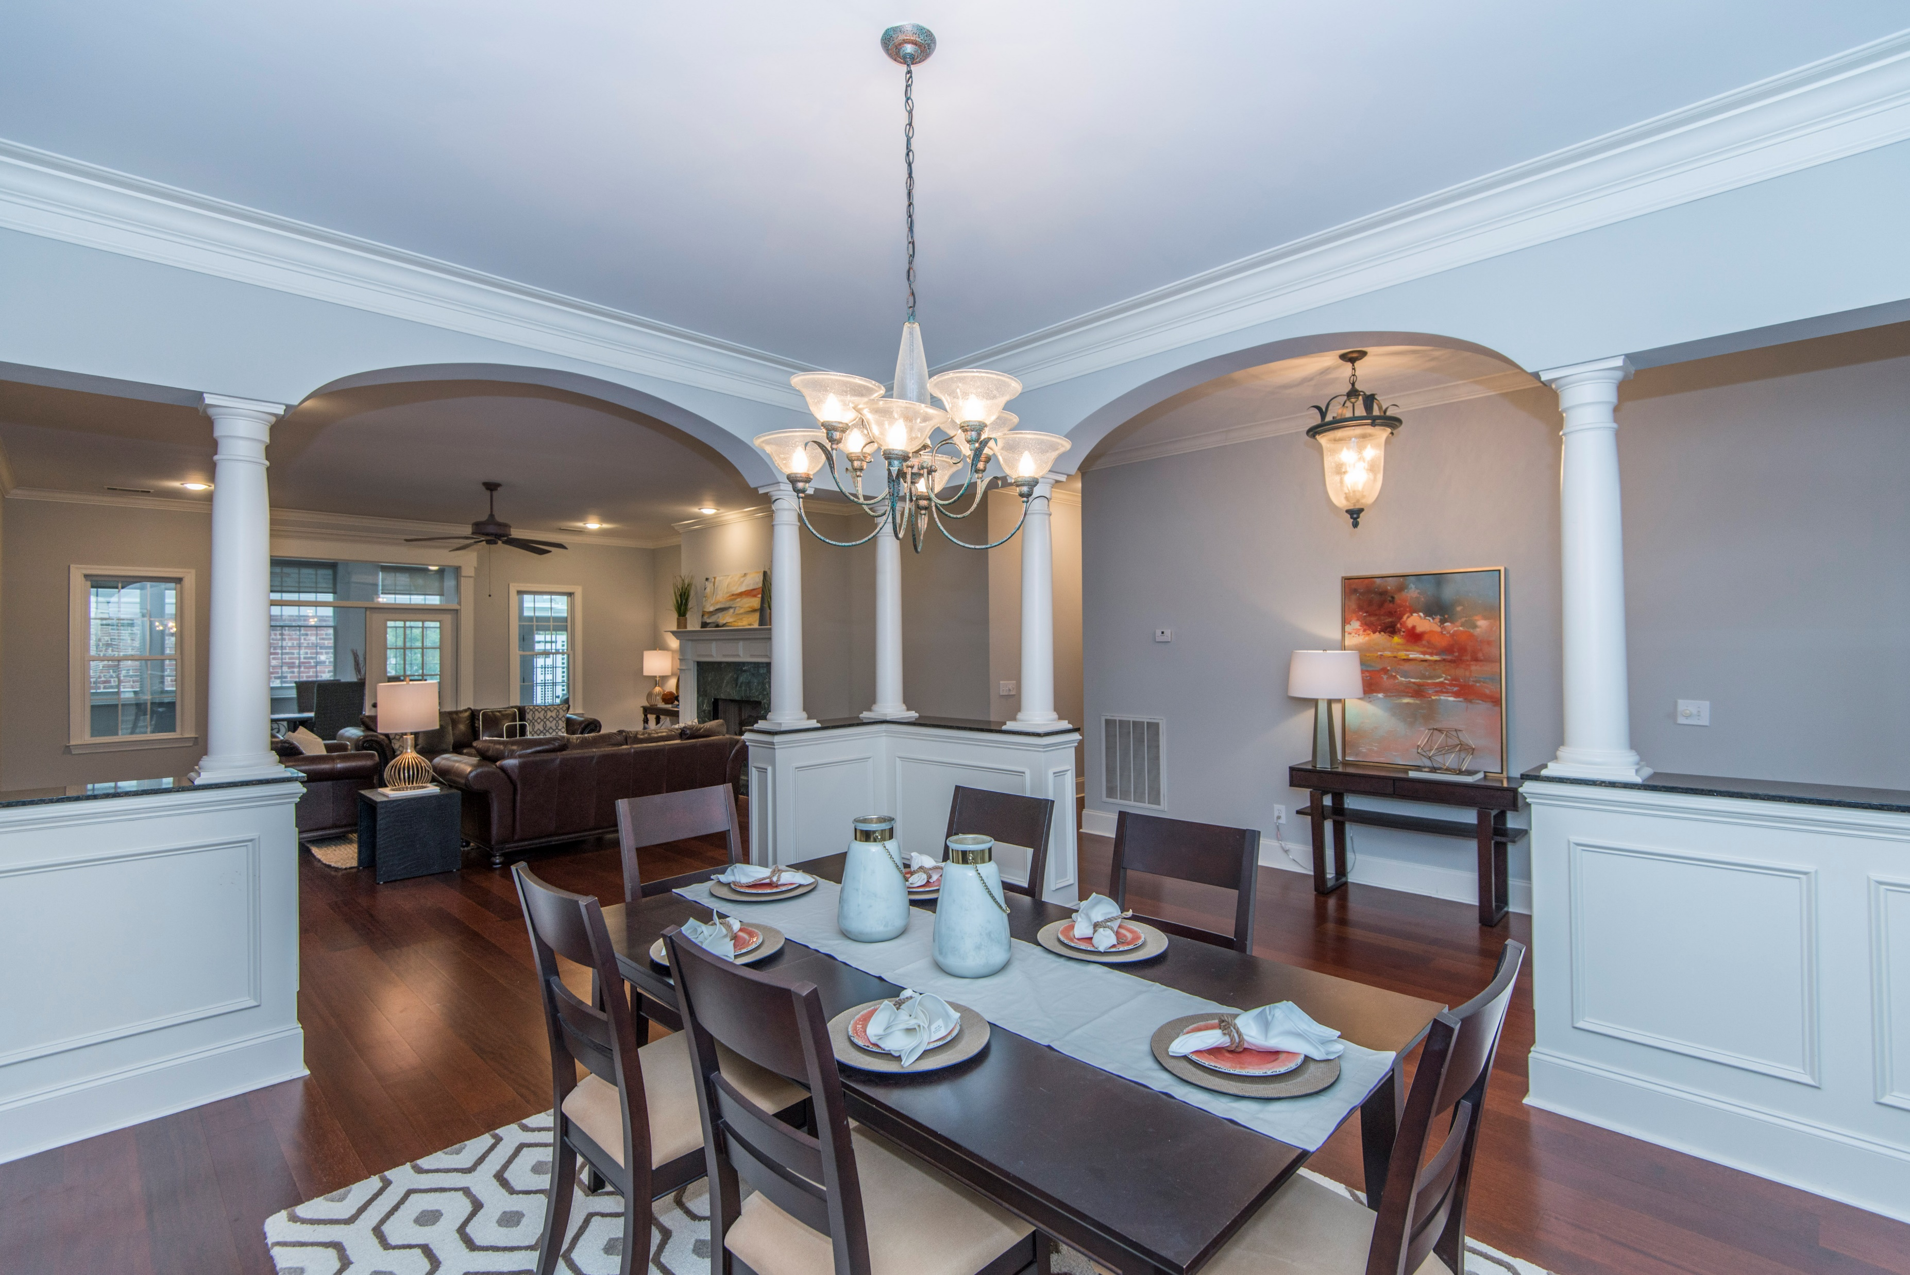


3447 Henrietta Hartford Road
Tennyson At Park West :: Mount Pleasant
MLS# 17028412 :: $669,900
Just Reduced
$785,000!
One Story Living at its Finest in Mt. Pleasant
This PRIVATE OASIS is a 3BR home that features an Open Floor Plan and is centered around a stunning Pool and Hot Tub. With an added Mother-In-Law Suite, it is perfect for the Mature Family, Executive Couple, Empty Nesters, or Buyers who work from home. For those who desire a great location, flexible space for in-home Office, Home Gym or Studio, the luxury of having incredible entertaining space around the pool, and minimal yard maintenance, this is for you! Notables are a New Roof in 2015, new chimney, ENCAPSULATED CRAWL SPACE; fabulous Cherry hardwood floors, new bedroom carpeting, 2 Rinnai Tankless Hot Water Heaters, and brand-new appliances. Park West, one of the Lowcountry's most desirable communities, offers a variety of dining, shopping, Workout options, Professional Offices, Salons, and 3 of the areas top schools. Amenities include 2 pools, tennis, Clubhouse, multiple Playgrounds, and miles of paved Sidewalks throughout.
Wendy Arnsdorff
843-364-8619 – M :: 843-284-1800 – O
wendy.arnsdorff@carolinaone.com
www.wendyarnsdorff.com
Carolina One Real Estate :: Mt. Pleasant North Office :: 2713 N Highway 17 :: Mt. Pleasant, SC 29466

