Slide 1
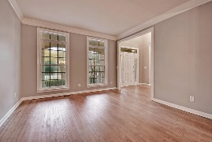
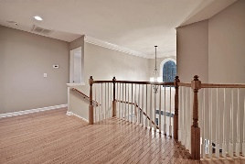
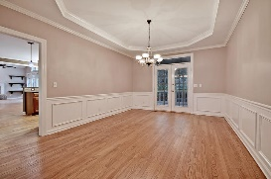
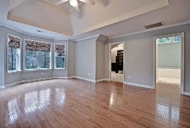
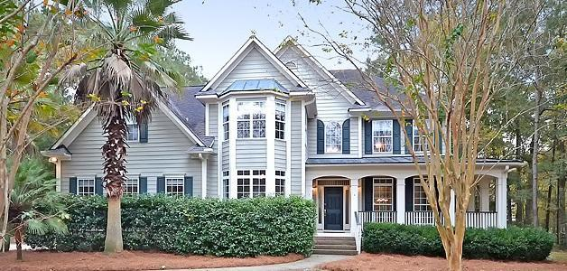
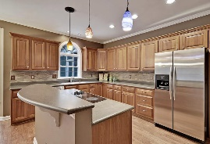
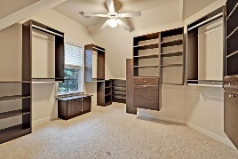
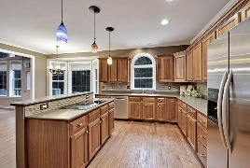
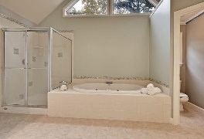
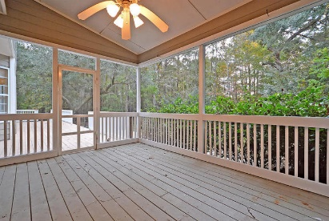
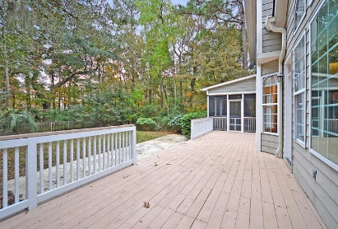
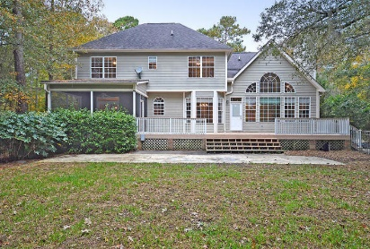
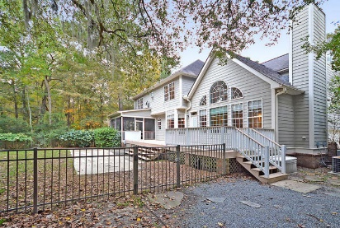

3449 Shagbark Circle Dunes West | Mount Pleasant, SC 29466 | MLS# 16001528 | $599,000
Motivated! Make Offers Now!
Beautiful 4 bedroom, 3.5 bathroom home on 1 acre private wooded lot! This gorgeous home boasts handsome wood floors, updated kitchen, new carpet and large master bedroom and bathroom with spectacular walk-in closet. The eat-in kitchen has bright natural light with new tile back splash, stainless steel appliances, new 2015 Bosch dishwasher, and is open to the great room. Also, there is an office with french doors and a bay window, an updated guest bath, dining and living rooms on the first floor. The grand master bedroom has hardwood floors, a trey ceiling, lots of natural light, an awesome custom closet, second closet, and spa-like bath with jetted tub and separate shower. Three large additional bedrooms upstairs-two that share a Jack-n-Jill bath and one with private bath. The expansive back yard is fenced, private and wooded and has a large deck and screened-in porch. Dunes West in Mount Pleasant, SC is a wonderfully landscaped gated community with large wooded landscaped lots and community dock, play park, walking trials, golf and pool memberships available and a clubhouse! The neighborhood is close to local shopping and grocery stores and is a short drive to downtown Charleston with 5-star restaurants, world class shopping and iconic history as well as a short drive to the beaches, the airport, Boeing and Daniel Island. Come take a look because you will not find another community that offers as much as Dunes West. This home is perfect for entertaining and still providing a private lifestyle!
Stan Huff
843-670-2835 stan.huff@agentowned.com
Jill Marcacci
843-297-5590 jill@agentowned.com
www.agentownedrealty.com
AgentOwned Realty Co. Preferred Group, Inc. | 824 Johnnie Dodds Blvd | Mt Pleasant, SC 29464

