Slide 1
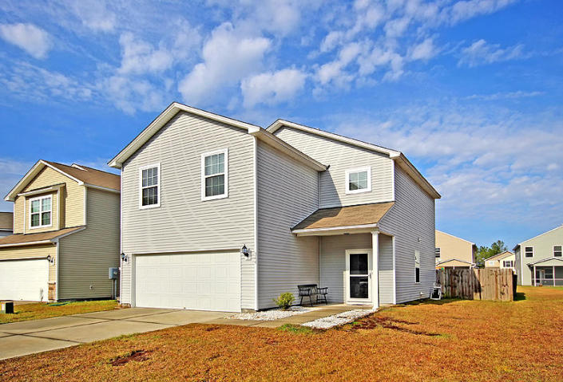
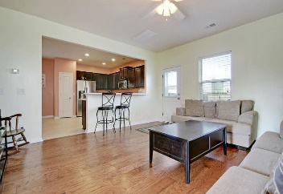
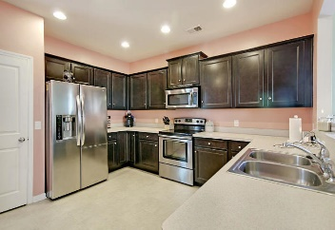
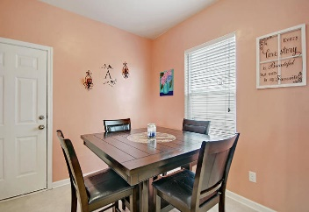
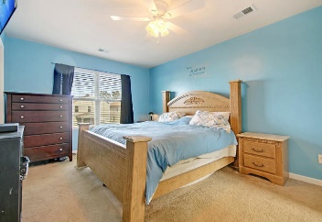
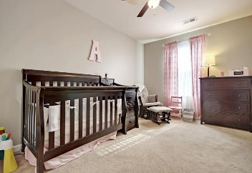
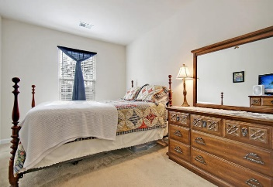
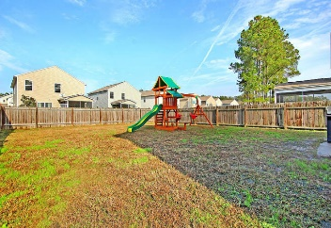
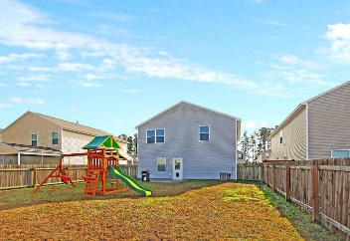


344 Iveson Road
Cane Bay Plantation ~ Summerville ~ MLS# 18032003 ~ $212,500
Open House Lunch ~ Friday, Oct 3 from 11 - 1
Handyman Special… Bring your hard hats!
Why Wait For New Construction!
This adorable single family home is in the highly sought after Cane Bay Plantation. Upon entering the home you are welcomed by the beautiful new Pergo hardwood flooring. The spacious kitchen is perfect for the chef in your family. It also offers a spacious dining area right off the kitchen. The 3 sizable bedrooms are all upstairs as well as a loft area that can serve a number of uses. Don't miss the opportunity to see this home. Schedule a showing today!
Carla Musgrave
(843) 371-2689
cmusgrave6987@gmail.com
HomeGate Real Estate
4000 S Faber Place Dr Ste 300
Charleston, SC 29405

