Slide 1
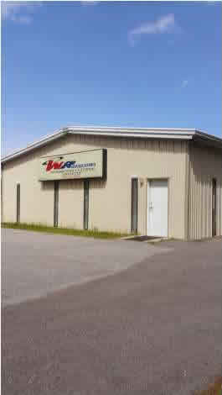
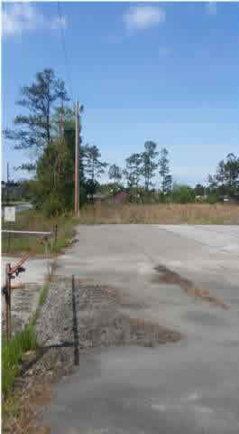
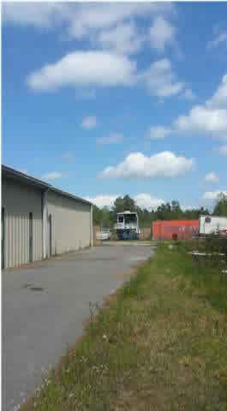
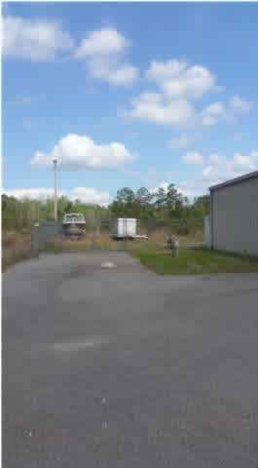
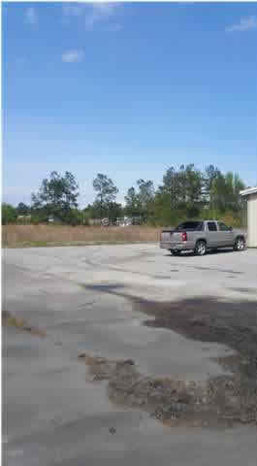
344 Merrimack Blvd
MONCKS CORNER, SC 29461
MLS# 1500724
$280,000
Commercial Building
With Land to Expand!
Bob Glover | Zachary Glover | Michelle Riser
843-693-1837 (Bob) | 843-810-9891 (Zachary) | 843-860-1229 (Michelle)
bobglover08@gmail.com | mrcrealestate1@gmail.com | mriser@ccim.net
Metal building with plenty of land to expand
OR
sell a residual acre!
Bob Glover | Zachary Glover | Michelle Riser
843-693-1837 | 843-810-9891 | 843-860-1229
bobglover08@gmail.com | mrcrealestate1@gmail.com | mriser@ccim.net
Matthew Ryan Company, 104 Berkeley Square, PMB 59, Goose Creek, 29445

