Slide 1
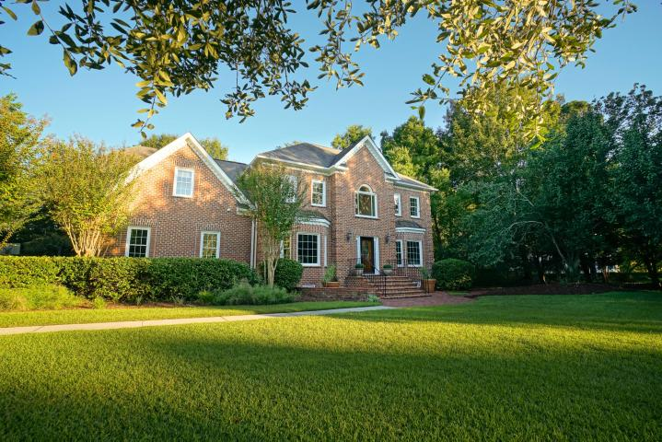
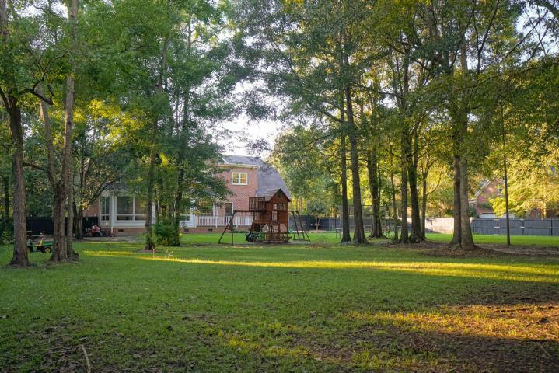
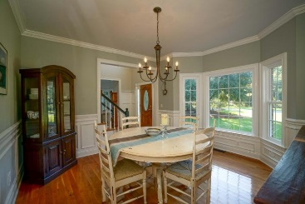
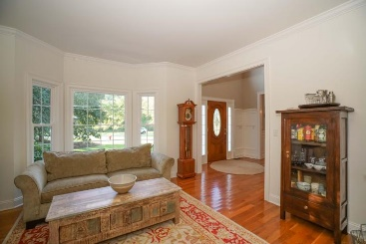
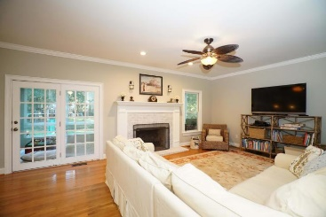
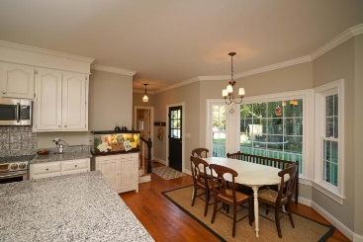
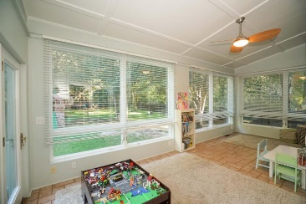
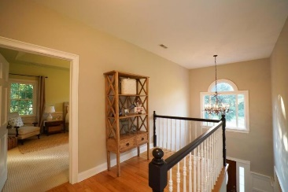
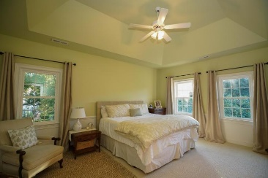
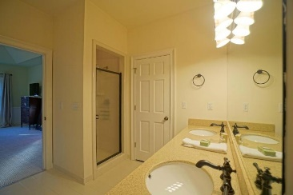

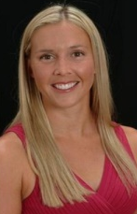
Dunes West upgraded home at a great price!!
3455 Colonel Vanderhorst Circle
Mount Pleasant, SC 29466 | MLS# 15026211 | $659,900
Welcome to this Dunes West home on over an acre private lot! Upon entering you will notice the beautiful hardwood floors that extend throughout the entire downstairs. Large 2 story foyer brings in an abundance of natural light to the open floor plan. Recently updated eat-in kitchen with granite countertops and stainless steel appliances. The living room has a wood burning fireplace for those cold fall evenings. Off the living room there is a great relaxing sun porch. Downstairs also offers a formal dining room and a den that can be used as an office or separate sitting room. Upstairs you will find the large master retreat along with 3 additional spacious bedrooms and a Jack and Jill bathroom and another full bath. All of the bathrooms have recently been updated. The backyard is very spacious and fully fenced in! Plenty of space for the kids and dogs to run around! Dunes West is an exclusive neighborhood with wonderful amenities! This home is a must see!!
Kristen Kern-Whitehead
Mobile - 843-670-1671
kwhitehead@kwchs.com
www.charlestonislandagents.com
Keller Williams Realty
Charleston Islands
1304 Palm Blvd
Isle Of Palms, SC 29451

