Slide 1
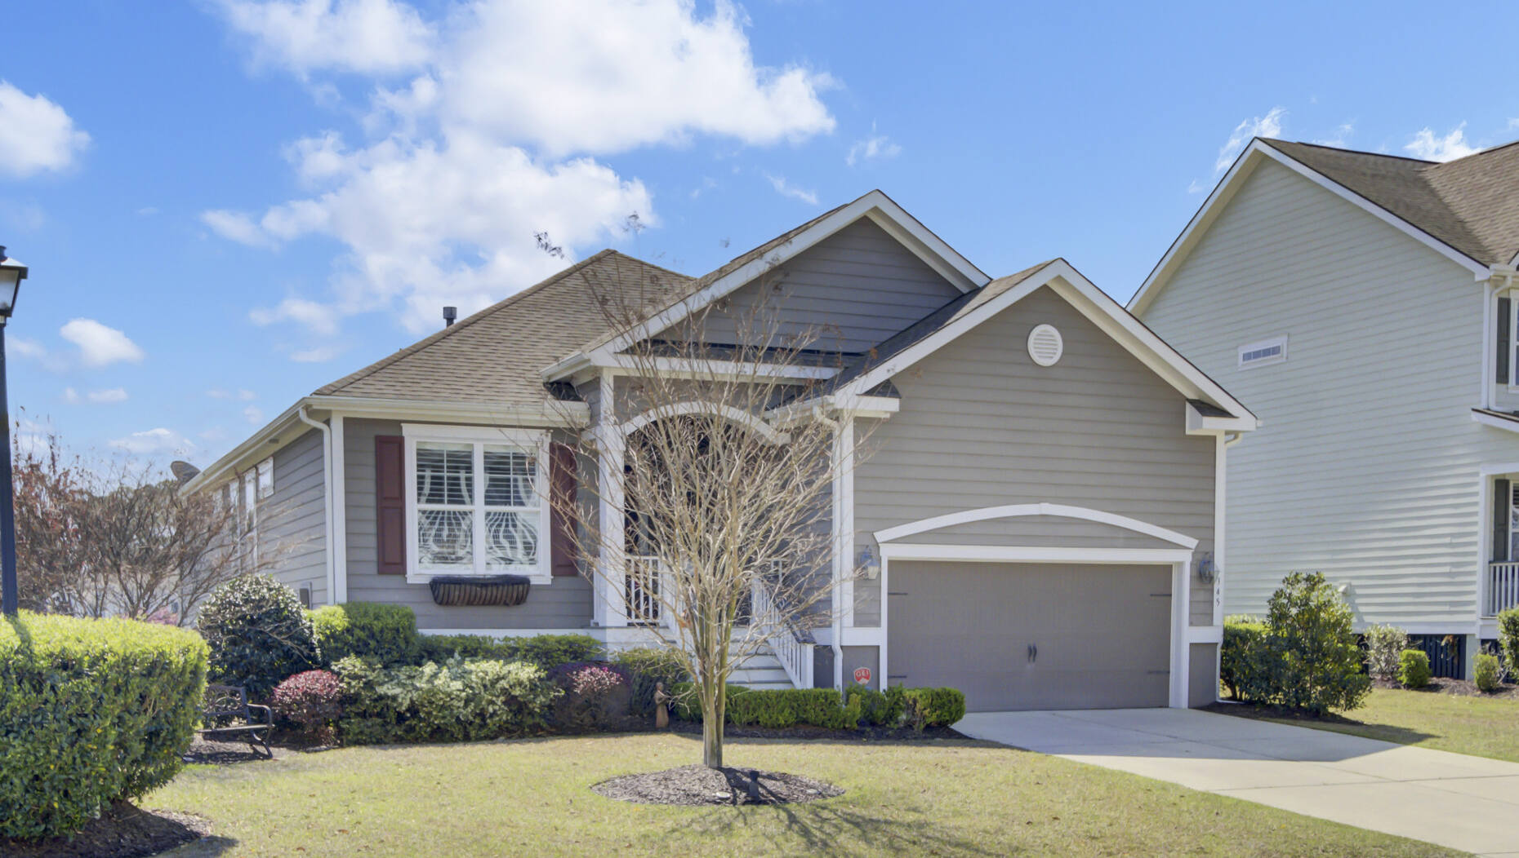


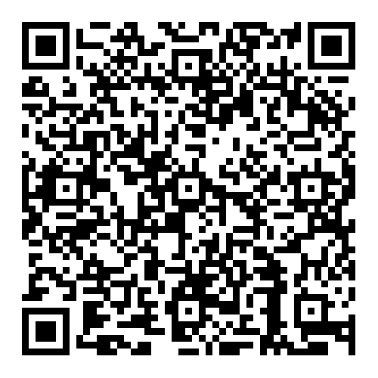

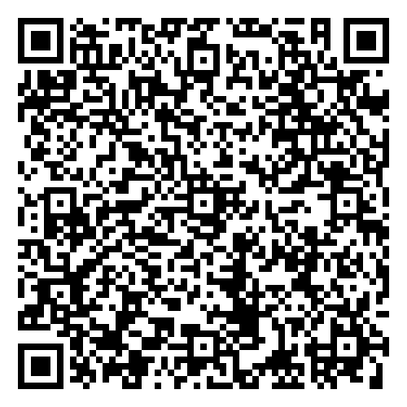


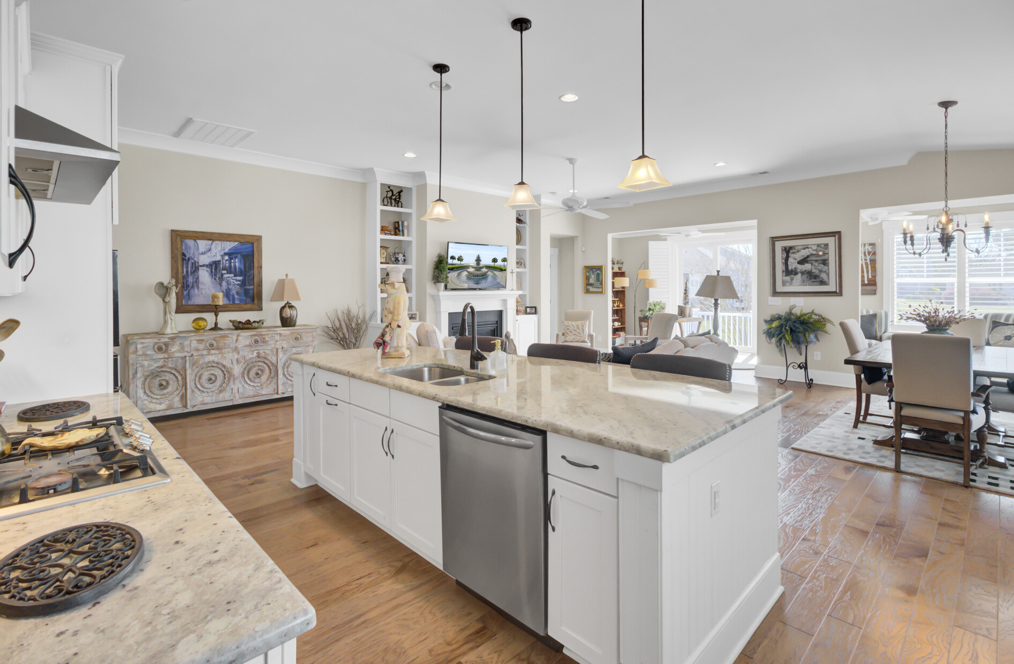

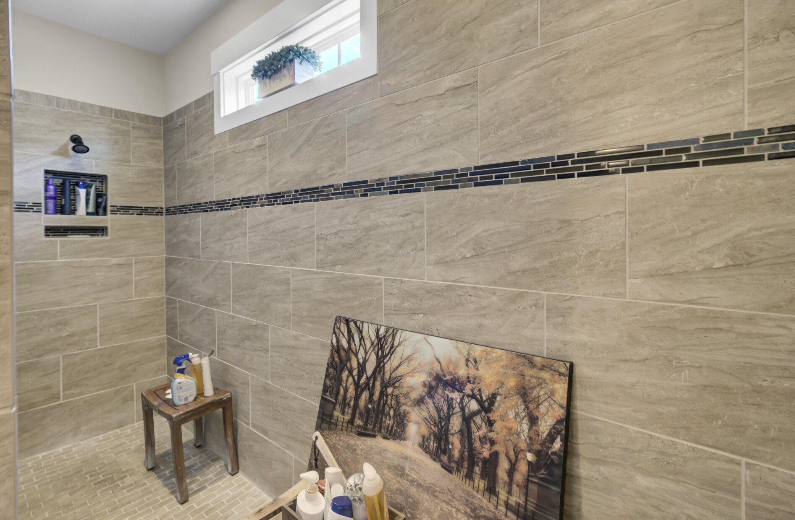
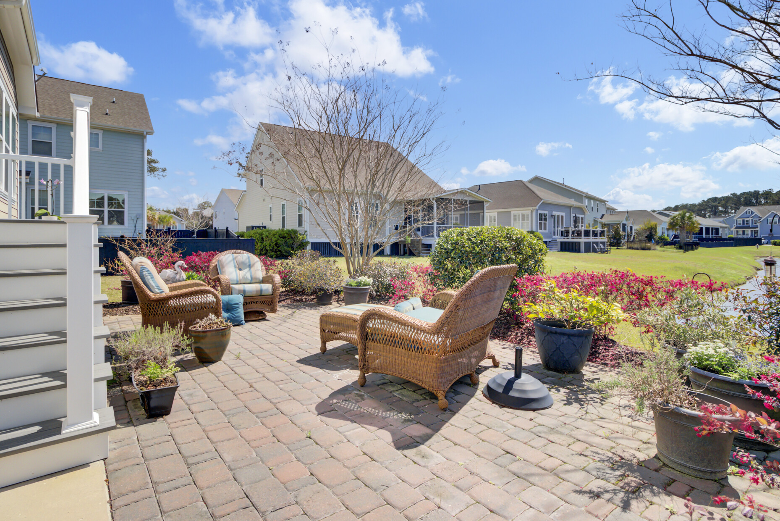



NEW LISTING COMING SOON
345 Turnstone Street
Tidal Walk | Mount Pleasant, SC 29464 | MLS# 25008534 | $829,900
Video Tour
Virtual Tour
Sellers Are Offering Buyer Agent Compensation Of 2.5% With Acceptable Offer
One-level luxury in Mt. Pleasant’s sought-after Tidal Walk! This pristine, light-filled home offers a chef’s kitchen, sunroom with pond views, and a stunning owner’s suite. Enjoy custom finishes, lush landscaping, and unbeatable location near beaches, shopping, and downtown Charleston. Homes like this don’t last—schedule your private tour today!
🔑 Showings start Thursday!
🏡 Open House: Sunday, April 6 | 12–3 PM
Video Tour
Ellen O'Neil
Broker/Owner, ABR, e-PRO, CNE
Charleston Realtor of Distinction
843-300-8530
www.EllenONeilProperties.com

