Slide 1
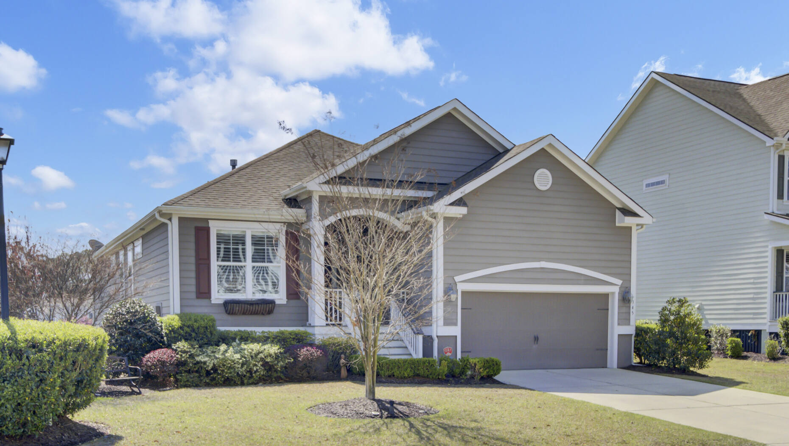


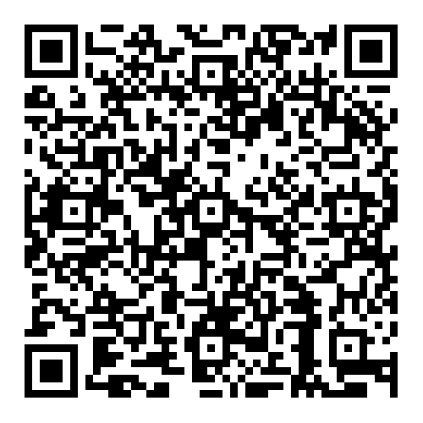

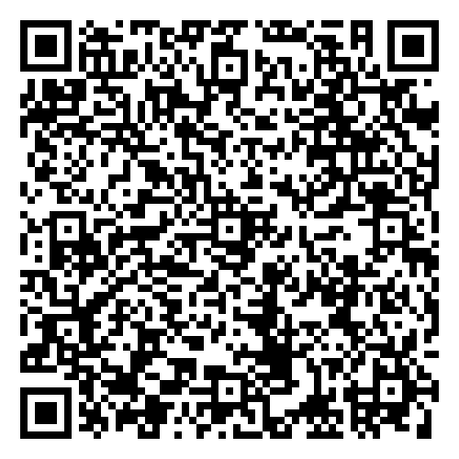




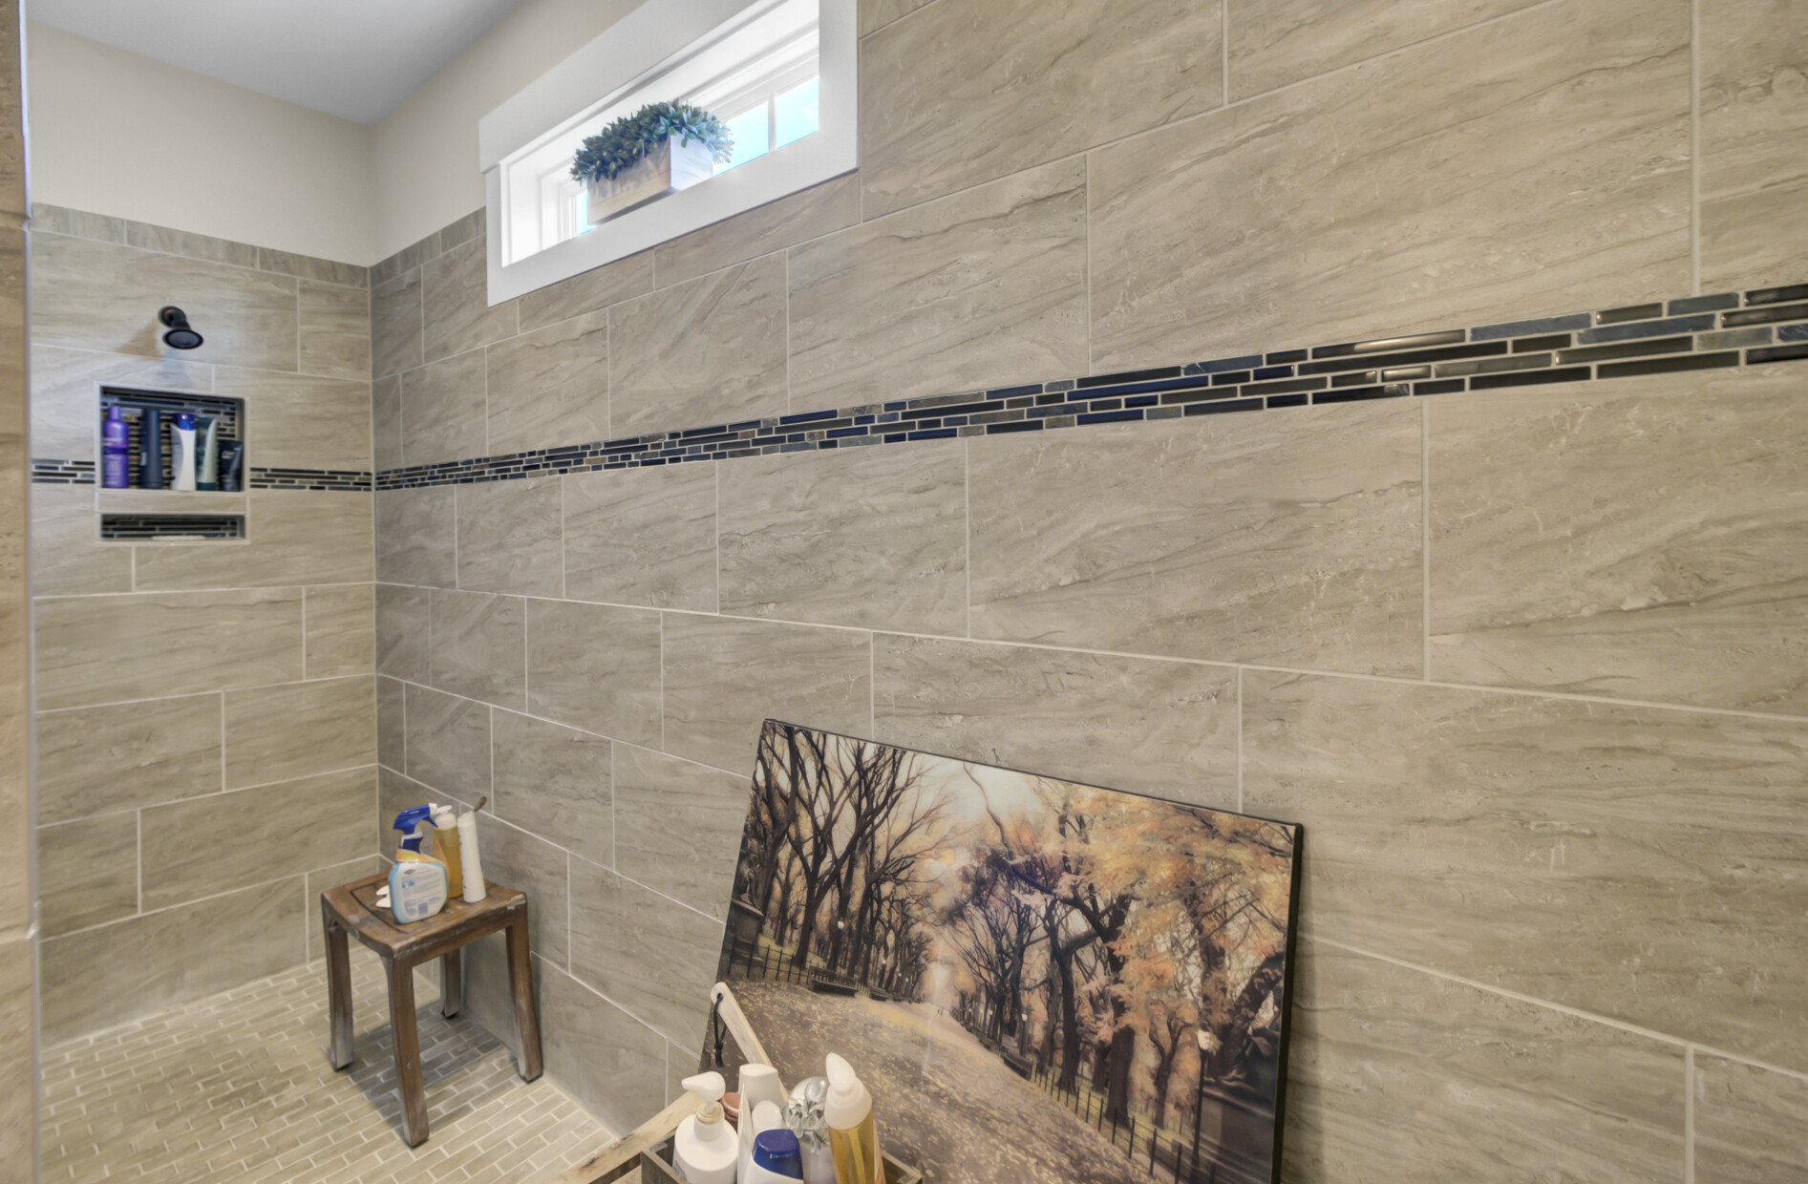
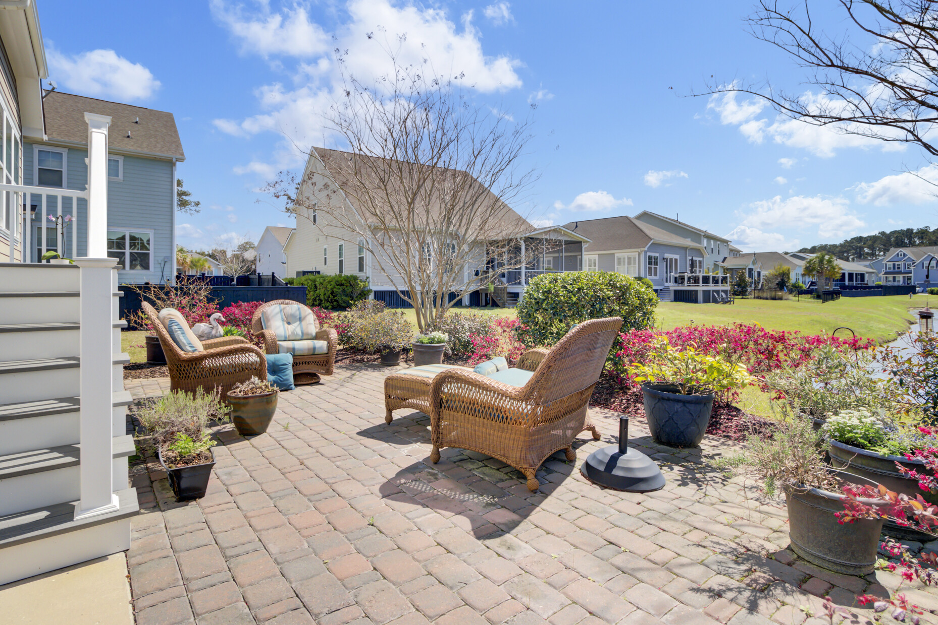



MASSIVE PRICE REDUCTION
345 Turnstone Street
Tidal Walk | Mount Pleasant, SC 29464 | MLS# 25008534 | $769,000
Video Tour
Virtual Tour
Sellers Are Offering Buyer Agent Compensation Of 2.5% With Acceptable Offer
MASSIVE Price Reduction on this stunning one-level home in Mt. Pleasant’s Tidal Walk! Featuring an open floor plan, chef’s kitchen, sunroom, and serene pond views, this meticulously maintained home rivals new construction. With gorgeous landscaping and community amenities, the location is unbeatable. Schedule your tour today before it’s gone!
Video Tour | Storybook
Ellen O'Neil
Broker/Owner, ABR, e-PRO, CNE
Charleston Realtor of Distinction
843-300-8530
www.EllenONeilProperties.com

