Slide 1
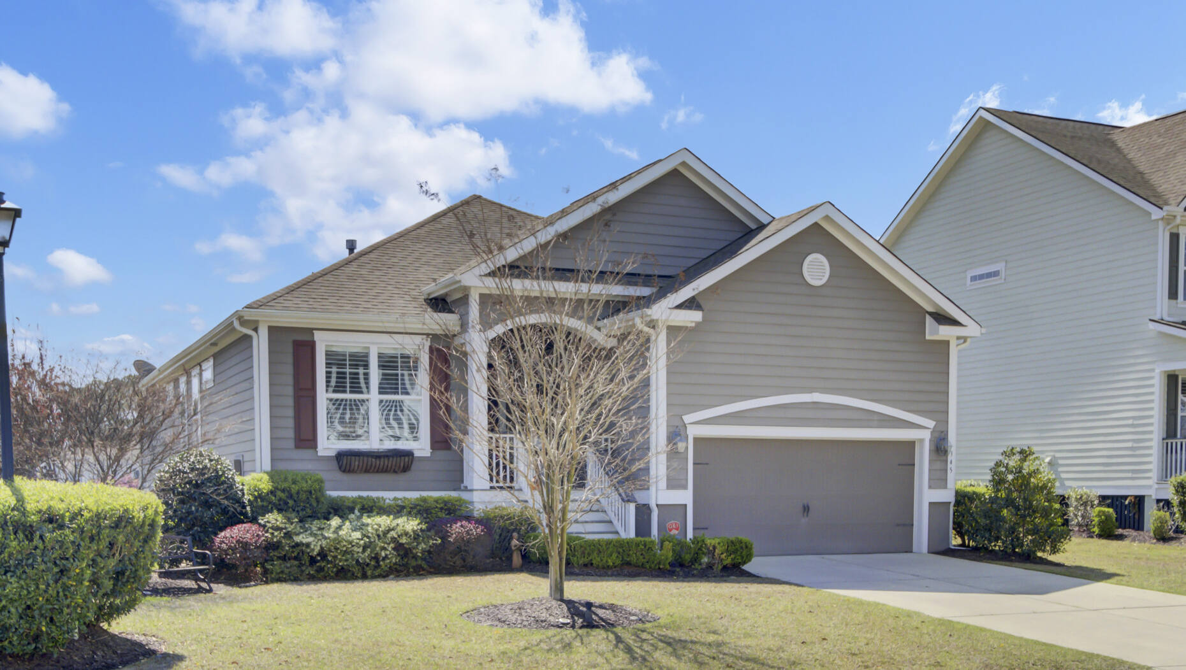










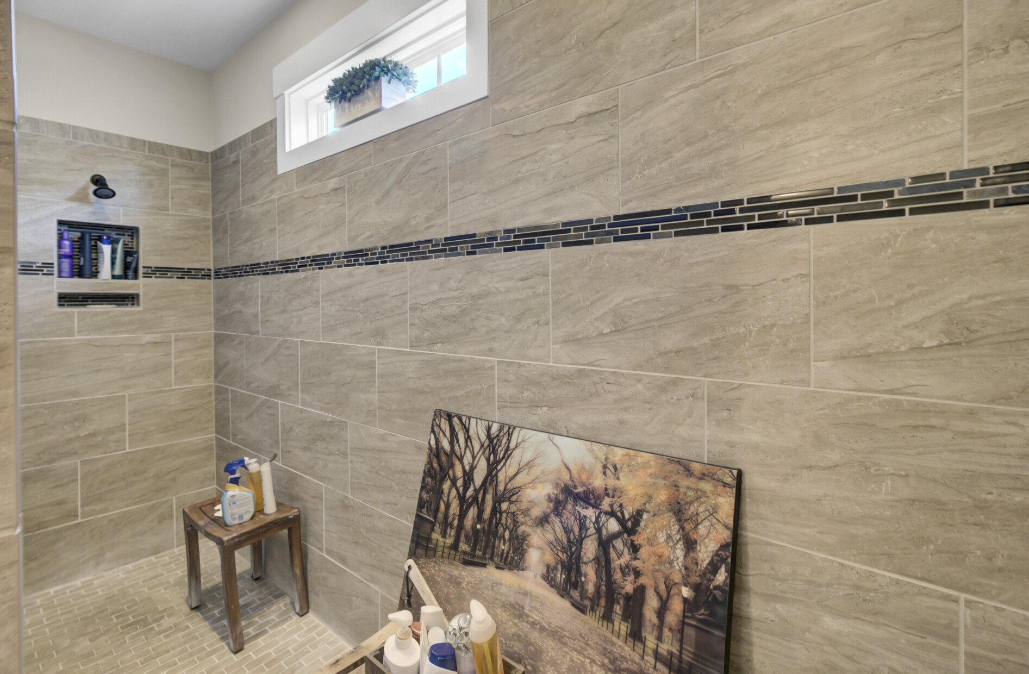
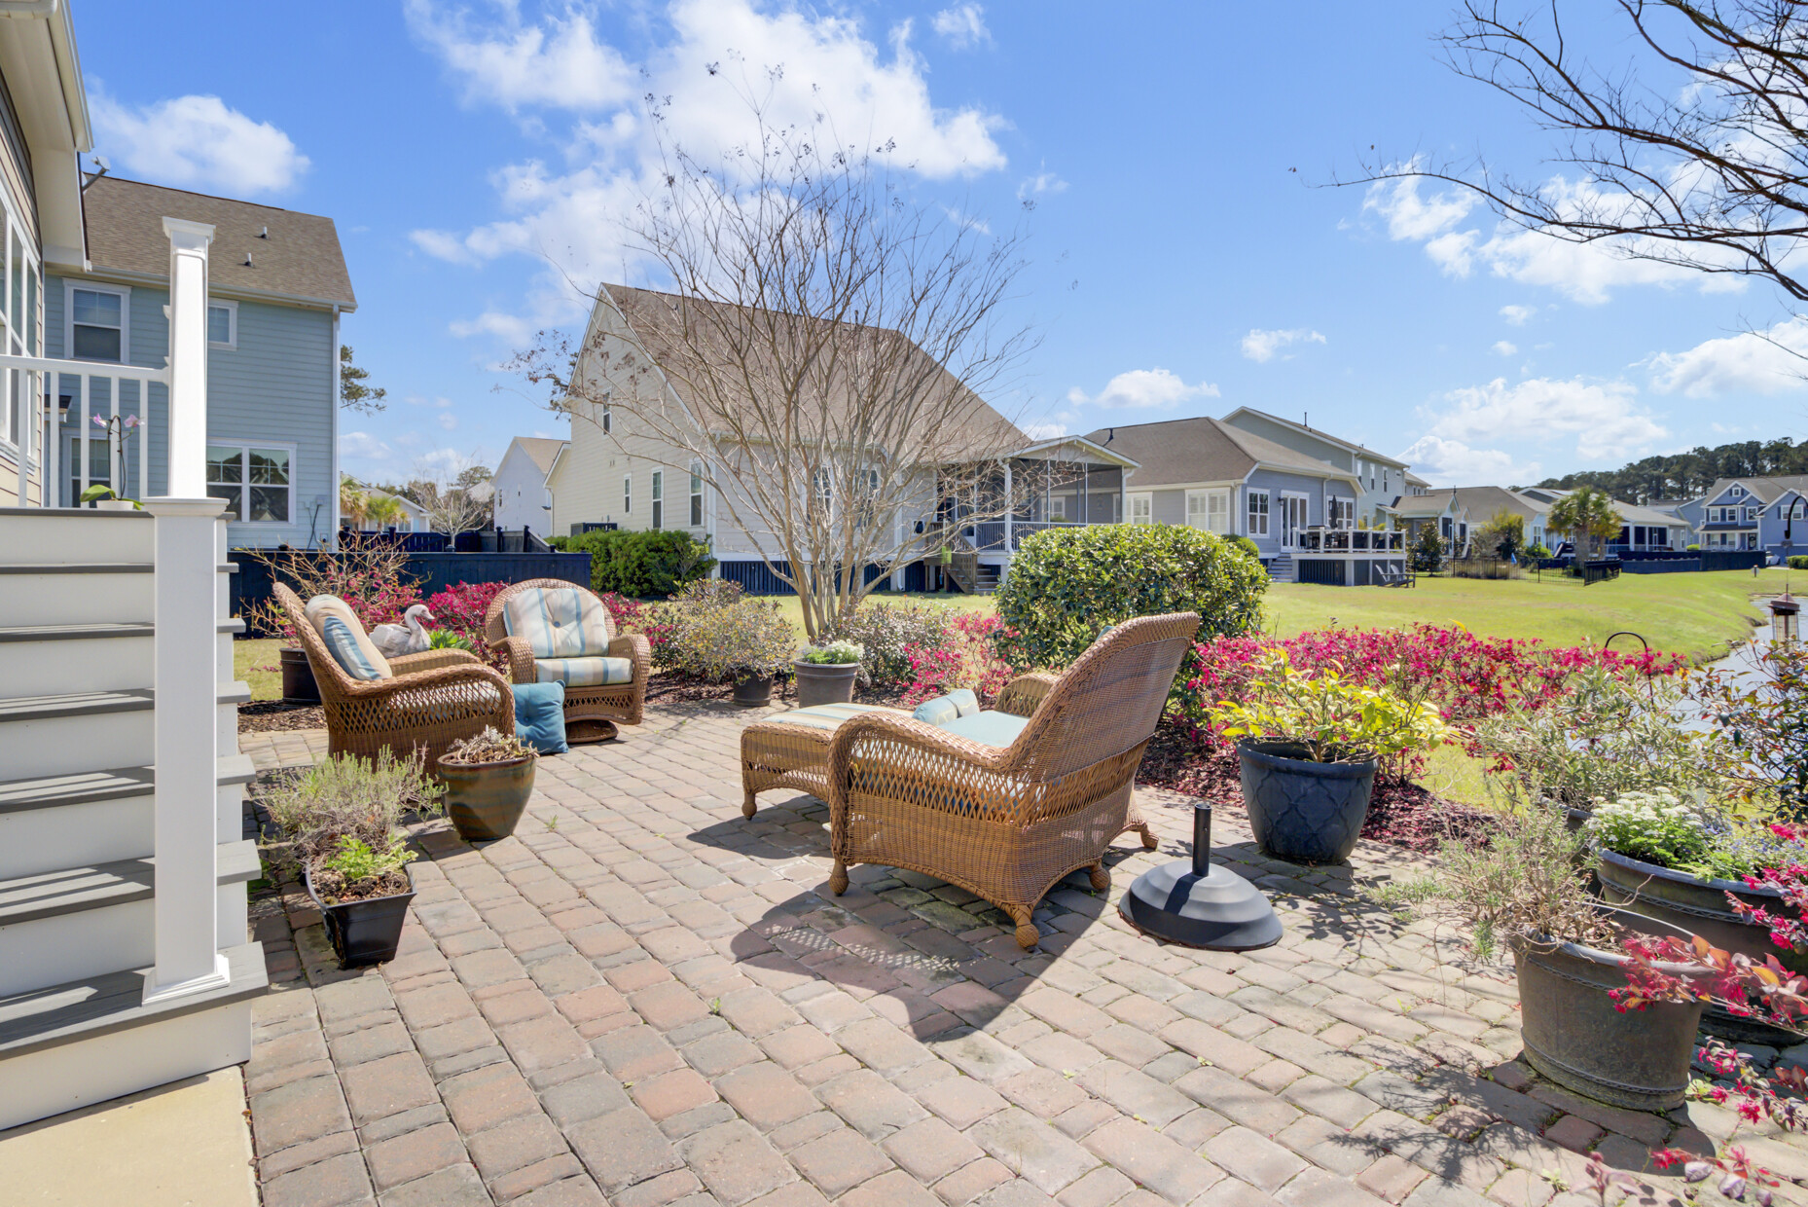



DON’T MISS THIS MT. PLEASANT GEM!
345 Turnstone Street
Tidal Walk | Mount Pleasant, SC 29464 | MLS# 25008534 | $759,000
Video Tour
Storybook
Property Site
ANOTHER PRICE DROP!
Now is the time to make your move on this immaculate one-level home in the sought-after Tidal Walk community! Featuring an open floor plan, chef’s kitchen, pond views, and a sunroom for year-round enjoyment. Gorgeous landscaping and a prime location just minutes to beaches, schools, and Historic Charleston.
📲 Call Ellen O’Neil directly at 843-300-8530 to arrange your private tour or ask questions today!
Video Tour | Property Site | Storybook
Ellen O'Neil
Broker/Owner, ABR, e-PRO, CNE
Charleston Realtor of Distinction
843-300-8530
www.EllenONeilProperties.com

