Slide 1
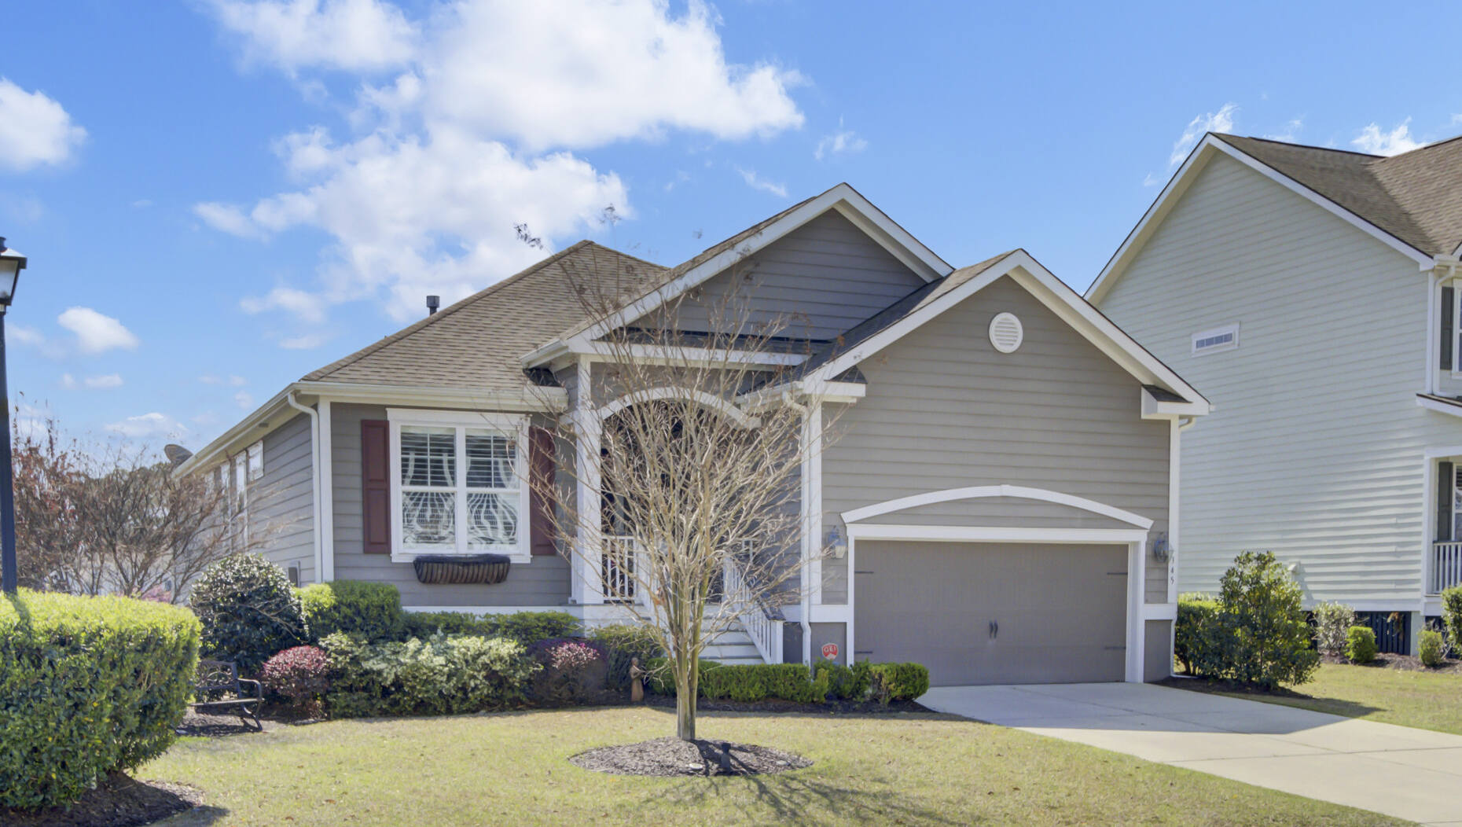









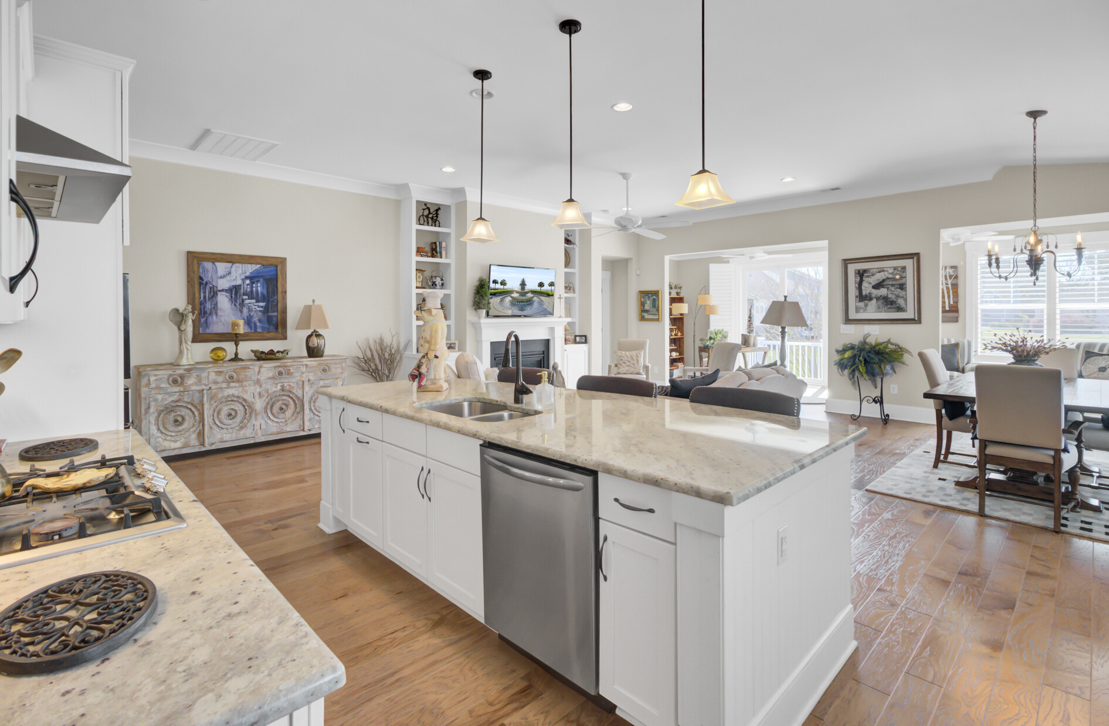

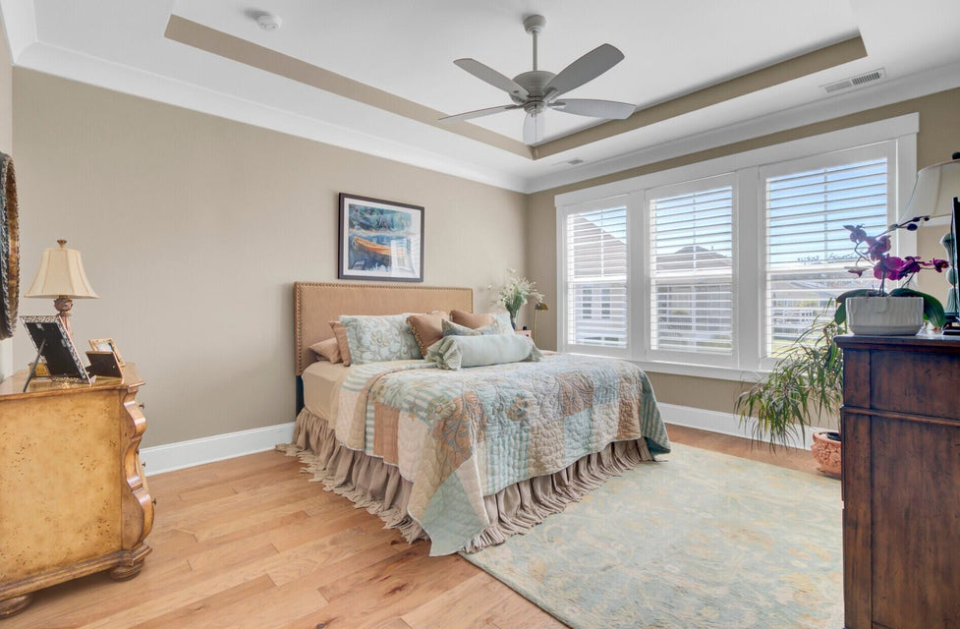
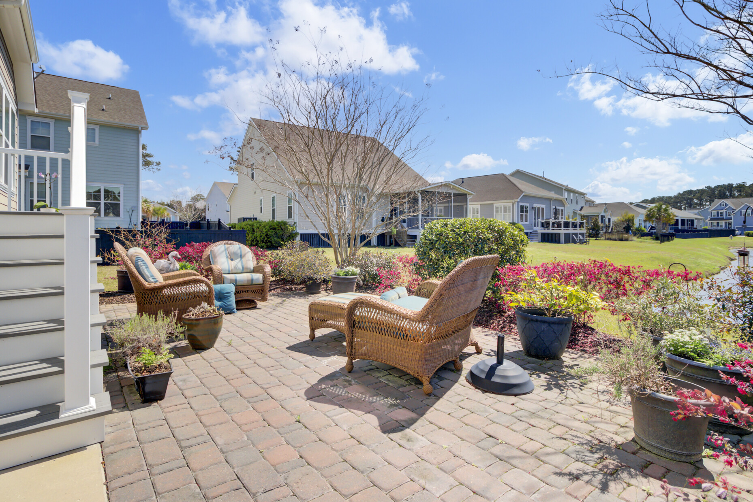





NEW LISTING AND OPEN HOUSE
345 Turnstone Street
Tidal Walk | Mount Pleasant, SC 29464 | MLS# 25026587 | $759,000
Video Tour
Storybook
Property Site
Now is the time to make your move! This meticulously maintained one-owner home offers one-level living at its finest with an open concept design, a stunning chef’s kitchen, cozy fireplace, sunroom with pond views, and a luxurious owner’s suite. Step outside to enjoy the beautifully landscaped yard, paver patio, and serene water views.
Ideally located near schools, shopping, dining, and just minutes from Charleston’s beaches and downtown, this home combines comfort, style, and convenience.
345 Turnstone St, Mount Pleasant, SC 29464 Open House: Saturday , October 04 | 11 AM – 1 PM
Don’t miss this opportunity—schedule your private tour today or join us at the Open House!
Call Ellen O’Neil directly at 843-300-8530 to arrange your showing.
Video Tour | Property Site | Storybook
Ellen O'Neil
Broker/Owner, ABR, e-PRO, CNE
Charleston Realtor of Distinction
843-300-8530
www.EllenONeilProperties.com

