Slide 1

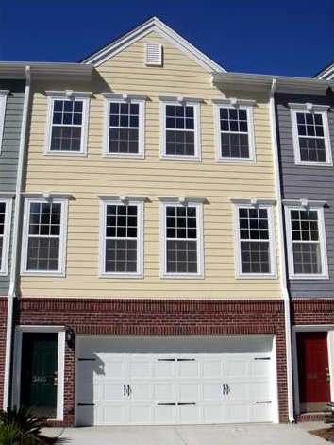
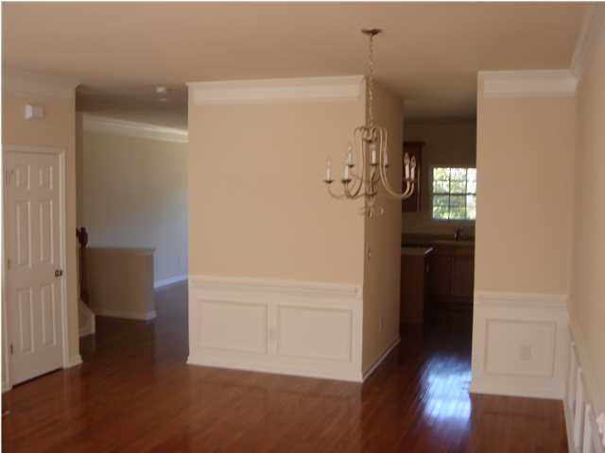
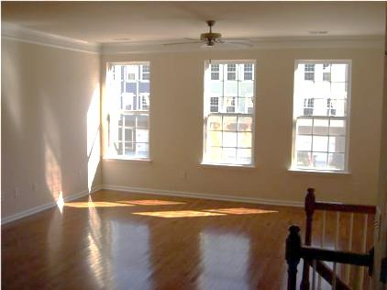
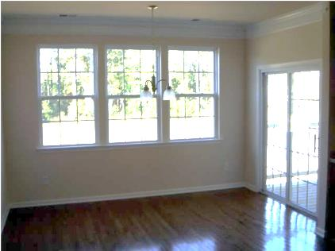
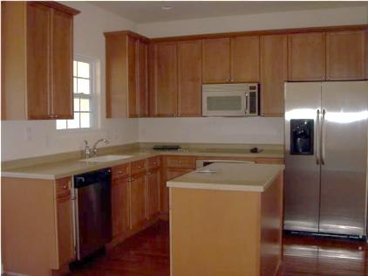

GREAT INVESTMENT OPPORTUNITY!!!
3460 Claremont St
Park West
MLS# 1414218
$244,500
· 3 Bed · 2½ Bath · 2,500sf ·
Well maintained multi-story townhome in desirable Park West subdivision. Living/dining room combo on the main level with gleaming wood floors. Eat-in kitchen with stainless appliances, maple cabinets, and Corian countertops. Breakfast room has access to an outside balcony. Upstairs are the 3 bedrooms. The master has dual vanities, garden tub, separate shower, walk-in closet, and access to another outside balcony. On the bottom level is a HUGE bonus room. This would make a perfect 2nd family room, exercise room, play room, or 4th bedroom. This room does access the back patio and the oversized 2 car garage. Short Sale approved with long term tenant.
Steve Radekopf
843-514-0761 cell
Steve@Radekopf.com
Andrew Tackitt
843-437-8726 cell
Andrew@Radekopf.com
1205 Two Island Court, Suite 201 | Mt Pleasant, SC 29466 | Phone: (843) 579.2217 | Fax: (843) 971-0281

