Slide 1
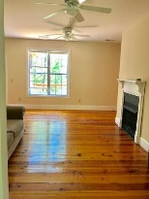
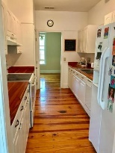
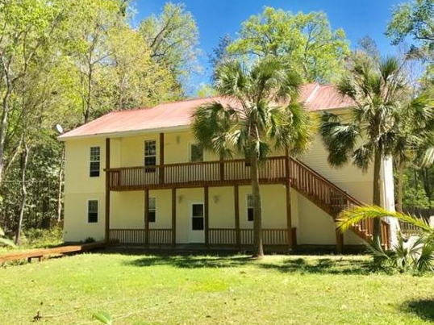
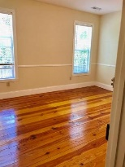
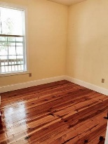
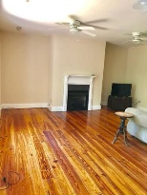
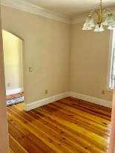
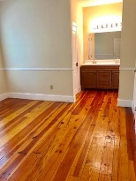
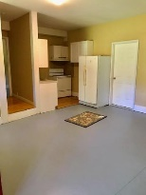
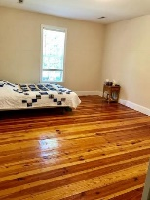
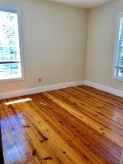
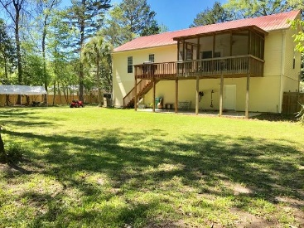
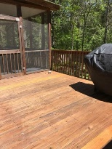



3465 Walter Drive
Johns Island | MLS# 17009942 | $325,000
Price Reduced in Cedar Springs
You must see this home to appreciate all the possibilities!
Approximately 1940 sq.ft. on main living floor plus an additional 700 sq. ft. mother-in-law suite in garage-ALL above flood plain. Beautiful heart pine wood floors throughout entire main floor-no carpet or tile! Upgraded 8'' baseboard throughout main floor. Galley kitchen wall can possibly be opened to living area for open concept. Brand new master dual vanity. New interior paint throughout main floor. New exterior paint. All decks and railings have just been stained. Large screened porch to enjoy the HUGE back yard. DOUBLE LOT with partial privacy fence in back yard. 3 car tandem garage and a wall in downstairs suite can be removed for additional garage space. Mother-in-law suite includes 2 bedrooms, office, 1 bath, kitchen and living room and freshly painted concrete. NO HOA!!
Stephanie Deaton
(843) 743-4219
sdeaton@palmettost.com
www.palmettost.com

