Slide 1
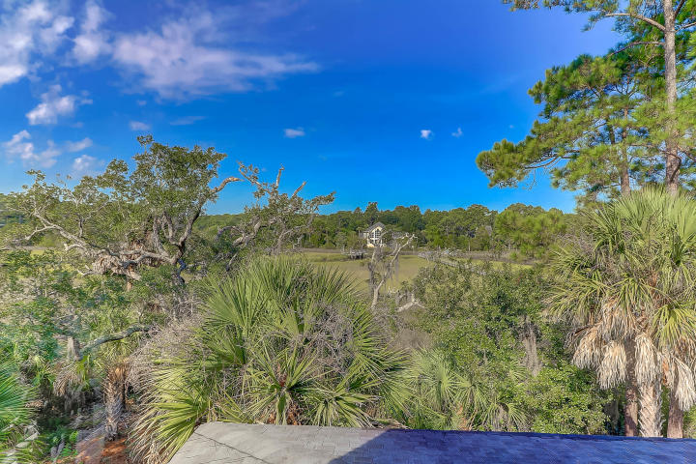
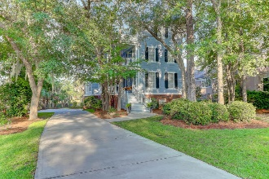
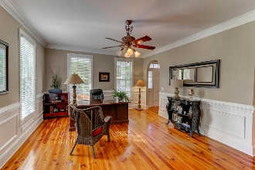
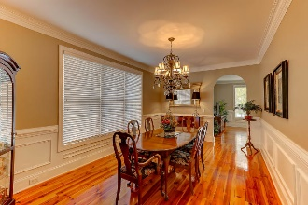
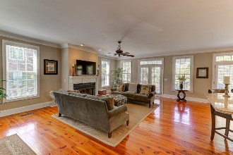
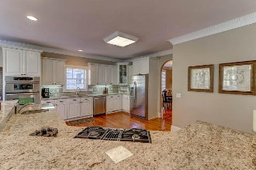
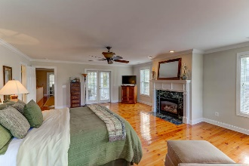
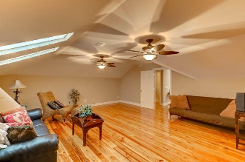
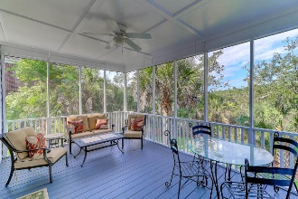
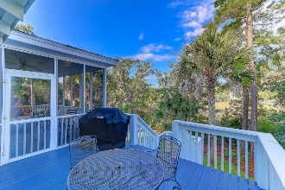
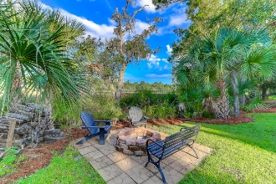

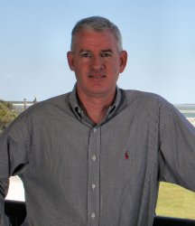
3468 Henrietta Hartford Road Mount Pleasant, SC 29466 :: MLS# 17023320 :: $795,000
Just Reduced - Tennyson - Park West
Incredible marsh front Charleston single home hidden away by mature trees in the Tennyson section of Park West. This three story home has it all. Large Family Room with fireplace that is open to kitchen with an over-sized island/counter area that makes entertaining a breeze. The kitchen is equipped with top of the line stainless appliances including gas cook top, double oven/convection microwave and gorgeous granite counters. Slip through the pass way to the formal dining room complete with wainscoting and dental moldings. The front of the house is a spacious living area that is being currently used as office. The entire main level has beautiful Heart Pine floors and crown moldings. There is a large screened porch and deck directly off the family room and kitchen area overlooking the peaceful marsh .The master retreat is located on second floor with marsh front views and is large, light and airy. There is plenty of room to cozy up to the fireplace with a good book or escape to the porch for morning coffee. This room also has gorgeous pine floors . The master bath boasts large corner shower and separate soaking tub, double vanities and a huge walk in closet. Down the hall separated from the master retreat are two more spacious bedrooms , a shared hall bath and the laundry room with sink. The third floor makes for a wonderful retreat area, with another bedroom, full bath and media/ playroom area that could be fifth bedroom if needed, there is also large storage area off this room. There is access to large side porch from both first and second floor. A large garage with additional storage below and don't forget to enjoy the lowcountry evenings from the marshfront fire pit. This home is waiting for you, so do not miss out. There is a possibility for a dock ( would need apply for permit ) as well on to the end waters of Toomer Creek that flows out to the Wando River.
Clay Cunningham
O (843) 886-8110
M (843) 345-4647
clay@carolinaone.com
www.claysre.com
Carolina One Real Estate
1503 Palm Blvd Ste
Isle of Palms, SC 29451

