Slide 1
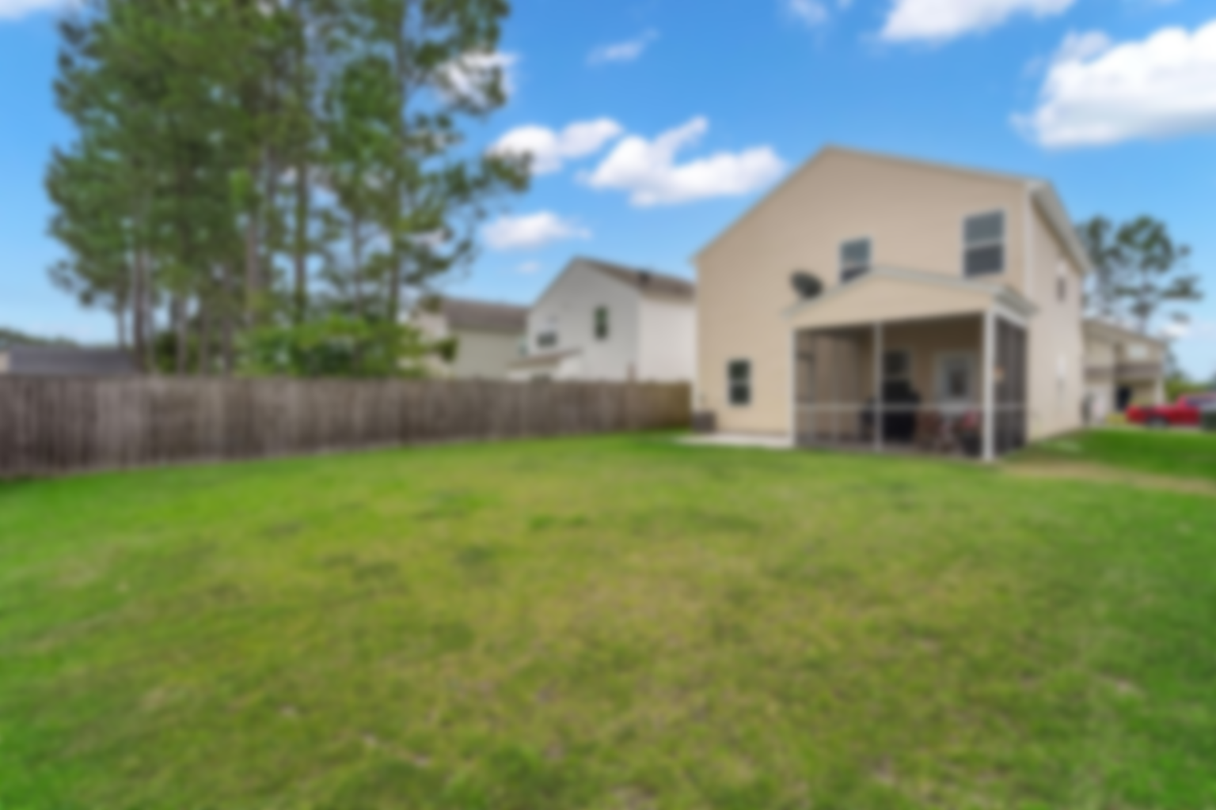
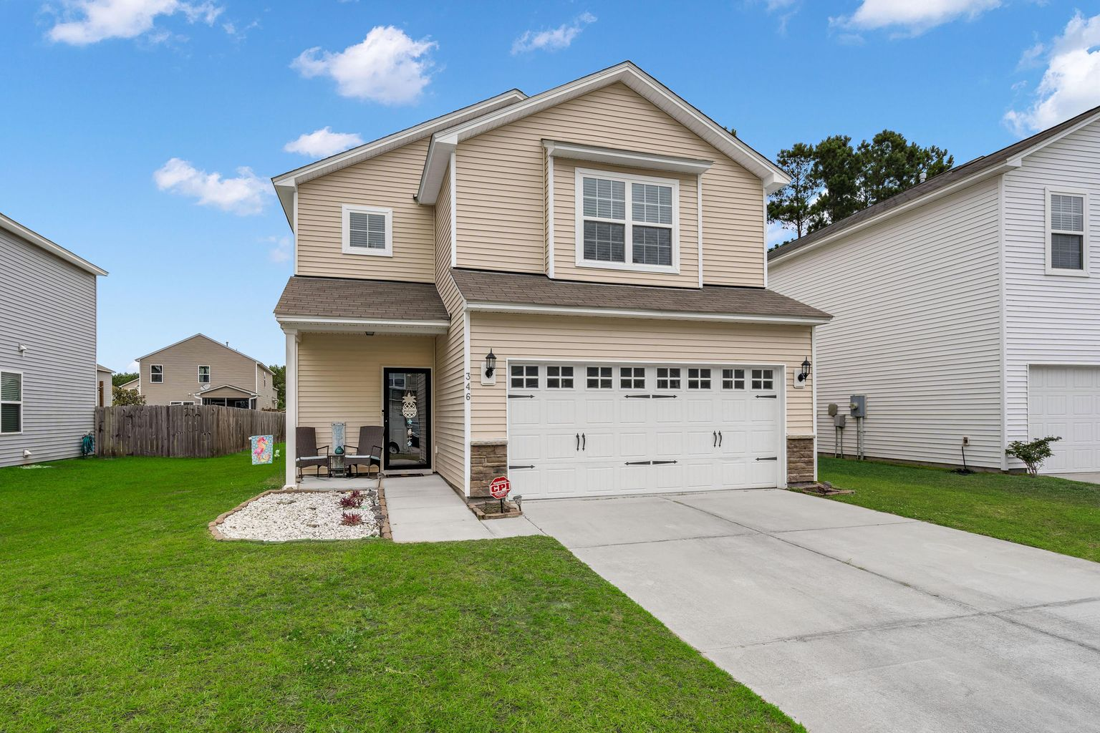
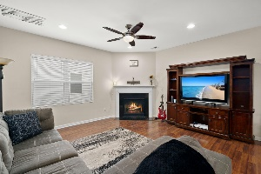
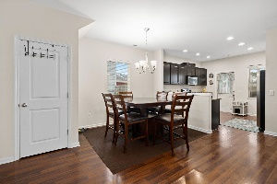
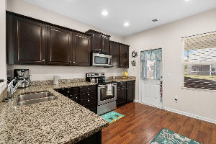
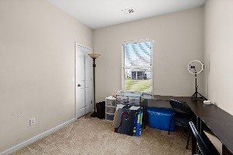
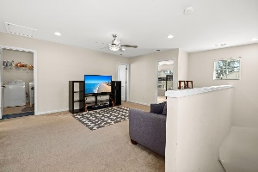
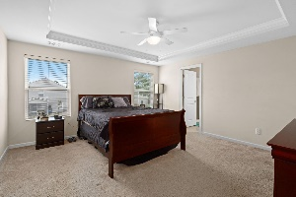
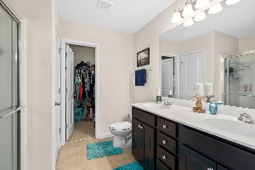
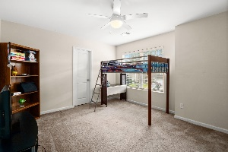
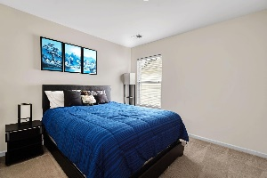


Open House Saturday 10am-1pm
346 Iveson Road
Cane Bay Plantation | Summerville, SC 29486 | MLS# 21015087 | $325,000
Welcome to the desirable Cane Bay's Old Rice Retreat subsection. This house has great open space downstairs along with 9' ceilings and a kitchen that is perfect for entertaining along with a screened in porch to enjoy warm evenings! There is a bonus room on the first floor that can be used as an office, play room, work out studio or could be turned into a 4th bedroom. On the second floor you will find a spacious master with a walk-in closet and bathroom with double vanity and shower! There are 2 more large bedrooms, full bathroom and large flex space that is great for a den! Think of all the memories you can make!
Marthe Teixeira (917) 325-8033
marthet@carolinaone.com
Scott Fulton 843-324-8845
ScottandMarthe@gmail.com
fultonteixeirahomes.com
Carolina One Real Estate | 2713 Highway 17 North | Mt. Pleasant, SC 29466

